Slide 1

Digital Preservation
8/7/2012
Karen Estlund
Head, Digital Library Services
kestlund@uoregon.edu

Slide 2
Threats to Preservation
Legal Issues and Permissions
File Integrity / Bit rot
System Failure
External Attacks (Hacking, Viruses)
Format Obsolescence
Media Obsolescence
Containers (Inseparable Content)
Lack of Context / Information
User Error
Natural Disasters

Slide 3
Key Services of Digital Preservation
Levels of service, agreements, and policies
Commitment to long-term viability
Participation in a community of practice & standards
Persistent identifiers
Data integrity practices
Risk management (e.g. redundancy)
Discoverable metadata
Methods of access

Slide 4
Levels of service / policies
Prioritize by:
  Risk to originals
    More important to preserve materials that are more vulnerable (preserving physical copies; born digital items)
Policies:
  Review
    Content: Are there materials that need to be preserved only for a limited amount of time?
    Container: File formats for obsolescence
  Technology: risk management
  Succession plan

Slide 5
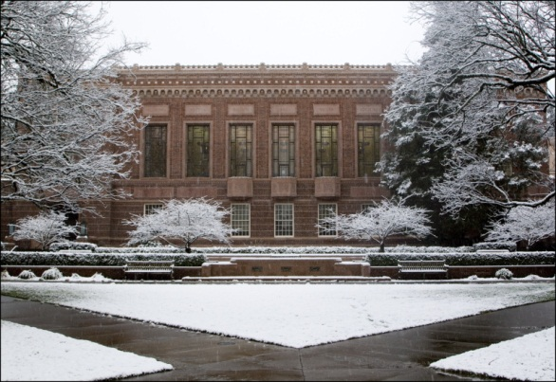
Organizational Commitment

Slide 6
Preservation Format Standards
Media | File Format | Specifications
Video | .mp4 | High profile
Audio (nature, concert, etc.) | .wav
Image | .tif | 300-600 ppi (16 bit grayscale or 24 bit color)
Image Text (printed) | .tif or .pdf | 200-300 ppi
Image Text (handwriting) | .tif | 600 ppi
Maps | .tif | 600 ppi (shorter than 36”); 300-400 ppi (longer than 36”)
Slides | .tif | 3000+ ppi

Slide 7
Persistent Identifiers
Uniform Resource Identifier (URI)
HDL
  http://hdl.handle.net/1794/12242
ARK
  http://nwda-db.orbiscascade.org/findaid/ark:/80444/xv14723
DOI
  doi:10.5061/dryad.60699

Slide 8
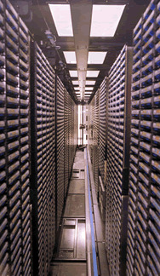
Data Integrity & Risk Management
File integrity checks
Refresh
Back-up
Off-site storage
  Preferably in another geographic region
Mirrored site

Slide 9
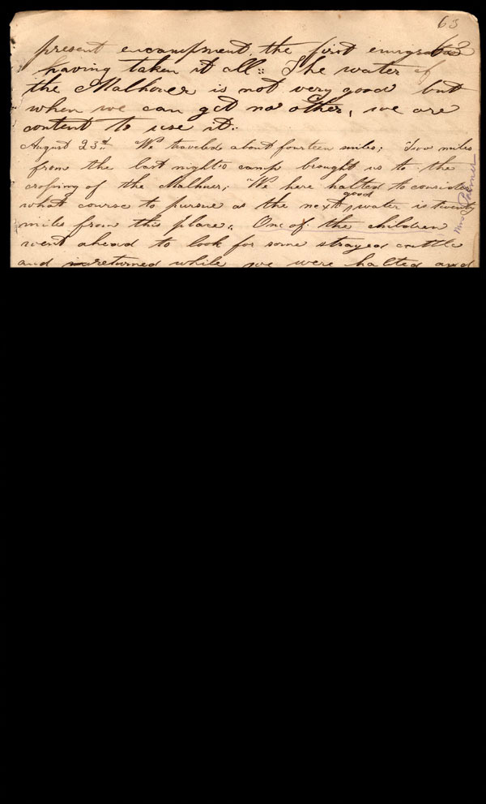
Copying as a means of preservation
Average Server lasts 5 years
Average Optical Media lasts 6-8 years (CD, DVD)
Digital Back-up Tapes (LTO) lasts 30 years in ideal conditions

Slide 10

Preservation copies
Create Digital Object
Transfer to Editing Tool
Export Preservation Format
Additional editing/processing, if necessary
Export Access Format(s)
DO NOT UPSAMPLE!

Slide 11

Metadata & Access
Context is important
  Metadata about the item
  Metadata embedded in the object
  File name
Digital provenance
Create plan for access
  Dark, Mediated, Open?

Slide 12
File Naming conventions
Unique identifier for each file
Start with collection name, location, identifying information
Use application-specific 3-letter file extension and lowercase: tif, jpg
When using sequential numbering, make sure to use leading zeros to allow for multi-digit versions. For example, a sequence of 1-10 should be numbered 01-10; a sequence of 1-100 should be numbered 001-010-100.
No special characters: & , * % # ; * ( ) ! @$ ^ ~ ' { } [ ] ? < > -
Only one period and before the file extension (e.g. coll_r.doc
NOT coll0021.b35.f02.001.tif OR coll001_b0956_f0035_d001_p01..tif)
Try to keep file and folder names under 32 characters
Keep track of versions (version control)
  Use a sequential numbered system: v01, v02
E.g. coll001_b0956_f0035_d001_p01.tif

