Slide 1

DSpace User & Group Permissions
UO NSRC Workshop
March 29, 2013
Karen Estlund
Head, Digital Scholarship Center

Slide 2
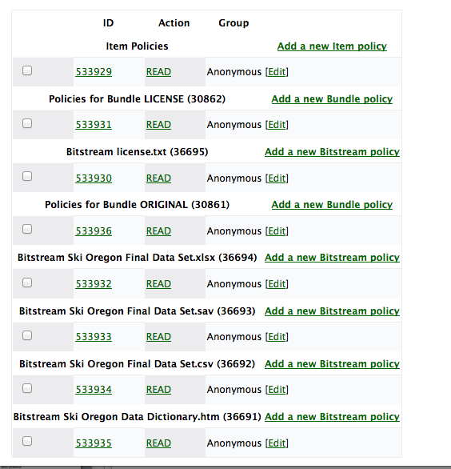
Authorizations
DSpace
Community
Collection
Item
Bundle
Group of Related Files
Bitstream / File
Document / File
Metadata
Copyright License, etc.

Slide 3

Registered Users
S’enregistrer
A registered user has no permissions on the system until a DSpace administrator assigns permissions.
Registered users can sign up for RSS notifications for particular collections

Slide 4
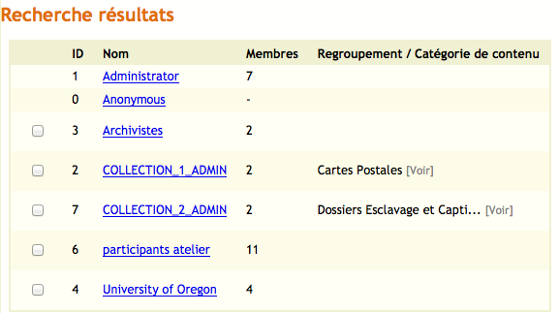
Groups
Use Groups for all of the people (E-personne)

Slide 5
Automatic Groups
Administrators
Can create new communities and collections
Create new users / groups
Assign rights
Run Reports and Curation activities
Anonymous
Anyone on the website that is not logged into Dspace
Do not add people to this group.

Slide 6
Creating Groups
Use Groups to manage people working on your system (organization / role)
UCAD
Archivists
Researchers
Then when assigning rights to a collection or item, assign the Group rather than individuals, best practice

Slide 7
Submission / Editing Authorizations

Slide 8
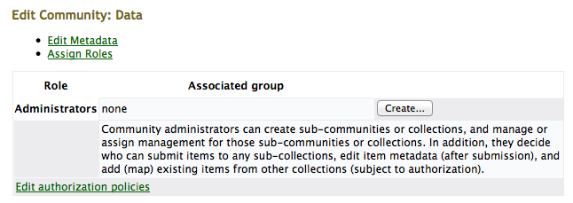
Community Authorizations

Slide 9
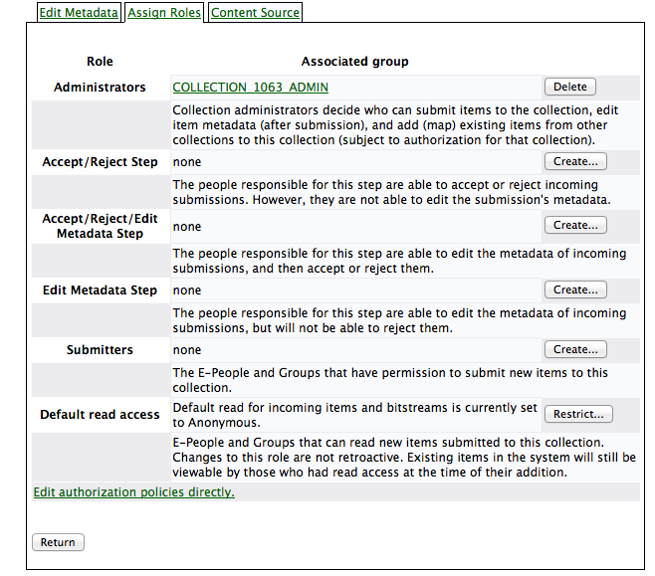
Collection Authorizations

Slide 10
Collection Authorizations Best Practices
Administrators
Add System Administrators as Administrators, or
Make sure someone at institution always has administrative access
Use “Accept/Reject/Edit Metadata Step”
Don’t use “Accept/Reject Step” and “Edit Metadata Step”

Slide 11
Restricting access

Slide 12


Restrict by Collection

Slide 13

Restricting an Individual Item
Add a new policy to restrict an item
Make sure to delete the policy allowing “Anonymous” the ability to READ

