Slide 1

Metadata
8/7/2012
Katie Moss
Digital Metadata Technician, Digital Library Services
kmoss@uoregon.edu

Slide 2
Dublin Core
The 15 Simple Dublin Core Elements
Title
Creator
Subject
Description
Publisher
Contributor
Date
Type
Format
Identifier
Source
Language
Relation
Coverage
Rights

Slide 3
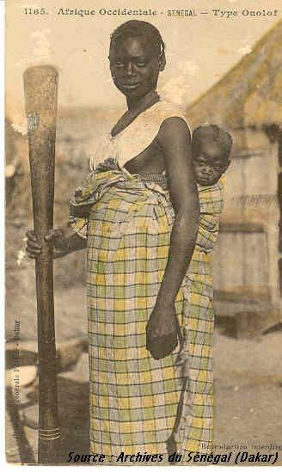
Title
Title: The name given to the item.
Example: Femme Wolof avec son pilon et son enfant sur le dos.

Slide 4
Subject
Subject: keywords that describe the topic
Example:

Slide 5
Description
Description: an explanation of the content
Example:

Slide 6
Type
Type: a category for the content
Example:

Slide 7
Source
Source: where the content originally derived from
Example:

Slide 8
Relation
Relation: how the content relates to other resources for instance, if it is a chapter in a book
Example:

Slide 9
Coverage
Coverage: the spatial or temporal topic of the resource.
Example:

Slide 10
Creator
Creator: the person or organization responsible for the content.
Example:

Slide 11
Publisher
Publisher: those responsible for making the resource available.
Example:

Slide 12
Contributor
Contributor: those who added to the content.
Example:

Slide 13
Rights
Rights: copyrights or a link to a copyright notice
Example:

Slide 14
Date
Date: when the resource was created
Example:

Slide 15
Format
Format: how the resource is presented
Example:

Slide 16
Identifier
Identifier: a unique reference for the resource.
Example:

Slide 17
Language
Language: in what language the content is written
Example:

