Slide 1
perfSONAR Overview
Presented by the perfSONAR Project
http://www.perfsonar.net
August 24th 2015
This document is a result of work by the perfSONAR Project (http://www.perfsonar.net) and is licensed under CC BY-SA 4.0 (https://creativecommons.org/licenses/by-sa/4.0/).

Slide 2
Outline
Problem statement
    Multi-domain, complex environment
    Hard vs. soft failures
The solution: perfSONAR
Primary Benefits of perfSONAR
Resources
Collaborators

Slide 3
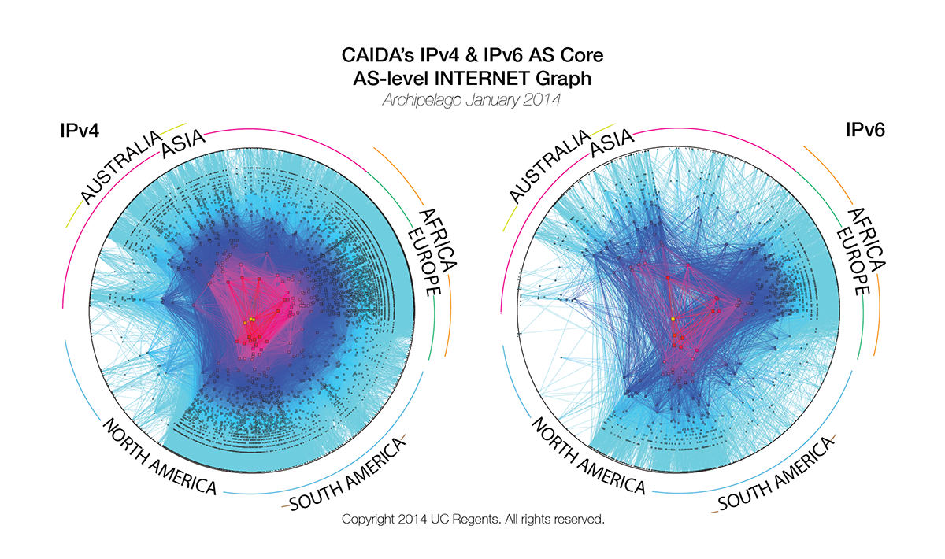
Problem Statement
The global Research & Education network ecosystem is comprised of hundreds of international, national, regional and local-scale networks.
Notes:
Make the point that the complexity of the network is too much for anyone to grasp – and with the complexity we need tools/methods to bite off smaller parts of the problem

Slide 4
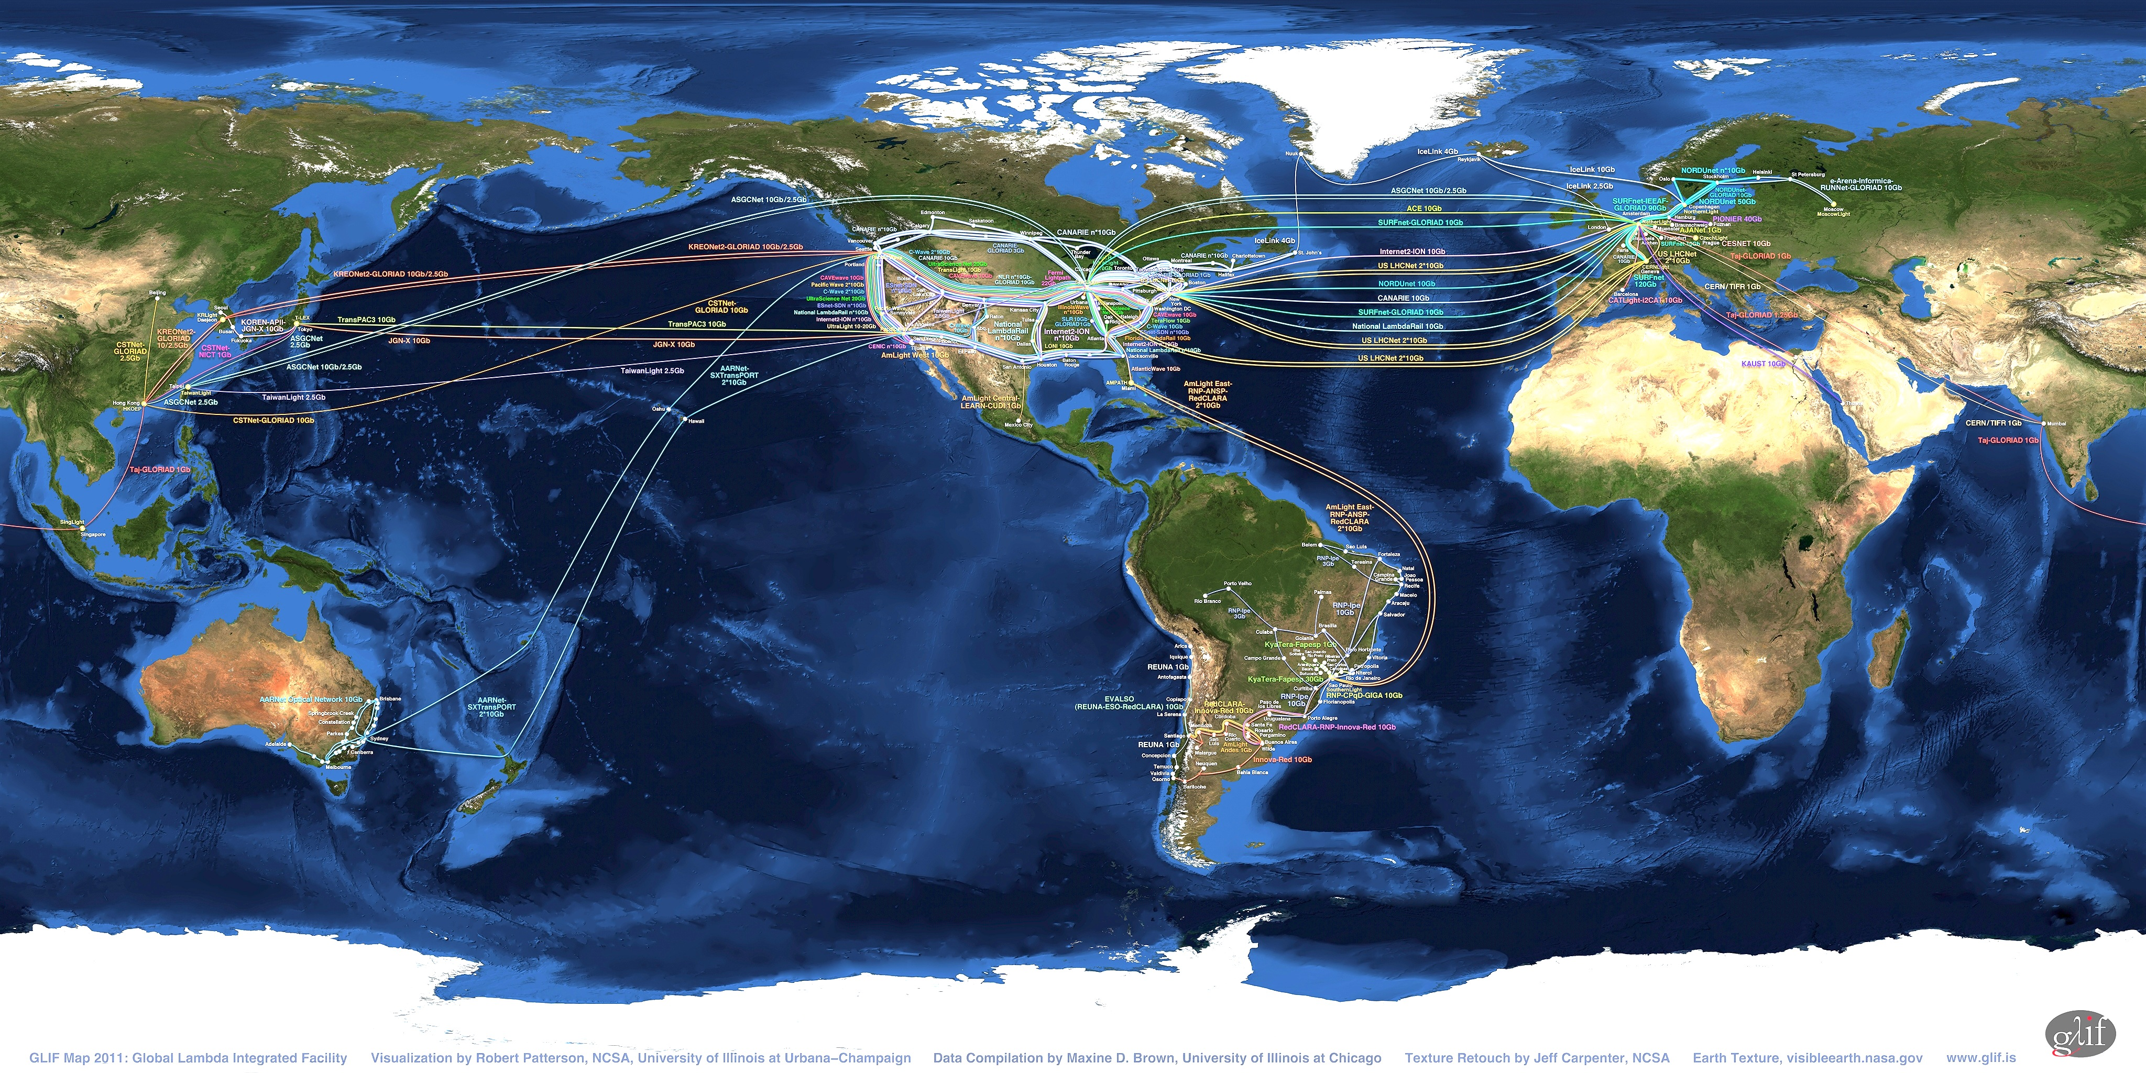
Problem Statement
While these networks all interconnect, each network is owned and operated by separate organizations (called “domains”) with different policies, customers, funding models, hardware, bandwidth and configurations.
Notes:
MAP is courtesy of the GLIF
perfSONAR is designed to be multi-domain, so drive home the fact that all transfers are multi-domain

Slide 5
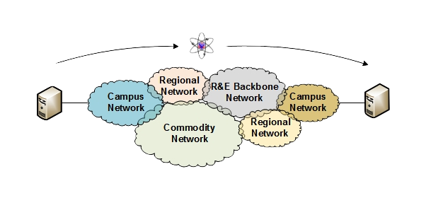
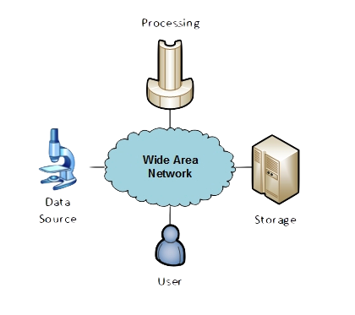
Problem Statement
This complex, heterogeneous set of networks must operate seamlessly from “end to end” to support science and research collaborations that are distributed globally.
Notes:
End to end performance verification is not a typical thing that is tested for – but al science is end to end.

Slide 6
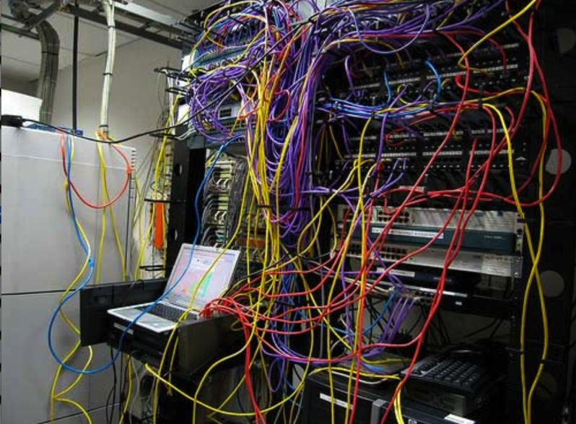
Problem Statement
In practice, performance issues are prevalent and distributed.
When a network is underperforming or errors occur, it is difficult to identify the source, as problems can happen anywhere, in any domain.
Local-area network testing is not sufficient, as errors can occur between networks.
Notes:
If we think about traditional testing – we test SLA agreements (e.g. provider to customer) over a potentially short link (< 10 ms), and this gives less useful information about user experience.

Slide 7
Problem Statement: Hard vs. Soft Failures
“Hard failures” are the kind of problems every organization understands
  Fiber cut
  Power failure takes down routers
  Hardware ceases to function
Classic monitoring systems are good at alerting hard failures
  i.e., NOC sees something turn red on their screen
  Engineers paged by monitoring systems
“Soft failures” are different and often go undetected
  Basic connectivity (ping, traceroute, web pages, email) works
  Performance is just poor
How much should we care about soft failures?
Notes:
This is more of a knock at the way things work now – versus how they should work. We do need hard failure analysis, but its asked/answered. We don’t have the ability to tell when things degrade very well (end to end especially).
We need a history, and we need active tools to compare expected/experienced performance.

Slide 8
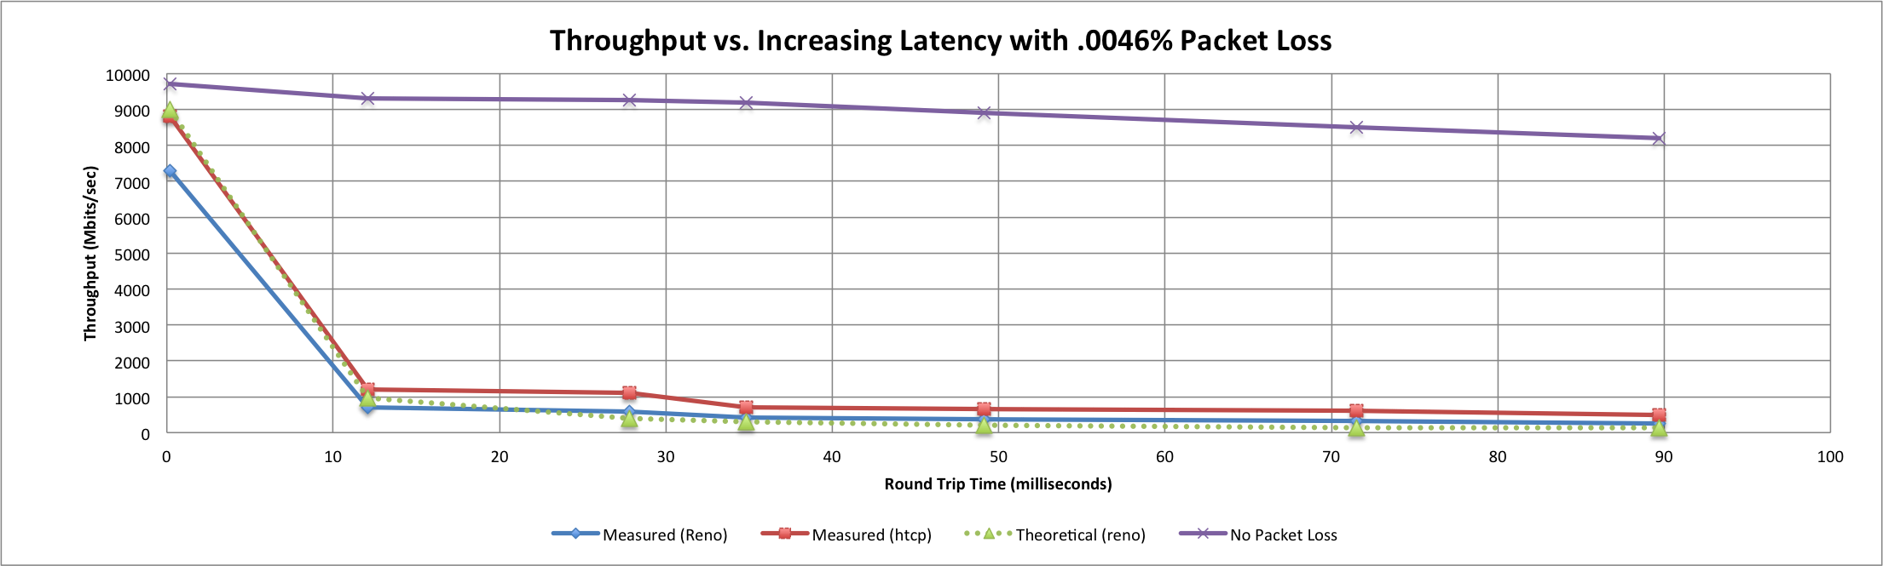
Soft Failures Cause Packet Loss and
Degraded TCP Performance
Local
(LAN)
With loss, high performance beyond metro distances is essentially impossible
International
Metro Area
Regional
Continental
Measured (TCP Reno)
Measured (HTCP)
Theoretical (TCP Reno)
Measured (no loss)
Notes:
TCP works well over short distances (e.g. 1% packet loss on the LAN will produce high throughput).
The further out you get the more pronounced the problems will be as the algorithms cope with retransmissions.

Slide 9
The solution: perfSONAR
A widely-deployed test and measurement infrastructure used by local, regional and national research networks as well as science facilities to actively track and troubleshoot network performance issues.
An open-source, community-developed software suite which:
  Provides a consistent set of proven tools to pinpoint and resolve network performance issues including soft failures across complex, multi-domain data paths.
  Allows you to set network performance expectations with your stakeholders and make informed decisions on future network investments.
  Creates a standard way to visualize, publish, and archive network metrics and data for future analysis, and aids other networks in debugging issues.

Slide 10
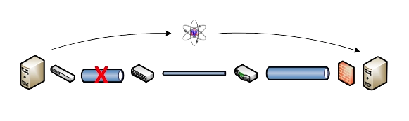
Benefits: Finding the needle in the haystack
Above all, perfSONAR allows you to maintain a healthy, high-performing network because it helps identify the “soft failures” in the network path.
  Classical monitoring systems have limitations
    Performance problems are often only visible at the ends
    Individual network components (e.g. routers) have no knowledge of end host state
  perfSONAR tests the network in ways that classical monitoring systems do not
More perfSONAR distributions equal better network visibility.
Notes:
This works because of the deployment footprint – we need more perfSONAR nodes for it to be useful. The perfSONAR nodes must be located along paths of interest.

Slide 11
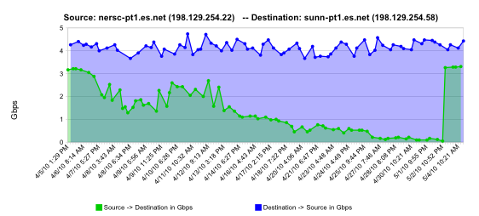
Benefits: Finding the needle in the haystack
perfSONAR is designed to pinpoint and identify soft failures to accelerate resolution.
Example: Find and replace failing optics
normal performance
Gb/s
degrading performance
repair
one month
Notes:
Soft failure example
Failing optic on an ESnet router. If you looked at the data in small windows (e.g. 1-2 days at a time) it may not seem out of the ordinary. E.g. people do use networks, throughput fluctuates.
Problem fixed on hard alarm values.

Slide 12
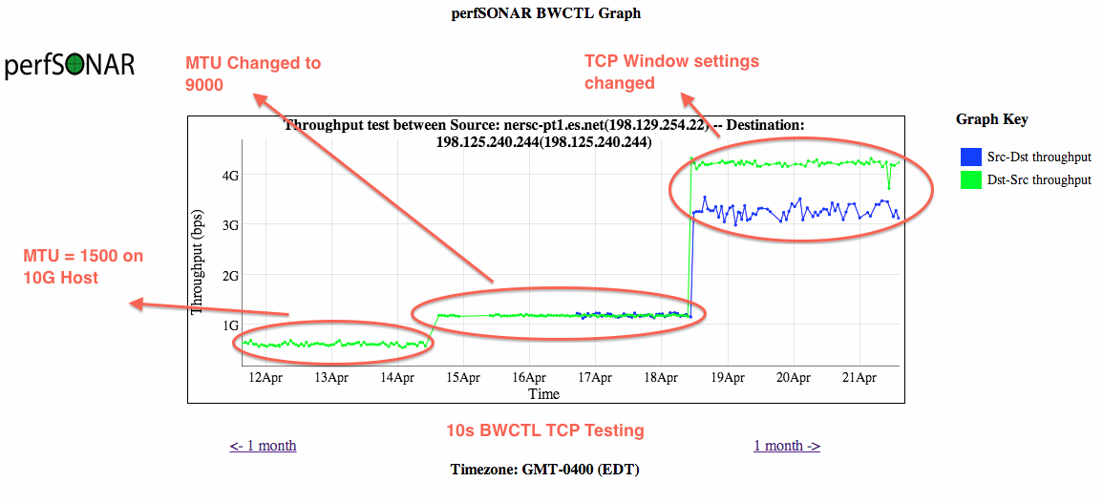
Benefits: Finding the needle in the haystack
perfSONAR is designed to pinpoint and identify soft failures to accelerate resolution.
Example: Host Tuning
Notes:
Host tuning:
1500 MTU with no tuning doesn’t work (this is what most scientists may see – max)
9000 MTU gives you a bump, but not that much. Hosts are faster and have more memory now – 40G hosts still need this modification.
window size adjustments are the biggest win – do this for all data transfer hosts.

Slide 13
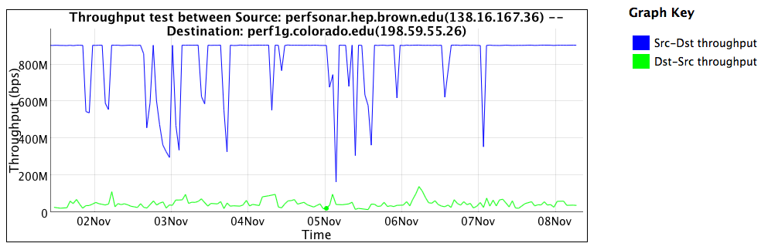
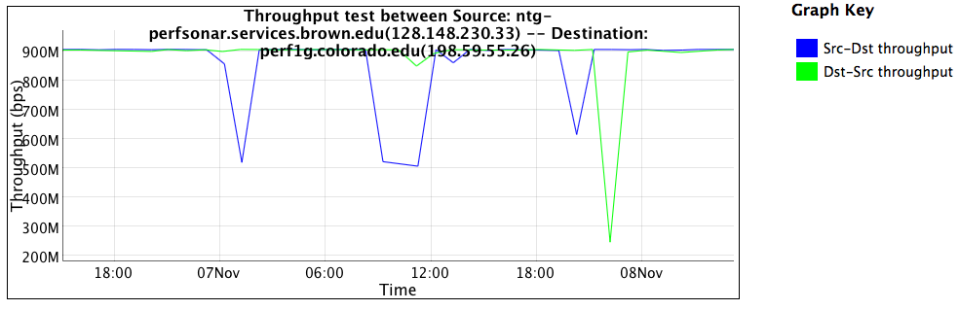
Benefits: Finding the needle in the haystack
Inside the firewall
One direction severely impacted by firewall
Not useful for science data
Outside the firewall
Good performance in both directions
Notes:
Similarly – firewall devices are not designed to support 10G flows. Firewalls are a part of enterprise security, but should not be in a science networking path.
We see low throughput when we traverse a firewall data plane in one direction.

Slide 14
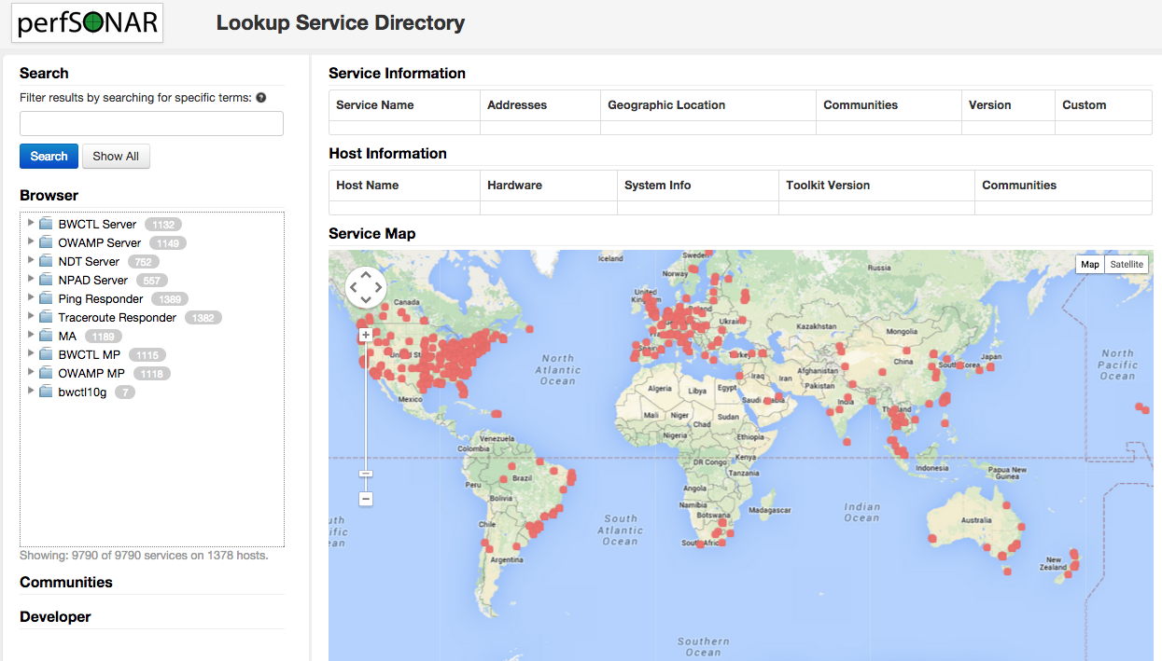
Who is running perfSONAR?
Currently close to 1500 deployments world-wide
http://stats.es.net/ServicesDirectory/
Notes:
Live view of worldwide perfSONAR isntances

Slide 15
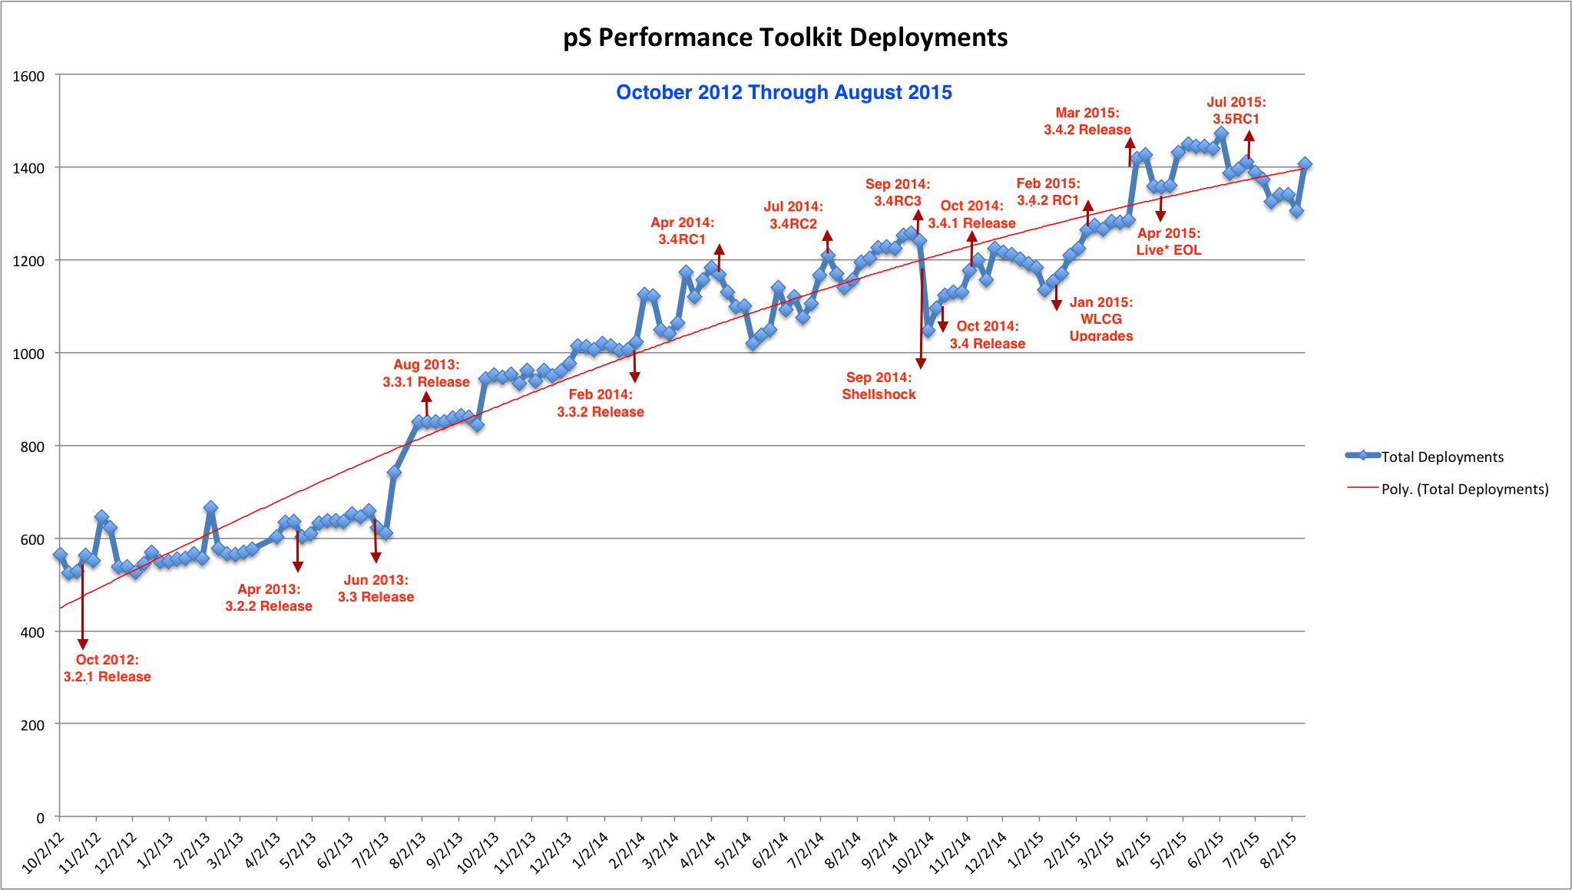
Benefit: Multi-domain insight
perfSONAR has seen a steady increase in deployments with each release.
Notes:
Last updated Feb 2015

Slide 16
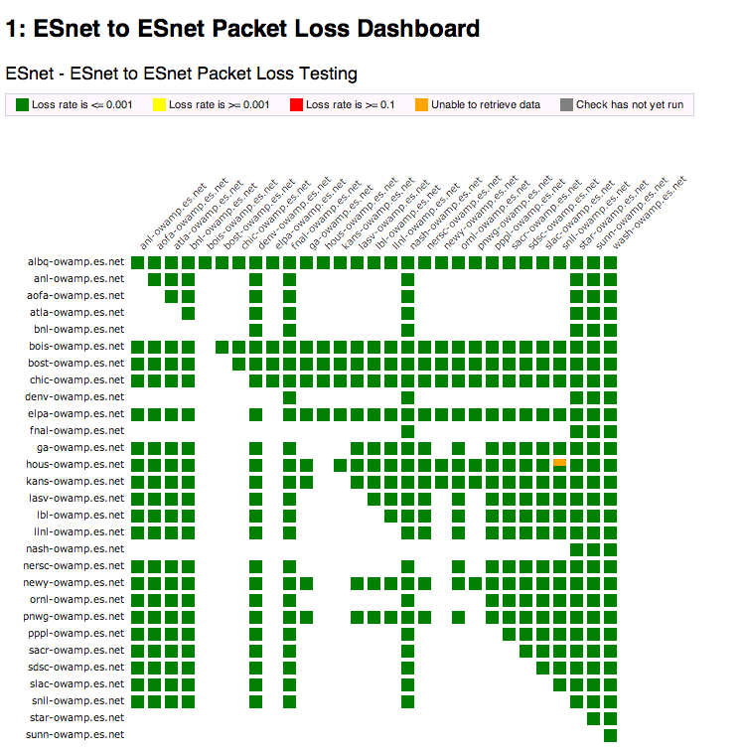
Benefit: Visibility – perfSONAR Dashboard
Status at-a-glance
Packet loss
Throughput
Correctness
Example available to browse: http://ps-dashboard.es.net/
http://pas.net.internet2.edu/
Drill-down capabilities:
Test history between hosts
Ability to correlate with other events
Very valuable for fault localization and isolation
Notes:
Dashboard references – encourage people to view live, and also ask to be added to tests

Slide 17
Benefit: Investment Planning, Verification
Test data and metrics verifies performance of current investments
  Can you get full use out of the carrier circuit you’re paying for?
  If performance suddenly changes, what caused it?
Data informs future investments
  Put resources in places with demonstrated need
  Example: if your firewall is limiting performance, buying more bandwidth won’t solve the problem
Make the case for architectural improvements
  How might a Science DMZ or alternate architecture change performance?
  How to evaluate potential purchases?
    Put perfSONAR hosts on them and run tests
    Prototype new model

Slide 18
Benefit: Improved Responsiveness
Test data allows for expectation management
  Communicate what is possible to stakeholders like users and senior management
Efficient troubleshooting
  If a customer is having problems, is it their machine or the network?
  Focus scarce human cycles on problems quickly
Localize troubleshooting
  Networking is global
  Often the problem isn’t local
  perfSONAR helps determine area of responsibility
  Again, directing human effort quickly and appropriately

Slide 19

Benefit: Active and Growing Community
Active email lists and forums provide:
  Instant access to advice and expertise from the community.
  Ability to share metrics, experience and findings with others to help debug issues on a global scale.
Joining the community automatically increases the reach and power of perfSONAR
  The more endpoints means exponentially more ways to test and discover issues, compare metrics

Slide 20

In Closing…
Long story made short,
  you can’t fix what you can’t find
  you can’t find what you can’t see
  perfSONAR lets you see
perfSONAR is a software tool that is:
  flexible
  provides active and passive network metrics
  inexpensive, low risk to deploy
  open-source
  community-developed, community curated

Slide 21

Resources
perfSONAR website
  http://www.perfsonar.net/
perfSONAR mailing lists
  http://www.perfsonar.net/about/getting-help/
perfSONAR directory of users
  http://stats.es.net/ServicesDirectory/
ESnet FasterData Knowledgebase
  http://fasterdata.es.net

Slide 22
perfSONAR Overview
Presented by the perfSONAR Project
http://www.perfsonar.net
August 24th 2015
This document is a result of work by the perfSONAR Project (http://www.perfsonar.net) and is licensed under CC BY-SA 4.0 (https://creativecommons.org/licenses/by-sa/4.0/).

