Slide 1
Deployment & Advanced Regular Testing Strategies
KENET Workshop
NSRC/IU
September 2015
This document is a result of work by the perfSONAR Project (http://www.perfsonar.net) and is licensed under CC BY-SA 4.0 (https://creativecommons.org/licenses/by-sa/4.0/).

Slide 2
Importance of Regular Testing
We can’t wait for users to report problems and then fix them (soft failures can go unreported for years!)
Things just break sometimes
Failing optics
Somebody messed around in a patch panel and kinked a fiber
Hardware goes bad
Problems that get fixed have a way of coming back
System defaults come back after hardware/software upgrades
New employees may not know why the previous employee set things up a certain way and back out fixes
Important to continually collect, archive, and alert on active throughput test results
Notes:
Soft failures are everywhere – and they may hide other soft failures

Slide 3

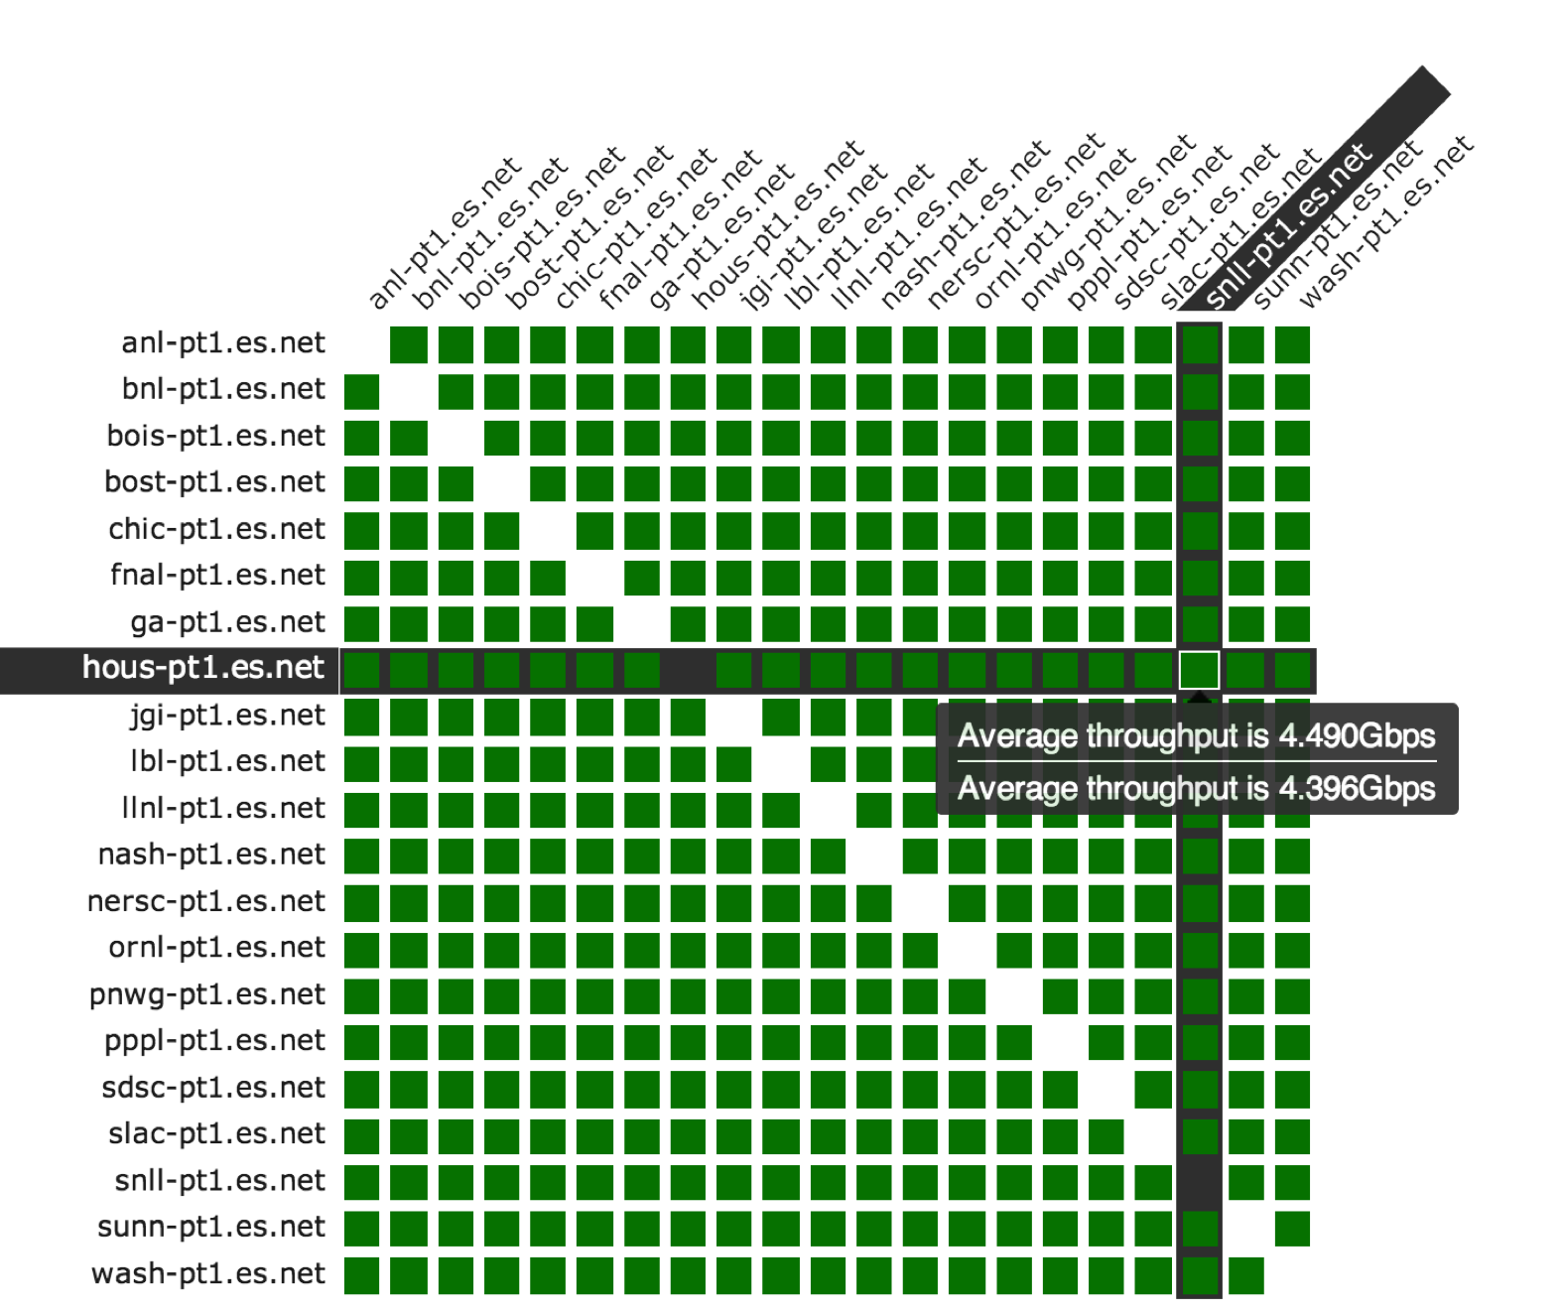
A perfSONAR Dashboard: http://ps-dashboard.es.net

Slide 4
Regular perfSONAR Tests
We run regular tests to check for three things
TCP throughput
One way packet loss and delay
traceroute
perfSONAR has mechanisms for managing regular testing between perfSONAR hosts
Statistics collection and archiving
Graphs
Dashboard display
Integration with NAGIOS
This infrastructure is deployed now – perfSONAR hosts at facilities can take advantage of it
At-a-glance health check for data infrastructure

Slide 5
Develop a Test Plan
What are you going to measure?
Achievable bandwidth
2-3 regional destinations
4-8 important collaborators
4-8 times per day to each destination
20 second tests within a region, longer across oceans and continents
Loss/Availability/Latency
OWAMP: ~10-20 collaborators over diverse paths
Interface Utilization & Errors (via SNMP)
What are you going to do with the results?
NAGIOS Alerts
Reports to user community
Dashboard
Notes:
On bandwidth – make note that localized (e.g. in the LAN or metro) bandwidth tests don’t give you much and may case loss themselves. Test bandwidth to things further out to get the most out of the measurement.
Packet loss should be done everywhere (especially LAN/MAN distances)

Slide 6
perfSONAR Deployment Locations
Critical to deploy near key resources such as DTNs
More perfSONAR hosts allow segments of the path to be tested separately
Reduced visibility for devices between perfSONAR hosts
Must rely on counters or other means where perfSONAR can’t go
Effective test methodology derived from protocol behavior
TCP suffers much more from packet loss as latency increases
TCP is more likely to cause loss as latency increases
Testing should leverage this in two ways
Design tests so that they are likely to fail if there is a problem
Mimic the behavior of production traffic as much as possible
Note: don’t design your tests to succeed
The point is not to “be green” even if there are problems
The point is to find problems when they come up so that the problems are fixed quickly
Notes:
A lot of people want to prove that they are not the problem, and design their tests to succeed. This is not helpful.

Slide 7
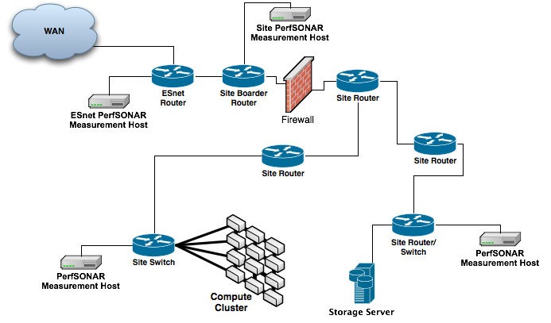
Sample Site Deployment
Notes:
Place nodes where the people are located

Slide 8
Maddash Installation & Use

Slide 9
Maddash & The Mesh Config
Measurement results are more useful when they can be “seen”, because this implies they will be acted on.
Maddash is a software package that can be used to visualize the results of many perfSONAR tests
The Mesh Config is a way to manage multiple nodes, by giving them a uniform testing schedule
E.g. this is in contrast to the other method of configuration
the “Island” model
Changes node from ‘testing as an island’ to being a part of a larger testing strategy
More at: http://docs.perfsonar.net/manage_choose.html

Slide 10
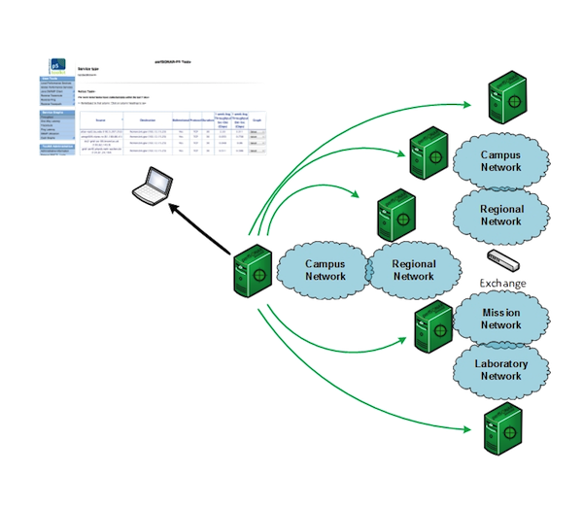
Performance Island
Notes:
Using traditional regular testing setup

Slide 11
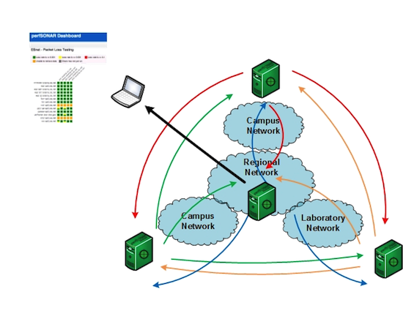
Performance Coordination
Notes:
Requires some close collaboration to make a common file

Slide 12
Maddash
Will go over a couple of things, more/alternative information available here: http://software.es.net/maddash/
Things I will go over:
The basics of what the mesh configuration looks like, and the tools used to create it
How to installing maddash server components
Installing an ‘agent’ on a node, so that it can participate in testing
Examples assume a closed testbed example, but can be used as a template for your own setup.

Slide 13
Mesh Configuration
Two main types of Meshes you can aim to configure:
Disjoint: one host (or a set of hosts) testing against other nodes that are ‘beacons’ (e.g. they are not consuming the same specification. Perfect for loose coordination activities
Full: each host consumes the same measurement specification and you can get a full n:n set of tests. Requires strong coordination efforts.

Slide 14
Disjoint Mesh Configuration
File has 5 main stanzas:
Administrative Info (name, who is the admin)
Node definitions (who is being tested against, or who is making tests)
Test specifications (type of test to run + parameters)
Group definitions (defining which hosts are involved in a test set)
Test definition – this is the glue between a specific test and a specific group
Will go over the last 4 (the first is self explanatory)
Detailed documentation on this is available here:
http://docs.perfsonar.net/multi_server_config.html

Slide 15
Host Definition (3.4 Specific)
<organization>
description Acme Examples, Inc
<site>
<host>
description Acme East
address east-bwctl.acme.local
address east-owamp.acme.local
<measurement_archive>
type perfsonarbuoy/bwctl
read_url http://localhost/esmond/perfsonar/archive
write_url http://localhost/esmond/perfsonar/archive
</measurement_archive>
<measurement_archive>
type perfsonarbuoy/owamp
read_url http://localhost/esmond/perfsonar/archive
write_url http://localhost/esmond/perfsonar/archive
</measurement_archive>
<measurement_archive>
type traceroute
read_url http://localhost/esmond/perfsonar/archive
write_url http://localhost/esmond/perfsonar/archive
</measurement_archive>
</host>
<site>
</organization>

Slide 16
Host Definition
Organization:
Reserved for broad category (e.g. ESnet is an org that has multiple sites, and multiple hosts per site)
Site:
Slightly more focused (e.g. ‘Denver’ may have 4 hosts)
Host:
Specific host running a measurement tool (or more than 1)

Slide 17
Test Specification
<test_spec bwctl_test_iperf_30min>
type perfsonarbuoy/
tool bwctl/iperf3 # Use 'iperf3’
protocol tcp # Run a TCP test
interval 1800 # run every 30 min
duration 20 # Perform a 20sec test
force_bidirectional 1 # do bidirectional test
random_start_percentage 10 # randomize start time
omit_interval 5 # ignore first 5 sec
</test_spec>

Slide 18
Test Specification
BWCTL/OWAMP/Traceroute specification
Tells how often, how long, any other special parameters
Its common to have many of these – allows you to run more specific tests for different groups of hosts
See: http://docs.perfsonar.net/multi_server_config.html

Slide 19
Group Definition
<group oin_bwctl_disjoint>
type disjoint
b_member 172.31.1.21
a_member 172.31.2.21
a_member 172.31.3.21
…
a_member 172.31.40.21
</group>

Slide 20
Group Definition
Groups a set of hosts into a logical unit.
Does not tie them to a test set (yet)
In the disjoint mesh, you have a_members (hosts that are not running the mesh – e.g. beacons) and b_members (hosts that are running the mesh configuration)
Common to have many groups for different purposes.

Slide 21
Test Definition
<test>
description OIN Disjoint Packet Loss Testing
group oin_owamp_disjoint
test_spec owamp_test
</test>
<test>
description OIN Disjoint Throughput Testing
group oin_bwctl_disjoint
test_spec bwctl_halfhour_tcp_test
</test>

Slide 22
Full Mesh Configuration
Same basic layout
Things the same:
Hosts
Test specifications are the same
Test definitions are the same

Slide 23
Full Mesh Configuration
Things different:
Groups (different type, different member defn):
<group oin_bwctl_disjoint>
type mesh
member 172.31.1.21
member 172.31.2.21
member 172.31.3.21
…
member 172.31.40.21
</group>

Slide 24
Configuration Conversion
The formats we have seen before are more for humans to better enter in info
The software uses a different format (JSON) to either make the tests, or to display info in the server UI.
Next couple of slides detail how we can convert to JSON, and then publish the files

Slide 25
Configuration Conversion
Install the JSON builder software:
sudo yum install perl-perfSONAR_PS-MeshConfig-JSONBuilder
We get a piece of software to make the conversion, we just need to point it to the conf file:
/opt/perfsonar_ps/mesh_config/bin/build_json FILE.conf > FILE.json
There may be errors, if so correct them in the conf file
If you are doing this on your own – it helps to publish the JSON in a public location.
Version for testing against URLs:
/opt/perfsonar_ps/mesh_config/bin/validate_json --config_url=https://HOST/FILE.json

Slide 26
Maddash Server Installation (http://software.es.net/maddash/install.html)
Start with installing the software (this command will pull down about 20 packages):
sudo yum install maddash perl-perfSONAR_PS-MeshConfig-GUIAgent
make a backup of this file:
/etc/maddash/maddash-server/maddash.yaml
After that, replace the content with this:
# Set the directory where the database will be stored
database: /var/lib/maddash/
##
# Set the host where the REST server listens
serverHost: "localhost”
##
# Activate http and set the port where it listens
http:
port: 8881

Slide 27
Maddash Server Installation
We need to tell the maddash instance about the JSON file we created, edit this file:
/opt/perfsonar_ps/mesh_config/etc/gui_agent_configuration.conf
Add the following:
<mesh>
configuration_url http://maddash-uon.kenet.or.ke/kenet-mesh.json
</mesh>

Slide 28
Maddash Server Installation
Run the following script:
/opt/perfsonar_ps/mesh_config/bin/generate_gui_configuration
And restart the server:
sudo /etc/init.d/maddash-server restart

Slide 29
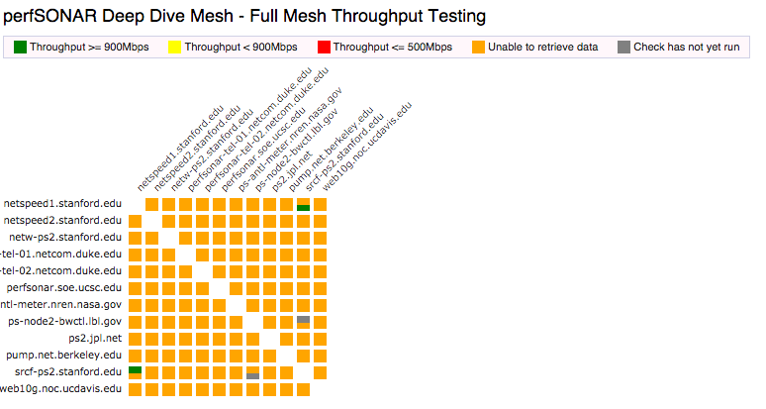
Maddash Server Installation

Slide 30
Configuring Measurement Agents
The final step is getting the agents running, that should be running an agent with the mesh config
Install the following package:
sudo yum install perl-perfSONAR_PS-MeshConfig-Agent
Make an edit to this file:
/opt/perfsonar_ps/mesh_config/etc/agent_configuration.conf

Slide 31
Configuring Measurement Agents
Add this to the end (or edit an existing mesh stanza):
<mesh>
configuration_url http://maddash-uon.kenet.or.ke/kenet-mesh.json
validate_certificate 0
</mesh>
sudo –u perfsonar /opt/perfsonar_ps/mesh_config/bin/generate_configuration
A reboot is recommended to get things running
There is a cron entry that will suck down the JSON file once a day (in the event that someone makes a change)

Slide 32
The Final Result
Over the course of the day, if you configured your agent properly, data will show up in this dashboard
Note that the checks take time to run – its not instant.

Slide 33
The Final Result
If you set up at your home institution:
Decide what hosts will be in it, and decide if you want to do mainly disjoint or mesh testing
Get the dashboard up first, along with the full mesh config
Get the remote sites to configure the mesh, and start to review the colors of the dashboard
Could take weeks to get ‘right’
Example:
http://ps-dashboard.es.net
http://dps11.ucsc.edu/maddash-webui/

Slide 34
Deployment & Advanced Regular Testing Strategies
KENET Workshop
NSRC/IU
September 2015
This document is a result of work by the perfSONAR Project (http://www.perfsonar.net) and is licensed under CC BY-SA 4.0 (https://creativecommons.org/licenses/by-sa/4.0/).

