Slide 1
perfSONAR Toolkit 3.5: What’s Coming Next?

Slide 2
Main themes
Support for central host management and node auto-configuration
Support for low cost nodes
Support for Debian, VMs, and other installation options
Modernize the GUIs
Timeline:
rc1 in July
final release in September

Slide 3
Expanded perfSONAR Use Cases
Current Use Case
perfSONAR Toolkit
Includes CentOS 6 and all perfSONAR components
New Use Cases
perfSONAR tools only
Support for both RHEL-based and Debian-based hosts
perfSONAR hosts that are centrally managed
perfSONAR hosts that ‘self-configure’
NDT only host

Slide 4
Current perfSONAR components
Measurement tools
iperf3, bwctl, owamp, traceroute, etc.
Measurement archive
Central test mesh management tools
Host management tools
Configure tests, configure NTP, etc.
Data analysis tools
Plot data from the archive
Dashboard tools
Lookup Service

Slide 5
Improved Support for Central Management
Goals:
Make it easy to incorporate perfSONAR hosts into existing host management systems (puppet, chef, SaltStack, cfengine, etc.)
Make it easy to manage many perfSONAR hosts at a single institution
New rpm and debian bundles to support this

Slide 6
Test Node Auto-Configuration
Goal: perfSONAR node that will require zero configuration
Site will register in the lookup service:
What hosts to run tests to
Where to send the test results
Assumes DHCP to get node address
Primary use case is for sites with several nodes

Slide 7
perfSONAR for Network Researchers
Active measurement interesting for network researchers
Traceroute data automatically collected along with bwctl/owamp results
Data easy to download for analysis
esmond-ps-get-bulk
Output CSV or JSON
See: https://pypi.python.org/pypi/esmond_client
Notes:
New tool makes it easy to download data from perfSONAR measurement archives for analysis

Slide 8
perfSONAR Hardware
Good 1U host able to sustain 10Gbps TCP are increasingly cheaper
$500 (+10G NIC cost).
See perfSONAR user list for sample configs
Cheap 1Gbps server now avaiable for $100
Intel Celeron-based (ARM is not fast enough)
e.g.: http://www.newegg.com/Product/Product.aspx?Item=N82E16856501007
VMs are not recommended
Tools work better if can guarantee NIC isolation
Notes:
These days you can get a good 1U host capable of pushing 10Gbps TCP for around $500 (+10G NIC cost).
See perfSONAR user list

Slide 9
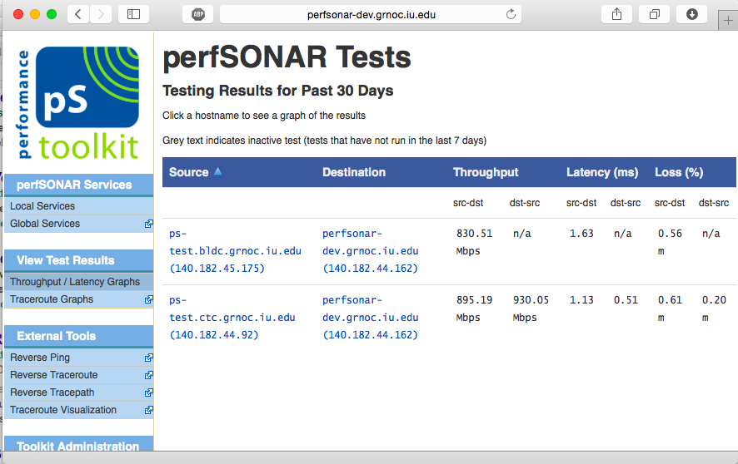
User Interface Refresh
Easy to use web interface
Targeted at users with variety of levels of technical expertise.
Our goals in perSONAR 3.5:
improve easy of use and visual appeal
integration of state of the art UI components
to extend UI lifespan.
Current Interface

Slide 10
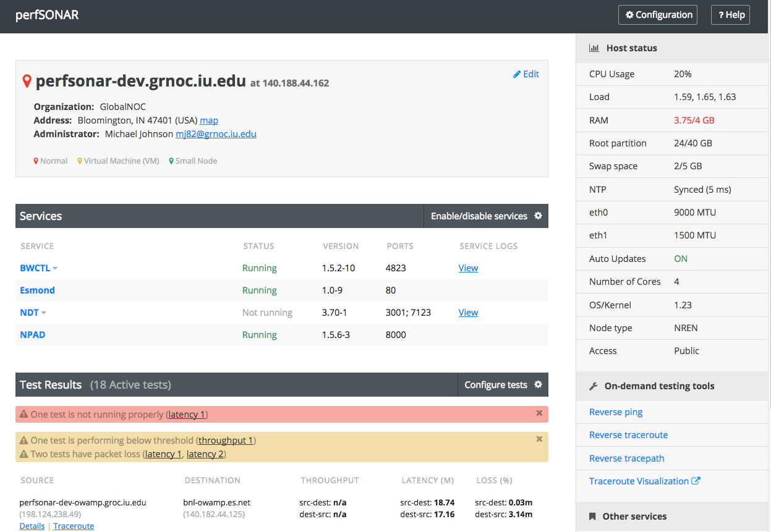
New Host Management Interface

Slide 11
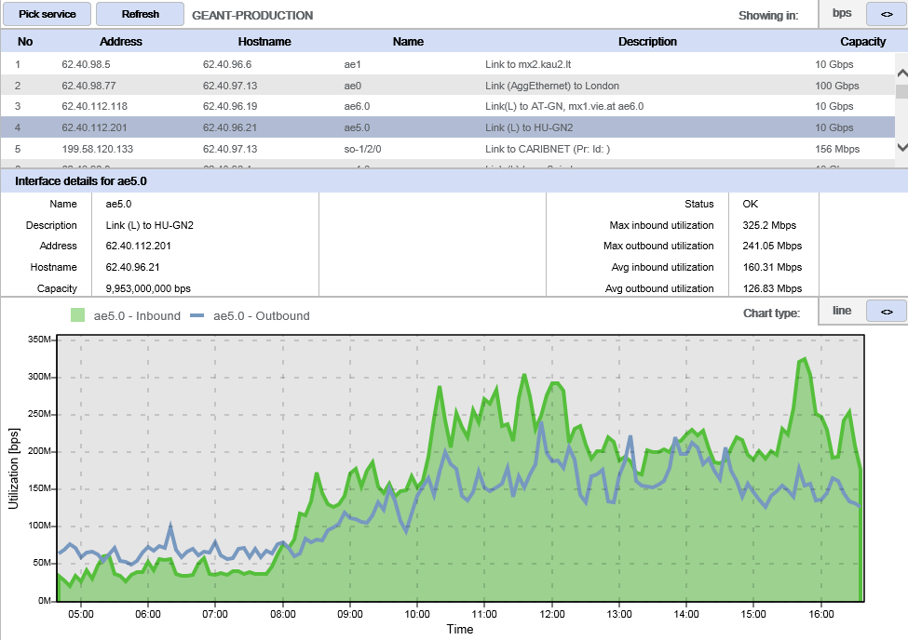
Updated psUI
Notes:
psUI lets you run tests on demand, and also review historical results

Slide 12
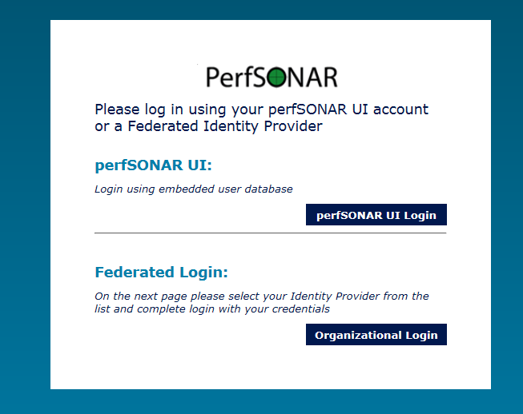
perfSONAR UI and eduGAIN

Slide 13
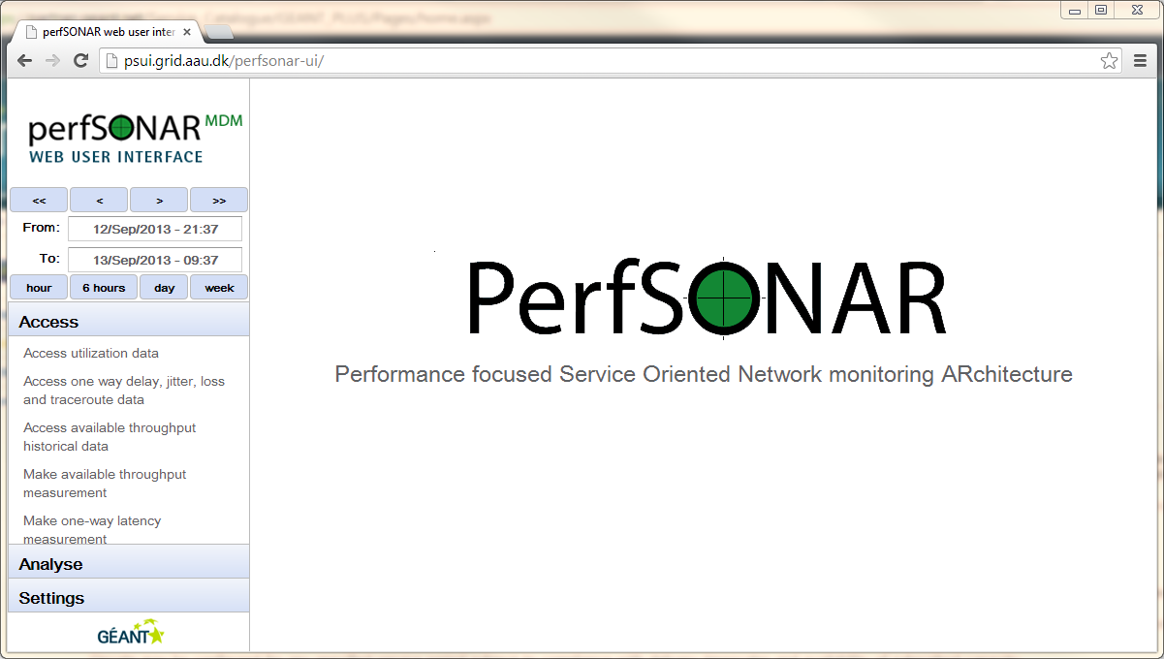
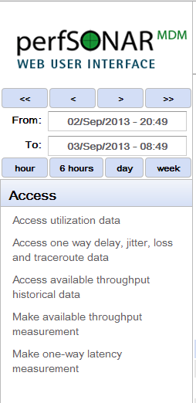
perfSONAR web user interface

Slide 14
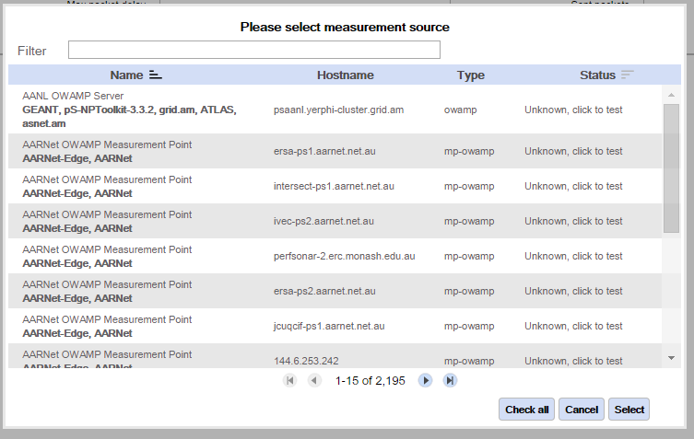
Dynamic discovery of sites through Lookup Service

Slide 15
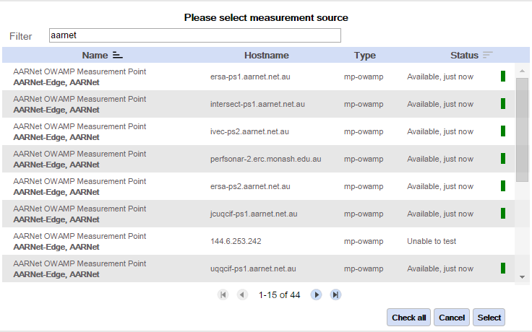
Search filter and remote check of availability

Slide 16
Useful URLs
http://docs.perfsonar.net/
https://www.perfsonar.net/
http://fasterdata.es.net/
http://fasterdata.es.net/performance-testing/network-troubleshooting-tools/
https://github.com/perfsonar
https://github.com/perfsonar/project/wiki

