Slide 1
Use of Measurement Tools
Event
Presenter, Organization, Email
Date
This document is a result of work by the perfSONAR Project (http://www.perfsonar.net) and is licensed under CC BY-SA 4.0 (https://creativecommons.org/licenses/by-sa/4.0/).

Slide 2
Tool Usage
All of the previous examples were discovered, debugged, and corrected through the aide of the tools on the pS Performance Toolkit
Some are run in a diagnostic (e.g. one off) fashion, others are automated
I will go over diagnostic usage of some of the tools:
    OWAMP
    BWCTL

Slide 3
Hosts Used:
BWCTL Hosts (10G)
    wash-pt1.es.net (McLean VA)
    sunn-pt1.es.net (Sunnyvale CA)
OWAMP Hosts (1G)
    wash-owamp.es.net (McLean VA)
    sunn-owamp.es.net (Sunnyvale CA)
Path
    ~60ms RTT
    traceroute to sunn-owamp.es.net (198.129.254.78), 30 hops max, 60 byte packets
    1 198.124.252.125 (198.124.252.125) 0.163 ms 0.149 ms 0.138 ms
    2 washcr5-ip-c-washsdn2.es.net (134.55.50.61) 0.655 ms washcr5-ip-a-washsdn2.es.net (134.55.42.33) 0.991 ms washcr5-ip-c-washsdn2.es.net (134.55.50.61) 1.324 ms
    3 chiccr5-ip-a-washcr5.es.net (134.55.36.45) 17.884 ms 17.939 ms 18.217 ms
    4 kanscr5-ip-a-chiccr5.es.net (134.55.43.82) 28.980 ms 29.066 ms 29.295 ms
    5 denvcr5-ip-a-kanscr5.es.net (134.55.49.57) 39.515 ms 39.601 ms 39.877 ms
    6 sacrcr5-ip-a-denvcr5.es.net (134.55.50.201) 60.382 ms 60.210 ms 60.437 ms
    7 sunncr5-ip-a-sacrcr5.es.net (134.55.40.6) 63.067 ms 68.035 ms 68.266 ms
    8 sunn-owamp.es.net (198.129.254.78) 62.462 ms 62.445 ms 62.436 ms
Notes:
Just for reference

Slide 4

Forcing Bad Performance (to illustrate behavior)
Add 10% Loss to a specific host
  sudo /sbin/tc qdisc delete dev eth0 root
  sudo /sbin/tc qdisc add dev eth0 root handle 1: prio
  sudo /sbin/tc qdisc add dev eth0 parent 1:1 handle 10: netem loss 10%
  sudo /sbin/tc filter add dev eth0 protocol ip parent 1:0 prio 3 u32 match ip dst 198.129.254.78/32 flowid 1:1
Add 10% Duplication to a specific host
  sudo /sbin/tc qdisc delete dev eth0 root
  sudo /sbin/tc qdisc add dev eth0 root handle 1: prio
  sudo /sbin/tc qdisc add dev eth0 parent 1:1 handle 10: netem duplicate 10%
  sudo /sbin/tc filter add dev eth0 protocol ip parent 1:0 prio 3 u32 match ip dst 198.129.254.78/32 flowid 1:1
Add 10% Corruption to a specific host
    sudo /sbin/tc qdisc delete dev eth0 root
    sudo /sbin/tc qdisc add dev eth0 root handle 1: prio
    sudo /sbin/tc qdisc add dev eth0 parent 1:1 handle 10: netem corrupt 10%
    sudo /sbin/tc filter add dev eth0 protocol ip parent 1:0 prio 3 u32 match ip dst 198.129.254.78/32 flowid 1:1
Reorder packets: 50% of packets (with a correlation of 75%) will get sent immediately, others will be delayed by 75ms.
    sudo /sbin/tc qdisc delete dev eth0 root
    sudo /sbin/tc qdisc add dev eth0 root handle 1: prio
    sudo /sbin/tc qdisc add dev eth0 parent 1:1 handle 10: netem delay 10ms reorder 25% 50%
    sudo /sbin/tc filter add dev eth0 protocol ip parent 1:0 prio 3 u32 match ip dst 198.129.254.78/32 flowid 1:1
Reset things
    sudo /sbin/tc qdisc delete dev eth0 root
Notes:
Note – this is an eye test, so suggest people play on their own. The point is that I need to mess up the network to get interesting behavior in the tools

Slide 5
Its All About the Buffers
A prequel to using BWCTL – The Bandwidth Delay Product
  The amount of “in flight” data allowed for a TCP connection (BDP = bandwidth * round trip time)
  Example: 1Gb/s cross country, ~100ms
    1,000,000,000 b/s * .1 s = 100,000,000 bits
    100,000,000 / 8 = 12,500,000 bytes
    12,500,000 bytes / (1024*1024) ~ 12MB
  Major OSs default to a base of 64k.
    For those playing at home, the maximum throughput with a TCP window of 64 KByte for RTTs:
      10ms = 50Mbps
      50ms = 10Mbps
      100ms = 5Mbps
    Autotuning does help by growing the window when needed. Do make this work properly, the host needs tuning: https://fasterdata.es.net/host-tuning/
Ignore the math aspect, its really just about making sure there is memory to catch packets. As the speed increases, there are more packets. If there is not memory, we drop them, and that makes TCP sad.
  Memory on hosts, and network gear
Notes:
Little math – if we don’t have buffers we don’t do well. All our hosts and network paths are tuned for these examples.

Slide 6
Lets Talk about IPERF
Start with a definition:
  network throughput is the rate of successful message delivery over a communication channel
  Easier terms: how much data can I shovel into the network for some given amount of time
What does this tell us?
  Opposite of utilization (e.g. its how much we can get at a given point in time, minus what is utilized)
  Utilization and throughput added together are capacity
Tools that measure throughput are a simulation of a real work use case (e.g. how well could bulk data movement perform)
Ways to game the system
  Parallel streams
  Manual window size adjustments
  ‘memory to memory’ testing – no spinning disk

Slide 7
Lets Talk about IPERF
Couple of varieties of tester that BWCTL (the control/policy wrapper) knows how to talk with:
  Iperf2
    Default for the command line (e.g. bwctl –c HOST will invoke this)
    Some known behavioral problems (CPU hog, hard to get UDP testing to be correct)
  Iperf3
    Default for the perfSONAR regular testing framework, can invoke via command line switch (bwctl –T iperf3 –c HOST)
    New brew, has features iperf2 is missing (retransmissions, JSON output, daemon mode, etc.)
  Nuttcp
    Different code base, can invoke via command line switch (bwctl –T nuttcp –c HOST)
    More control over how the tool behaves on the host (bind to CPU/core, etc.)
    Similar feature set to iperf3

Slide 8
What IPERF Tells Us
Lets start by describing throughput, which is vague.
  Capacity: link speed
    Narrow Link: link with the lowest capacity along a path
    Capacity of the end-to-end path = capacity of the narrow link
  Utilized bandwidth: current traffic load
  Available bandwidth: capacity – utilized bandwidth
    Tight Link: link with the least available bandwidth in a path
  Achievable bandwidth: includes protocol and host issues (e.g. BDP!)
All of this is “memory to memory”, e.g. we are not involving a spinning disk (more later)
45 Mbps
10 Mbps
100 Mbps
45 Mbps
source
sink
Narrow Link
(Shaded portion shows background traffic)
Tight Link
Notes:
Remember that BWCTL will only tell us the ‘results’ of the white part of the tight link – that is the constraining factor.

Slide 9
Some Quick Words on BWCTL
BWCTL is the wrapper around a couple of tools (we will show the throughput tools first)
Policy specification can do things like prevent tests to subnets, or allow longer tests to others. See the man pages for more details
Some general notes:
  Use ‘-c’ to specify a ‘catcher’ (receiver)
  Use ‘-s’ to specify a ‘sender’
  Will default to IPv6 if available (use -4 to force IPv4 as needed, or specify things in terms of an address if your host names are dual homed)

Slide 10
BWCTL Example (iperf)
[zurawski@wash-pt1 ~]$ bwctl -T iperf -f m -t 10 -i 2 -c sunn-pt1.es.net
bwctl: 83 seconds until test results available
RECEIVER START
bwctl: exec_line: /usr/bin/iperf -B 198.129.254.58 -s -f m -m -p 5136 -t 10 -i 2.000000
bwctl: run_tool: tester: iperf
bwctl: run_tool: receiver: 198.129.254.58
bwctl: run_tool: sender: 198.124.238.34
bwctl: start_tool: 3598657357.738868
------------------------------------------------------------
Server listening on TCP port 5136
Binding to local address 198.129.254.58
TCP window size: 0.08 MByte (default)
------------------------------------------------------------
[ 16] local 198.129.254.58 port 5136 connected with 198.124.238.34 port 5136
[ ID] Interval Transfer Bandwidth
[ 16] 0.0- 2.0 sec 90.4 MBytes 379 Mbits/sec
[ 16] 2.0- 4.0 sec 689 MBytes 2891 Mbits/sec
[ 16] 4.0- 6.0 sec 684 MBytes 2867 Mbits/sec
[ 16] 6.0- 8.0 sec 691 MBytes 2897 Mbits/sec
[ 16] 8.0-10.0 sec 691 MBytes 2898 Mbits/sec
[ 16] 0.0-10.0 sec 2853 MBytes 2386 Mbits/sec
[ 16] MSS size 8948 bytes (MTU 8988 bytes, unknown interface)
bwctl: stop_tool: 3598657390.668028
RECEIVER END
N.B. This is what perfSONAR Graphs – the average of the complete test

Slide 11
BWCTL Example (iperf3)
[zurawski@wash-pt1 ~]$ bwctl -T iperf3 -f m -t 10 -i 2 -c sunn-pt1.es.net
bwctl: 55 seconds until test results available
SENDER START
bwctl: run_tool: tester: iperf3
bwctl: run_tool: receiver: 198.129.254.58
bwctl: run_tool: sender: 198.124.238.34
bwctl: start_tool: 3598657653.219168
Test initialized
Running client
Connecting to host 198.129.254.58, port 5001
[ 17] local 198.124.238.34 port 34277 connected to 198.129.254.58 port 5001
[ ID] Interval Transfer Bandwidth Retransmits
[ 17] 0.00-2.00 sec 430 MBytes 1.80 Gbits/sec 2
[ 17] 2.00-4.00 sec 680 MBytes 2.85 Gbits/sec 0
[ 17] 4.00-6.00 sec 669 MBytes 2.80 Gbits/sec 0
[ 17] 6.00-8.00 sec 670 MBytes 2.81 Gbits/sec 0
[ 17] 8.00-10.00 sec 680 MBytes 2.85 Gbits/sec 0
[ ID] Interval Transfer Bandwidth Retransmits
Sent
[ 17] 0.00-10.00 sec 3.06 GBytes 2.62 Gbits/sec 2
Received
[ 17] 0.00-10.00 sec 3.06 GBytes 2.63 Gbits/sec
iperf Done.
bwctl: stop_tool: 3598657664.995604
SENDER END
N.B. This is what perfSONAR Graphs – the average of the complete test

Slide 12
BWCTL Example (nuttcp)
[zurawski@wash-pt1 ~]$ bwctl -T nuttcp -f m -t 10 -i 2 -c sunn-pt1.es.net
bwctl: 73 seconds until test results available
SENDER START
bwctl: exec_line: /usr/bin/nuttcp -vv -p 5001 -i 2.000000 -T 10 -t 198.129.254.58
bwctl: run_tool: tester: nuttcp
bwctl: run_tool: receiver: 198.129.254.58
bwctl: run_tool: sender: 198.124.238.34
bwctl: start_tool: 3598657844.605350
nuttcp-t: v7.1.6: socket
nuttcp-t: buflen=65536, nstream=1, port=5001 tcp -> 198.129.254.58
nuttcp-t: time limit = 10.00 seconds
nuttcp-t: connect to 198.129.254.58 with mss=8948, RTT=62.418 ms
nuttcp-t: send window size = 98720, receive window size = 87380
nuttcp-t: available send window = 74040, available receive window = 65535
nuttcp-r: v7.1.6: socket
nuttcp-r: buflen=65536, nstream=1, port=5001 tcp
nuttcp-r: interval reporting every 2.00 seconds
nuttcp-r: accept from 198.124.238.34
nuttcp-r: send window size = 98720, receive window size = 87380
nuttcp-r: available send window = 74040, available receive window = 65535
131.0625 MB / 2.00 sec = 549.7033 Mbps 1 retrans
725.6250 MB / 2.00 sec = 3043.4964 Mbps 0 retrans
715.0000 MB / 2.00 sec = 2998.8284 Mbps 0 retrans
714.3750 MB / 2.00 sec = 2996.4168 Mbps 0 retrans
707.1250 MB / 2.00 sec = 2965.8349 Mbps 0 retrans
nuttcp-t: 2998.1379 MB in 10.00 real seconds = 307005.08 KB/sec = 2514.9856 Mbps
nuttcp-t: 2998.1379 MB in 2.32 CPU seconds = 1325802.48 KB/cpu sec
nuttcp-t: retrans = 1
nuttcp-t: 47971 I/O calls, msec/call = 0.21, calls/sec = 4797.03
nuttcp-t: 0.0user 2.3sys 0:10real 23% 0i+0d 768maxrss 0+2pf 156+28csw
nuttcp-r: 2998.1379 MB in 10.07 real seconds = 304959.96 KB/sec = 2498.2320 Mbps
nuttcp-r: 2998.1379 MB in 2.36 CPU seconds = 1301084.31 KB/cpu sec
nuttcp-r: 57808 I/O calls, msec/call = 0.18, calls/sec = 5742.21
nuttcp-r: 0.0user 2.3sys 0:10real 23% 0i+0d 770maxrss 0+4pf 9146+24csw
bwctl: stop_tool: 3598657866.949026
SENDER END
N.B. This is what perfSONAR Graphs – the average of the complete test

Slide 13
BWCTL Example (nuttcp, [1%] loss)
[zurawski@wash-pt1 ~]$ bwctl -T nuttcp -f m -t 10 -i 2 -c sunn-pt1.es.net
bwctl: 41 seconds until test results available
SENDER START
bwctl: exec_line: /usr/bin/nuttcp -vv -p 5004 -i 2.000000 -T 10 -t 198.129.254.58
bwctl: run_tool: tester: nuttcp
bwctl: run_tool: receiver: 198.129.254.58
bwctl: run_tool: sender: 198.124.238.34
bwctl: start_tool: 3598658394.807831
nuttcp-t: v7.1.6: socket
nuttcp-t: buflen=65536, nstream=1, port=5004 tcp -> 198.129.254.58
nuttcp-t: time limit = 10.00 seconds
nuttcp-t: connect to 198.129.254.58 with mss=8948, RTT=62.440 ms
nuttcp-t: send window size = 98720, receive window size = 87380
nuttcp-t: available send window = 74040, available receive window = 65535
nuttcp-r: v7.1.6: socket
nuttcp-r: buflen=65536, nstream=1, port=5004 tcp
nuttcp-r: interval reporting every 2.00 seconds
nuttcp-r: accept from 198.124.238.34
nuttcp-r: send window size = 98720, receive window size = 87380
nuttcp-r: available send window = 74040, available receive window = 65535
6.3125 MB / 2.00 sec = 26.4759 Mbps 27 retrans
3.5625 MB / 2.00 sec = 14.9423 Mbps 4 retrans
3.8125 MB / 2.00 sec = 15.9906 Mbps 7 retrans
4.8125 MB / 2.00 sec = 20.1853 Mbps 13 retrans
6.0000 MB / 2.00 sec = 25.1659 Mbps 7 retrans
nuttcp-t: 25.5066 MB in 10.00 real seconds = 2611.85 KB/sec = 21.3963 Mbps
nuttcp-t: 25.5066 MB in 0.01 CPU seconds = 1741480.37 KB/cpu sec
nuttcp-t: retrans = 58
nuttcp-t: 409 I/O calls, msec/call = 25.04, calls/sec = 40.90
nuttcp-t: 0.0user 0.0sys 0:10real 0% 0i+0d 768maxrss 0+2pf 51+3csw
nuttcp-r: 25.5066 MB in 10.30 real seconds = 2537.03 KB/sec = 20.7833 Mbps
nuttcp-r: 25.5066 MB in 0.02 CPU seconds = 1044874.29 KB/cpu sec
nuttcp-r: 787 I/O calls, msec/call = 13.40, calls/sec = 76.44
nuttcp-r: 0.0user 0.0sys 0:10real 0% 0i+0d 770maxrss 0+4pf 382+0csw
bwctl: stop_tool: 3598658417.214024
SENDER END
N.B. This is what perfSONAR Graphs – the average of the complete test

Slide 14
BWCTL Example (nuttcp, re-ordering)
[zurawski@wash-pt1 ~]$ bwctl -T nuttcp -f m -t 10 -i 2 -c sunn-pt1.es.net
bwctl: 45 seconds until test results available
SENDER START
bwctl: exec_line: /usr/bin/nuttcp -vv -p 5007 -i 2.000000 -T 10 -t 198.129.254.58
bwctl: run_tool: tester: nuttcp
bwctl: run_tool: receiver: 198.129.254.58
bwctl: run_tool: sender: 198.124.238.34
bwctl: start_tool: 3598658824.115013
nuttcp-t: v7.1.6: socket
nuttcp-t: buflen=65536, nstream=1, port=5007 tcp -> 198.129.254.58
nuttcp-t: time limit = 10.00 seconds
nuttcp-t: connect to 198.129.254.58 with mss=8948, RTT=62.433 ms
nuttcp-t: send window size = 98720, receive window size = 87380
nuttcp-t: available send window = 74040, available receive window = 65535
nuttcp-r: v7.1.6: socket
nuttcp-r: buflen=65536, nstream=1, port=5007 tcp
nuttcp-r: interval reporting every 2.00 seconds
nuttcp-r: accept from 198.124.238.34
nuttcp-r: send window size = 98720, receive window size = 87380
nuttcp-r: available send window = 74040, available receive window = 65535
3.4375 MB / 2.00 sec = 14.4176 Mbps 3 retrans
39.5625 MB / 2.00 sec = 165.9376 Mbps 472 retrans
45.5625 MB / 2.00 sec = 191.1028 Mbps 912 retrans
55.9375 MB / 2.00 sec = 234.6186 Mbps 1750 retrans
57.7500 MB / 2.00 sec = 242.2218 Mbps 2434 retrans
nuttcp-t: 210.7074 MB in 10.00 real seconds = 21576.30 KB/sec = 176.7531 Mbps
nuttcp-t: 210.7074 MB in 0.13 CPU seconds = 1622544.64 KB/cpu sec
nuttcp-t: retrans = 6059
nuttcp-t: 3372 I/O calls, msec/call = 3.04, calls/sec = 337.20
nuttcp-t: 0.0user 0.1sys 0:10real 1% 0i+0d 768maxrss 0+2pf 72+10csw
nuttcp-r: 210.7074 MB in 11.25 real seconds = 19175.61 KB/sec = 157.0866 Mbps
nuttcp-r: 210.7074 MB in 0.20 CPU seconds = 1073614.78 KB/cpu sec
nuttcp-r: 4692 I/O calls, msec/call = 2.46, calls/sec = 416.99
nuttcp-r: 0.0user 0.1sys 0:11real 1% 0i+0d 770maxrss 0+4pf 1318+12csw
bwctl: stop_tool: 3598658835.981810
SENDER END
N.B. This is what perfSONAR Graphs – the average of the complete test

Slide 15
BWCTL Example (nuttcp, duplication)
[zurawski@wash-pt1 ~]$ bwctl -T nuttcp -f m -t 10 -i 2 -c sunn-pt1.es.net
bwctl: 70 seconds until test results available
SENDER START
bwctl: exec_line: /usr/bin/nuttcp -vv -p 5008 -i 2.000000 -T 10 -t 198.129.254.58
bwctl: run_tool: tester: nuttcp
bwctl: run_tool: receiver: 198.129.254.58
bwctl: run_tool: sender: 198.124.238.34
bwctl: start_tool: 3598659020.747514
nuttcp-t: v7.1.6: socket
nuttcp-t: buflen=65536, nstream=1, port=5008 tcp -> 198.129.254.58
nuttcp-t: time limit = 10.00 seconds
nuttcp-t: connect to 198.129.254.58 with mss=8948, RTT=62.425 ms
nuttcp-t: send window size = 98720, receive window size = 87380
nuttcp-t: available send window = 74040, available receive window = 65535
nuttcp-r: v7.1.6: socket
nuttcp-r: buflen=65536, nstream=1, port=5008 tcp
nuttcp-r: interval reporting every 2.00 seconds
nuttcp-r: accept from 198.124.238.34
nuttcp-r: send window size = 98720, receive window size = 87380
nuttcp-r: available send window = 74040, available receive window = 65535
114.8125 MB / 2.00 sec = 481.5470 Mbps 22 retrans
726.5625 MB / 2.00 sec = 3047.4347 Mbps 0 retrans
711.5625 MB / 2.00 sec = 2984.4841 Mbps 0 retrans
716.3750 MB / 2.00 sec = 3004.7216 Mbps 0 retrans
713.5000 MB / 2.00 sec = 2992.6404 Mbps 0 retrans
nuttcp-t: 2991.1407 MB in 10.00 real seconds = 306290.41 KB/sec = 2509.1311 Mbps
nuttcp-t: 2991.1407 MB in 2.45 CPU seconds = 1250875.20 KB/cpu sec
nuttcp-t: retrans = 22
nuttcp-t: 47859 I/O calls, msec/call = 0.21, calls/sec = 4785.86
nuttcp-t: 0.0user 2.4sys 0:10real 24% 0i+0d 768maxrss 0+2pf 155+30csw
nuttcp-r: 2991.1407 MB in 10.08 real seconds = 303823.24 KB/sec = 2488.9200 Mbps
nuttcp-r: 2991.1407 MB in 2.49 CPU seconds = 1231762.62 KB/cpu sec
nuttcp-r: 58710 I/O calls, msec/call = 0.18, calls/sec = 5823.66
nuttcp-r: 0.0user 2.4sys 0:10real 24% 0i+0d 770maxrss 0+4pf 10146+24csw
bwctl: stop_tool: 3598659043.778699
SENDER END
N.B. This is what perfSONAR Graphs – the average of the complete test

Slide 16

What IPERF May Not be Telling Us
Fasterdata Tunings
  Fasterdata recommends a set of tunings (https://fasterdata.es.net/host-tuning/) that are designed to increase the performance of a single COTS host, on a shared network infrastructure
    What this means is that we don’t recommend ‘maximum’ tuning
  We are assuming (expecting? hoping?) the host can do parallel TCP streams via the data transfer application (e.g. Globus)
  Because of that you don’t want to assign upwards of 256M of kernel memory to a single TCP socket – a sensible amount is 32M/64M, and if you have 4 streams you are getting the benefits of 128M/256M (enough for a 10G cross country flow)
  We also strive for good citizenship – its very possible for a single 10G machine to get 9.9Gbps TCP, we see this often. If its on a shared infrastructure, there is benefit to downtuning buffers.
Can you ignore the above? Sure – overtune as you see fit, KNOW YOUR NETWORK, USERS, AND USE CASES
Notes:
BWCTL works for long paths – its less useful for short paths.
It also must be run on adaquate hosts (tuned, enough CPU, etc.). We want to measure the network, not the host.

Slide 17
What BWCTL May Not be Telling Us
Regular Testing Setup
  If we don’t ‘max tune’, and run a 20/30 second single streamed TCP test (defaults for the toolkit) we are not going to see 9.9Gbps.
  Think critically: TCP ramp up takes 1-5 seconds (depending on latency), and any tiny blip of congestion will cut TCP performance in half.
    N.B. Iperf3 has the ‘omit’ flag now, that allows you to ignore some amount of slow start
  It is common (and in my mind - expected) to see regular testing values on clean networks range between 1Gbps and 5Gbps, latency dependent
  Performance has two ranges – really crappy, and expected (where expected has a lot of headroom). You will know when its really crappy (trust me).
Diagnostic Suggestions
  You can max out BWCTL in this capacity
  Run long tests (-T 60), with multiple streams (-P 4), and large windows (-W 128M); go crazy
  It is also VERY COMMON that doing so will produce different results than your regular testing. It’s a different set of test parameters, its not that the tools are deliberately lying.
Notes:
More info – if you tune things to work like a data management tool, you will get ‘better’ results.

Slide 18
When at the end of the road …
Throughput is a number, and is not useful in many cases except to tell you where the performance fits on a spectrum
Insight into why the number is low or high has to come from other factors
  Recall that TCP relies on a feedback loop that relies on latency and minimal packet loss
We need to pull another tool out of the shed

Slide 19
OWAMP
OWAMP = One Way Active Measurement Protocol
  E.g. ‘one way ping’
Some differences from traditional ping:
  Measure each direction independently (recall that we often see things like congestion occur in one direction and not the other)
  Uses small evenly spaced groupings of UDP (not ICMP) packets
  Ability to ramp up the interval of the stream, size of the packets, number of packets
OWAMP is most useful for detecting packet train abnormalities on an end to end basis
  Loss
  Duplication
  Orderness
  Latency on the forward vs. reverse path
  Number of Layer 3 hops
Does require some accurate time via NTP – the perfSONAR toolkit does take care of this for you.
Notes:
This is more useful for local/MAN testing

Slide 20
What OWAMP Tells Us
OWAMP is a necessity in regular testing – if you aren’t using this you need to be
  Queuing often occurs in a single direction (think what everyone is doing at noon on a college campus)
  Packet loss (and how often/how much occurs over time) is more valuable than throughput
    This gives you a ‘why’ to go with an observation.
  If your router is going to drop a 50B UDP packet, it is most certainly going to drop a 15000B/9000B TCP packet
Overlaying data
  Compare your throughput results against your OWAMP – do you see patterns?
  Alarm on each, if you are alarming (and we hope you are alarming …)

Slide 21
OWAMP (initial)
[zurawski@wash-owamp ~]$ owping sunn-owamp.es.net
Approximately 12.6 seconds until results available
--- owping statistics from [wash-owamp.es.net]:8885 to [sunn-owamp.es.net]:8827 ---
SID: c681fe4ed67f1b3e5faeb249f078ec8a
first: 2014-01-13T18:11:11.420
last: 2014-01-13T18:11:20.587
100 sent, 0 lost (0.000%), 0 duplicates
one-way delay min/median/max = 31/31.1/31.7 ms, (err=0.00201 ms)
one-way jitter = 0 ms (P95-P50)
Hops = 7 (consistently)
no reordering
--- owping statistics from [sunn-owamp.es.net]:9027 to [wash-owamp.es.net]:8888 ---
SID: c67cfc7ed67f1b3eaab69b94f393bc46
first: 2014-01-13T18:11:11.321
last: 2014-01-13T18:11:22.672
100 sent, 0 lost (0.000%), 0 duplicates
one-way delay min/median/max = 31.4/31.5/32.6 ms, (err=0.00201 ms)
one-way jitter = 0 ms (P95-P50)
Hops = 7 (consistently)
no reordering
N.B. This is what perfSONAR Graphs – the average of the complete test

Slide 22
OWAMP (w/ loss)
[zurawski@wash-owamp ~]$ owping sunn-owamp.es.net
Approximately 12.6 seconds until results available
--- owping statistics from [wash-owamp.es.net]:8852 to [sunn-owamp.es.net]:8837 ---
SID: c681fe4ed67f1f0908224c341a2b83f3
first: 2014-01-13T18:27:22.032
last: 2014-01-13T18:27:32.904
100 sent, 12 lost (12.000%), 0 duplicates
one-way delay min/median/max = 31.1/31.1/31.3 ms, (err=0.00502 ms)
one-way jitter = nan ms (P95-P50)
Hops = 7 (consistently)
no reordering
--- owping statistics from [sunn-owamp.es.net]:9182 to [wash-owamp.es.net]:8893 ---
SID: c67cfc7ed67f1f09531c87cf38381bb6
first: 2014-01-13T18:27:21.993
last: 2014-01-13T18:27:33.785
100 sent, 0 lost (0.000%), 0 duplicates
one-way delay min/median/max = 31.4/31.5/31.5 ms, (err=0.00502 ms)
one-way jitter = 0 ms (P95-P50)
Hops = 7 (consistently)
no reordering
N.B. This is what perfSONAR Graphs – the average of the complete test

Slide 23
OWAMP (w/ re-ordering)
[zurawski@wash-owamp ~]$ owping sunn-owamp.es.net
Approximately 12.9 seconds until results available
--- owping statistics from [wash-owamp.es.net]:8814 to [sunn-owamp.es.net]:9062 ---
SID: c681fe4ed67f21d94991ea335b7a1830
first: 2014-01-13T18:39:22.543
last: 2014-01-13T18:39:31.503
100 sent, 0 lost (0.000%), 0 duplicates
one-way delay min/median/max = 31.1/106/106 ms, (err=0.00201 ms)
one-way jitter = 0.1 ms (P95-P50)
Hops = 7 (consistently)
1-reordering = 19.000000%
2-reordering = 1.000000%
no 3-reordering
--- owping statistics from [sunn-owamp.es.net]:8770 to [wash-owamp.es.net]:8939 ---
SID: c67cfc7ed67f21d994c1302dff644543
first: 2014-01-13T18:39:22.602
last: 2014-01-13T18:39:31.279
100 sent, 0 lost (0.000%), 0 duplicates
one-way delay min/median/max = 31.4/31.5/32 ms, (err=0.00201 ms)
one-way jitter = 0 ms (P95-P50)
Hops = 7 (consistently)
no reordering
N.B. This is what perfSONAR Graphs – the average of the complete test

Slide 24
OWAMP (w/ duplication)
[zurawski@wash-owamp ~]$ owping sunn-owamp.es.net
Approximately 12.6 seconds until results available
--- owping statistics from [wash-owamp.es.net]:8905 to [sunn-owamp.es.net]:8933 ---
SID: c681fe4ed67f228b6b36524c3d3531da
first: 2014-01-13T18:42:20.443
last: 2014-01-13T18:42:30.223
100 sent, 0 lost (0.000%), 11 duplicates
one-way delay min/median/max = 31.1/31.1/33 ms, (err=0.00201 ms)
one-way jitter = 0.1 ms (P95-P50)
Hops = 7 (consistently)
no reordering
--- owping statistics from [sunn-owamp.es.net]:9057 to [wash-owamp.es.net]:8838 ---
SID: c67cfc7ed67f228bb9a5a9b27f4b2d47
first: 2014-01-13T18:42:20.716
last: 2014-01-13T18:42:29.822
100 sent, 0 lost (0.000%), 0 duplicates
one-way delay min/median/max = 31.4/31.5/31.9 ms, (err=0.00201 ms)
one-way jitter = 0 ms (P95-P50)
Hops = 7 (consistently)
no reordering
N.B. This is what perfSONAR Graphs – the average of the complete test

Slide 25
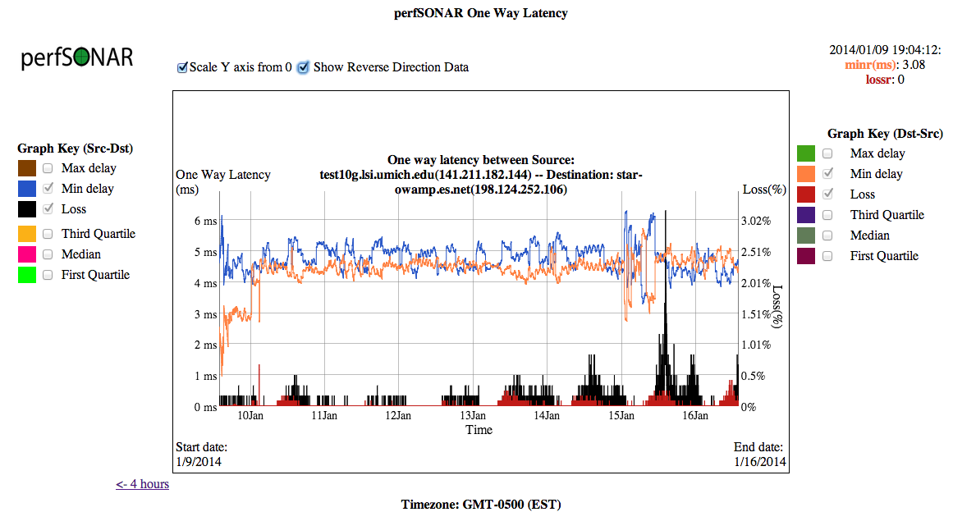
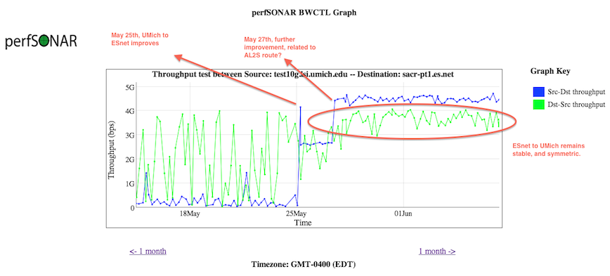
What OWAMP Tells Us
Notes:
A way to combine the results – not automated, but you get a good picture of behavior

Slide 26
Expectation Management
Installing perfSONAR, even on a completely clean network, will not yet you instant line rate results.
  Machine architecture, as well as OS tuning plays a huge role in the equation
  perfSONAR is a stable set of software choices that ride of COTS hardware – some hardware works better than others
  Equally, perfSONAR (and fasterdata.es.net) recommend ‘friendly’ tunings that will not blow the barn doors off of the rest of the network
The following will introduce some expectation management tips.

Slide 27
New BWCTL Tricks
BWCTL has the ability to invoke other tools as well
  Forward and reverse Traceroute/Tracepath
  Forward and reverse Ping
  Forward and reverse OWPing
The BWCTL daemon can be used to request and retrieve results for these tests
Both are useful in the course of debugging problems:
  Get the routes before a throughput test
  Determine path MTU with tracepath
  Getting the reverse direction without having to coordinate with a human on the other end (huge win when debugging multiple networks).
Note that these are command line only – not used in the regular testing interface.

Slide 28
New BWCTL Tricks (Traceroute)
[zurawski@wash-pt1 ~]$ bwtraceroute -T traceroute -4 -s sacr-pt1.es.net
bwtraceroute: Using tool: traceroute
bwtraceroute: 37 seconds until test results available
SENDER START
traceroute to 198.124.238.34 (198.124.238.34), 30 hops max, 60 byte packets
1 sacrcr5-sacrpt1.es.net (198.129.254.37) 0.490 ms 0.788 ms 1.114 ms
2 denvcr5-ip-a-sacrcr5.es.net (134.55.50.202) 21.304 ms 21.594 ms 21.924 ms
3 kanscr5-ip-a-denvcr5.es.net (134.55.49.58) 31.944 ms 32.608 ms 32.838 ms
4 chiccr5-ip-a-kanscr5.es.net (134.55.43.81) 42.904 ms 43.236 ms 43.566 ms
5 washcr5-ip-a-chiccr5.es.net (134.55.36.46) 60.046 ms 60.339 ms 60.670 ms
6 wash-pt1.es.net (198.124.238.34) 59.679 ms 59.693 ms 59.708 ms
SENDER END
[zurawski@wash-pt1 ~]$ bwtraceroute -T traceroute -4 -c sacr-pt1.es.net
bwtraceroute: Using tool: traceroute
bwtraceroute: 35 seconds until test results available
SENDER START
traceroute to 198.129.254.38 (198.129.254.38), 30 hops max, 60 byte packets
1 wash-te-perf-if1.es.net (198.124.238.33) 0.474 ms 0.816 ms 1.145 ms
2 chiccr5-ip-a-washcr5.es.net (134.55.36.45) 19.133 ms 19.463 ms 19.786 ms
3 kanscr5-ip-a-chiccr5.es.net (134.55.43.82) 28.515 ms 28.799 ms 29.083 ms
4 denvcr5-ip-a-kanscr5.es.net (134.55.49.57) 39.077 ms 39.348 ms 39.628 ms
5 sacrcr5-ip-a-denvcr5.es.net (134.55.50.201) 60.013 ms 60.299 ms 60.983 ms
6 sacr-pt1.es.net (198.129.254.38) 59.679 ms 59.678 ms 59.668 ms
SENDER END

Slide 29
New BWCTL Tricks (Tracepath)
[zurawski@wash-pt1 ~]$ bwtraceroute -T tracepath -4 -s sacr-pt1.es.net
bwtraceroute: Using tool: tracepath
bwtraceroute: 36 seconds until test results available
SENDER START
1?: [LOCALHOST] pmtu 9000
1: sacrcr5-sacrpt1.es.net (198.129.254.37) 0.489ms
1: sacrcr5-sacrpt1.es.net (198.129.254.37) 0.463ms
2: denvcr5-ip-a-sacrcr5.es.net (134.55.50.202) 21.426ms
3: kanscr5-ip-a-denvcr5.es.net (134.55.49.58) 31.957ms
4: chiccr5-ip-a-kanscr5.es.net (134.55.43.81) 42.947ms
5: washcr5-ip-a-chiccr5.es.net (134.55.36.46) 60.092ms
6: wash-pt1.es.net (198.124.238.34) 59.753ms reached
Resume: pmtu 9000 hops 6 back 59
SENDER END
[zurawski@wash-pt1 ~]$ bwtraceroute -T tracepath -4 -c sacr-pt1.es.net
bwtraceroute: Using tool: tracepath
bwtraceroute: 36 seconds until test results available
SENDER START
1?: [LOCALHOST] pmtu 9000
1: wash-te-perf-if1.es.net (198.124.238.33) 1.115ms
1: wash-te-perf-if1.es.net (198.124.238.33) 0.616ms
2: chiccr5-ip-a-washcr5.es.net (134.55.36.45) 17.646ms
3: kanscr5-ip-a-chiccr5.es.net (134.55.43.82) 28.573ms
4: denvcr5-ip-a-kanscr5.es.net (134.55.49.57) 39.164ms
5: sacrcr5-ip-a-denvcr5.es.net (134.55.50.201) 60.077ms
6: sacr-pt1.es.net (198.129.254.38) 59.780ms reached
Resume: pmtu 9000 hops 6 back 59
SENDER END

Slide 30
New BWCTL Tricks (Ping)
[zurawski@wash-pt1 ~]$ bwping -T ping -4 -s sacr-pt1.es.net
bwping: Using tool: ping
bwping: 41 seconds until test results available
SENDER START
PING 198.124.238.34 (198.124.238.34) from 198.129.254.38 : 56(84) bytes of data.
64 bytes from 198.124.238.34: icmp_seq=1 ttl=59 time=59.6 ms
64 bytes from 198.124.238.34: icmp_seq=2 ttl=59 time=59.6 ms
64 bytes from 198.124.238.34: icmp_seq=3 ttl=59 time=59.6 ms
64 bytes from 198.124.238.34: icmp_seq=4 ttl=59 time=59.6 ms
64 bytes from 198.124.238.34: icmp_seq=5 ttl=59 time=59.6 ms
64 bytes from 198.124.238.34: icmp_seq=6 ttl=59 time=59.6 ms
64 bytes from 198.124.238.34: icmp_seq=7 ttl=59 time=59.7 ms
64 bytes from 198.124.238.34: icmp_seq=8 ttl=59 time=59.6 ms
64 bytes from 198.124.238.34: icmp_seq=9 ttl=59 time=59.6 ms
64 bytes from 198.124.238.34: icmp_seq=10 ttl=59 time=59.6 ms
--- 198.124.238.34 ping statistics ---
10 packets transmitted, 10 received, 0% packet loss, time 9075ms
rtt min/avg/max/mdev = 59.671/59.683/59.705/0.244 ms
SENDER END

Slide 31
New BWCTL Tricks (OWPing)
[zurawski@wash-pt1 ~]$ bwping -T owamp -4 -s sacr-pt1.es.net
bwping: Using tool: owamp
bwping: 42 seconds until test results available
SENDER START
Approximately 13.4 seconds until results available
--- owping statistics from [198.129.254.38]:5283 to [198.124.238.34]:5121 ---
SID: c67cee22d85fc3b2bbe23f83da5947b2
first: 2015-01-13T08:17:58.534
last: 2015-01-13T08:18:17.581
10 sent, 0 lost (0.000%), 0 duplicates
one-way delay min/median/max = 29.9/29.9/29.9 ms, (err=0.191 ms)
one-way jitter = 0.1 ms (P95-P50)
Hops = 5 (consistently)
no reordering
SENDER END
[zurawski@wash-pt1 ~]$ bwping -T owamp -4 -c sacr-pt1.es.net
bwping: Using tool: owamp
bwping: 41 seconds until test results available
SENDER START
Approximately 13.4 seconds until results available
--- owping statistics from [198.124.238.34]:5124 to [198.129.254.38]:5287 ---
SID: c681fe26d85fc3f24790a7572840013f
first: 2015-01-13T08:19:00.975
last: 2015-01-13T08:19:10.582
10 sent, 0 lost (0.000%), 0 duplicates
one-way delay min/median/max = 29.8/29.9/29.9 ms, (err=0.191 ms)
one-way jitter = 0 ms (P95-P50)
Hops = 5 (consistently)
no reordering
SENDER END

Slide 32
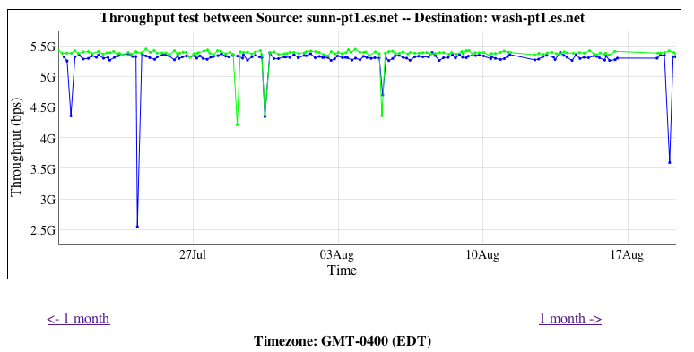
Common Pitfalls – “it should be higher!”
There have been some expectation management problems with the tools that we have seen
  Some feel that if they have 10G, they will get all of it
  Some may not understand the makeup of the test
  Some may not know what they should be getting
Lets start with an ESnet to ESnet test, between very well tuned and recent pieces of hardware
5Gbps is “awesome” for:
  A 20 second test
  60ms Latency
  Homogenous servers
  Using fasterdata tunings
  On a shared infrastructure
Notes:
Example of the differences between well tuned/well provisioned hosts. Little differences matter.

Slide 33
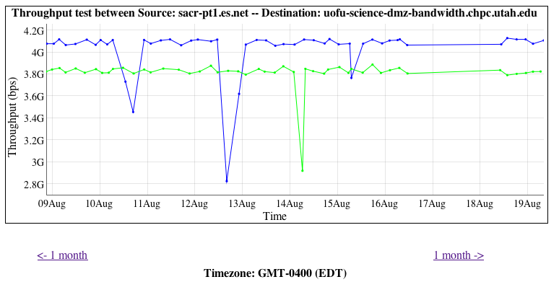
Common Pitfalls – “it should be higher!”
Another example, ESnet (Sacremento CA) to Utah, ~20ms of latency
Is it 5Gbps? No, but still outstanding given the environment:
  20 second test
  Heterogeneous hosts
  Possibly different configurations (e.g. similar tunings of the OS, but not exact in terms of things like BIOS, NIC, etc.)
  Different congestion levels on the ends
Notes:
Example of the differences between well tuned/well provisioned hosts. Little differences matter.

Slide 34
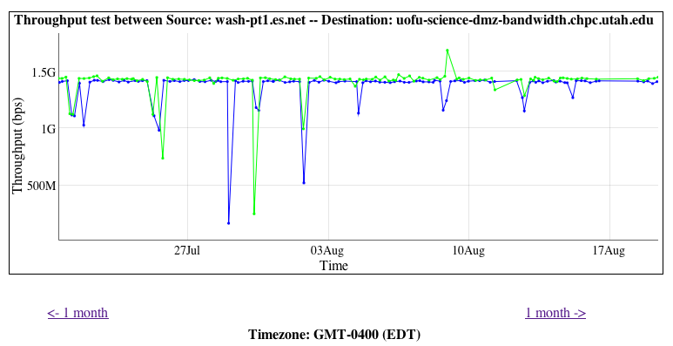
Common Pitfalls – “it should be higher!”
Similar example, ESnet (Washington DC) to Utah, ~50ms of latency
Is it 5Gbps? No. Should it be? No! Could it be higher? Sure, run a different diagnostic test.
  Longer latency – still same length of test (20 sec)
  Heterogeneous hosts
  Possibly different configurations (e.g. similar tunings of the OS, but not exact in terms of things like BIOS, NIC, etc.)
  Different congestion levels on the ends
Takeaway – you will know bad performance when you see it. This is consistent and jives with the environment.
Notes:
Example of the differences between well tuned/well provisioned hosts. Little differences matter.

Slide 35
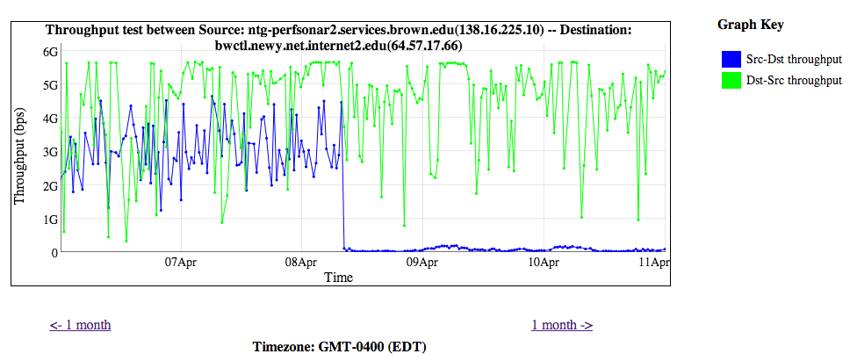
Common Pitfalls – “it should be higher!”
Another Example – the 1st half of the graph is perfectly normal
  Latency of 10-20ms (TCP needs time to ramp up)
  Machine placed in network core of one of the networks – congestion is a fact of life
  Single stream TCP for 20 seconds
The 2nd half is not (e.g. packet loss caused a precipitous drop)
You will know it, when you see it.

Slide 36
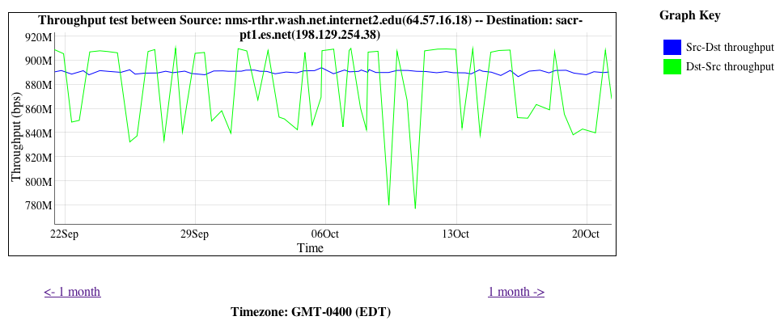
Common Pitfalls – “the tool is unpredictable”
Sometimes this happens:
Is it a “problem”? Yes and no.
Cause: this is called “overdriving” and is common. A 10G host and a 1G host are testing to each other
  1G to 10G is smooth and expected (~900Mbps, Blue)
  10G to 1G is choppy (variable between 900Mbps and 700Mbps, Green)
Notes:
Host mismatch – 1G to 10G is ok, opposite is not true

Slide 37
Common Pitfalls – “the tool is unpredictable”
A NIC doesn’t stream packets out at some average rate - it’s a binary operation:
  Send (e.g. @ max rate) vs. not send (e.g. nothing)
10G of traffic needs buffering to support it along the path. A 10G switch/router can handle it. So could another 10G host (if both are tuned of course)
A 1G NIC is designed to hold bursts of 1G. Sure, they can be tuned to expect more, but may not have enough physical memory
  Ditto for switches in the path
At some point things ‘downstep’ to a slower speed, that drops packets on the ground, and TCP reacts like it were any other loss event.

Slide 38
Common Pitfalls – Summary
When in doubt – test again!
  Diagnostic tests are informative – and they should provide more insight into the regular stuff (still do regular testing, of course)
  Be prepared to divide up a path as need be
A poor carpenter blames his tools
  The tools are only as good as the people using them, do it methodically
  Trust the results – remember that they are giving you a number based on the entire environment
If the site isn’t using perfSONAR – step 1 is to get them to do so
  http://www.perfsonar.net
Get some help
  perfsonar-user@internet2.edu

Slide 39
Use of Measurement Tools
Event
Presenter, Organization, Email
Date
This document is a result of work by the perfSONAR Project (http://www.perfsonar.net) and is licensed under CC BY-SA 4.0 (https://creativecommons.org/licenses/by-sa/4.0/).

