Slide 1

Country Report on IP/ISP
Network
Marshall Islands National Telecommunications Authority
By
Bredalyn Jatios & Douglas Kilemente

Slide 2

I.T Dept
Managing/Configuring/Installing/Monitoring/ Troubleshooting/Deploying/Maintaining:
miNTA Backbone Network
miNTA Internet Services
Virtual Machines (VMWare)- Servers
External Tech Support
Internal Tech Support
UniFi Hotspot

Slide 3

miNTA’s Network
Backbone consists of 90+ switches, storage medias and routers:
Majuro and Ebeye backbone switches (Cisco)
Cisco routers – Border, distribution, access
NAS/SAN- Synology/Brocade
DSLAMs- ADSL/VDSL; Zhone and Calix
Ubiquiti (Rockets, NanoStations, Access Points)- Hot Spots

Slide 4
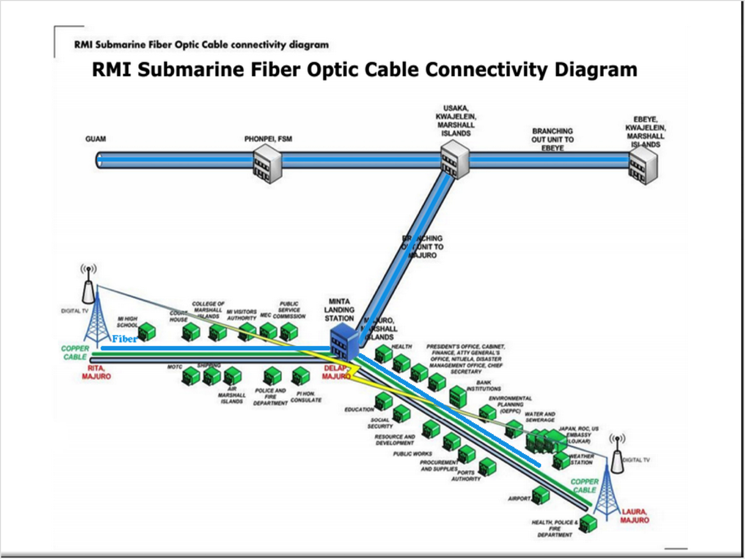

Slide 5
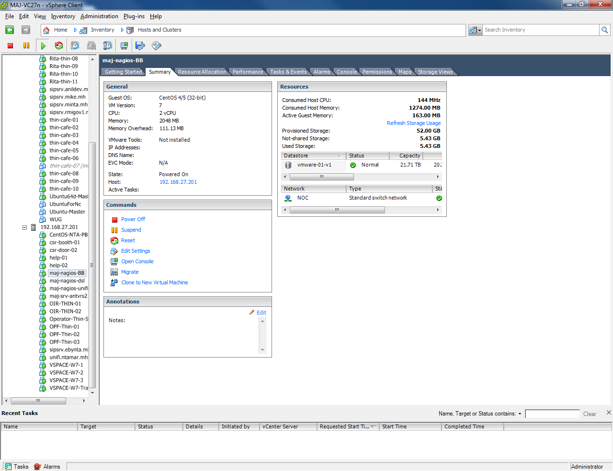
miNTA Virtual Machines: VMWare
Houses Servers for:
miNTA’s AD, Anti-Virus, VPN, etc.
SIP-Server
Thin Clients
Monitoring System:
Cacti
SPAM
WhatsUpGold
Nagios
UniFi Controller

Slide 6
External/Internal Tech Support
Extra Paid service
Maintain fast data flow within the network and in and out of the network
Provide NAT, IP Routing, and UDP or TCP port forwarding
Network Security and Audit.
Monitoring System (CPU, Memory, disk, and Bandwidth Usage)
----Cacti
----Whatsup Gold
----Nagios
Internal SIP services (VOIP)

Slide 7
Internet Services
Internet- High Speed DSL, email, and Hot Spots
DAMA- Demand Assigned
Multiple Access Satellite System for
Outer Islands
Leased Line(FTTx or ADSL or VDSL)
UniFi- for Hot Spots
Air Fiber
VoIP

Slide 8
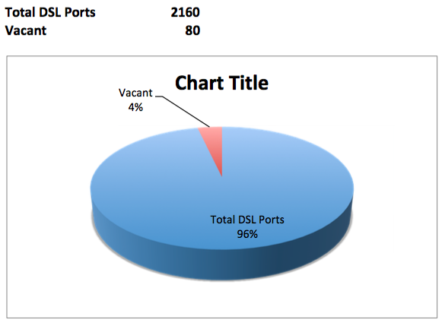
Overall DSL Port Status

Slide 9
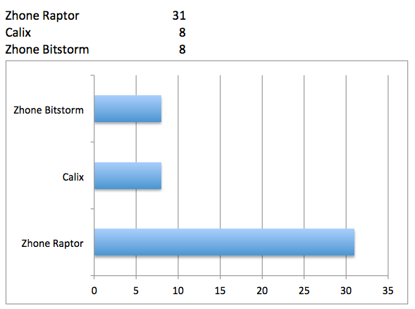
DSL Port Break Down

Slide 10
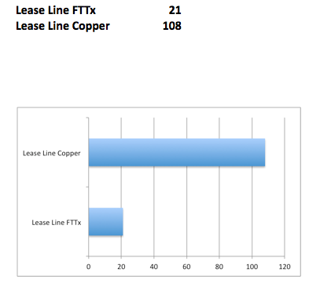
Leased Line/FTTx

Slide 11
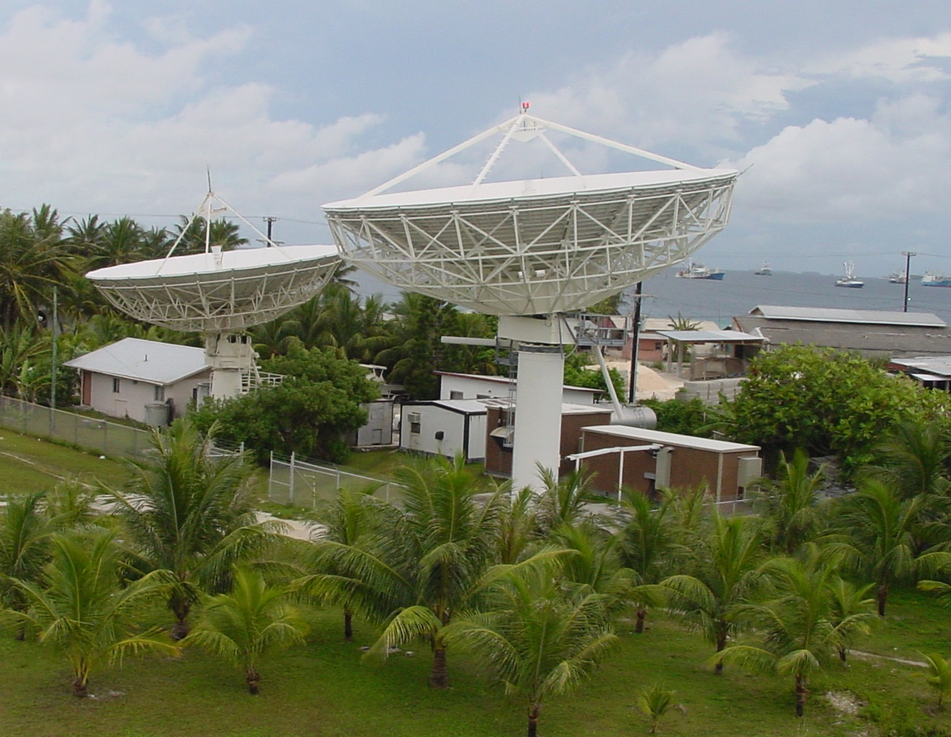

Slide 12
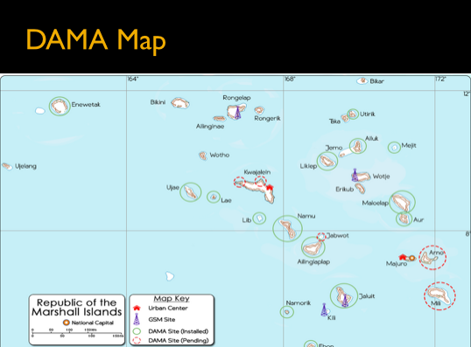

Slide 13
HOT Spots-UniFi
Available only in Majuro and Ebeye
each hotspot up to 30 mbps
23 Coverage Areas including 4 of the islets and portable Wi-Fi on fishing ships throughout the lagoon
The current total subscriber of our Wi-Fi service is 500.

Slide 14
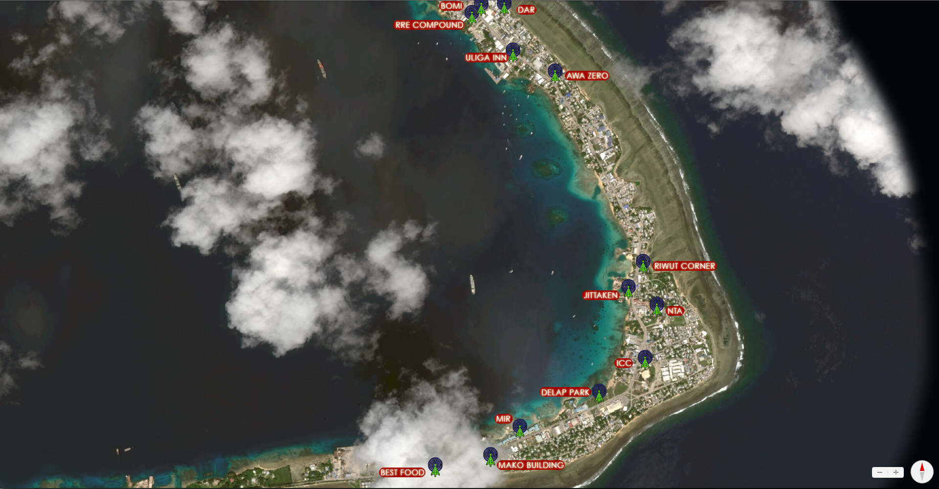

Slide 15
On-going Projects
Ubiquiti Air Fiber link between Majuro and Arno
Introducing VoIP services into Market
Dual Stacking edge routers- miNTA prepping for IPv6. Core is mostly done, now working on end
build more Hot Spots in Ebeye
Create a Data Center for hosting- miNTA to play both Registry and Registrar role?(pending Government election)
update miNTA website-include customer portal.
Setup more FTTx

Slide 16
Challenges
Backing up Fiber connection with Guam
Provide higher bandwidth for Outer Islands
Deploy Hybrid(NAS and SAN)
Repairing main copper cable; troubleshooting Outer islands; raising employee capacity
Keeping up with the demand for higher speeds
Create more efficient Monitoring System
SPAM/Intrusion/DoS detection and mitigation
User protection from hackers, bots, and other harmful programs

Slide 17
Conclusion
Questions???
Thank you!!!

