Slide 1
APNIC Update
Paul Wilson
30 November
PACNOG 18 and APNIC Regional Meeting

Slide 2
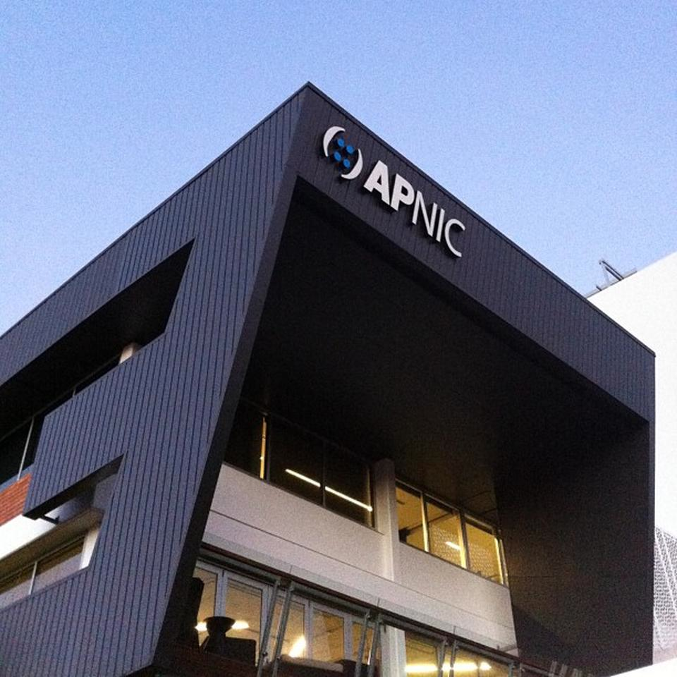
What is APNIC?
The Regional Internet address Registry (RIR) for the Asia Pacific region
Delegates and manages Internet number resources
Including IPv4 and IPv6 addresses
Supports training, education and internet development
A neutral, independent, not-for-profit, open membership-based organisation, since 1993

Slide 3
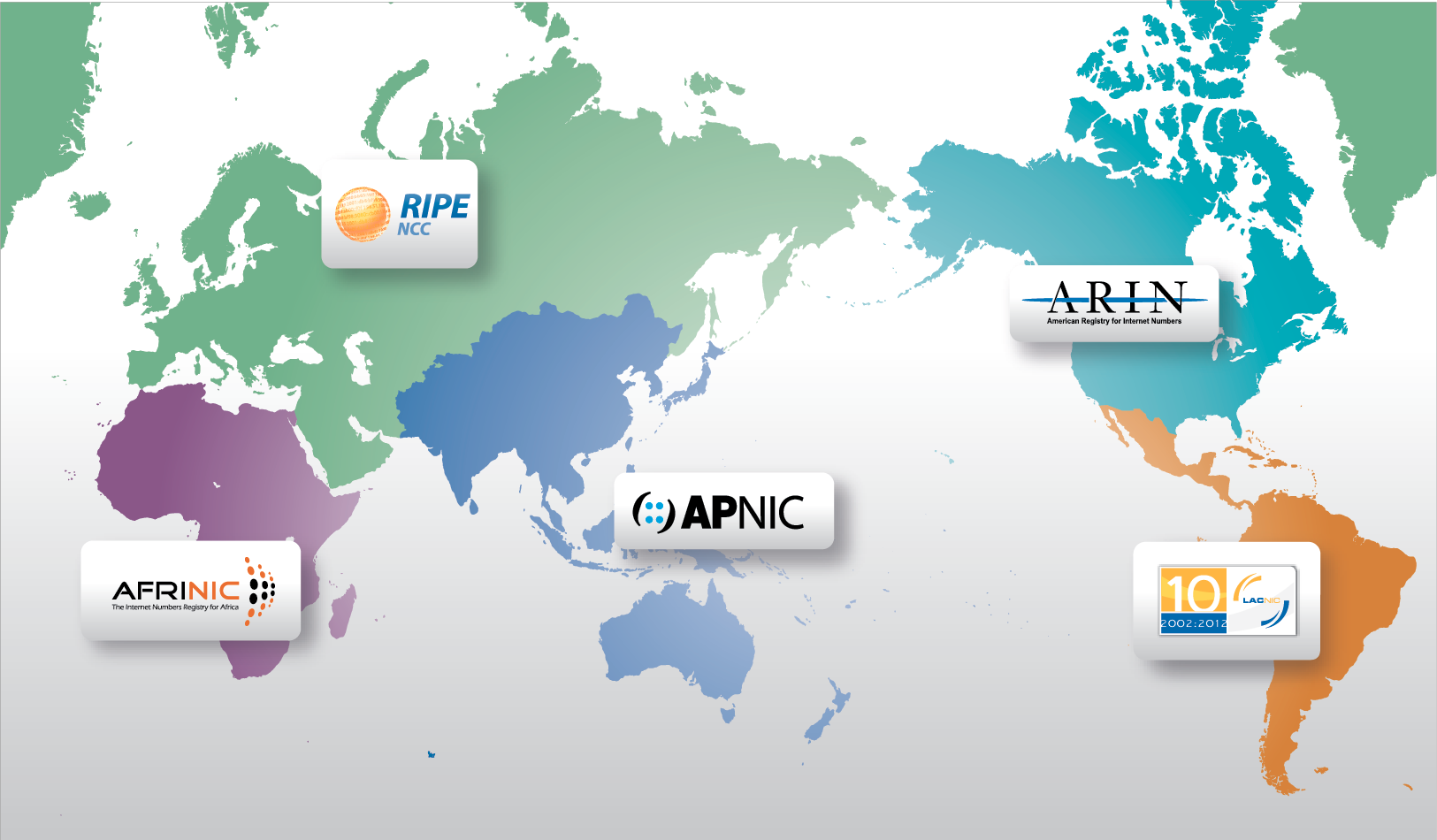
Regional Internet Registries

Slide 4
APNIC’s Vision
A global, open, stable, and secure Internet that serves the entire Asia Pacific community

Slide 5
APNIC Activities
Serving
Supporting
Collaborating

Slide 6
Serving our Members
Serving
Supporting
Collaborating

Slide 7
Serving our Members
Service Statistics
IPv6 delegations
IPv4 delegations
IPv4 transfers
ASN delegations
Membership
Service Developments
MyAPNIC
RDAP
RPKI

Slide 8
Annual IPv6 Delegations
2015
By delegation type
By size
By request type
As at 31 Oct

Slide 9
Annual IPv4 Delegations
2015
By pool
By size
By Member
As at 31 Oct

Slide 10
Annual IPv4 Transfers
2015
Using listing service
Pre-approval usage
As at 31 Oct

Slide 11
Annual ASN Assignments
2015
By type
4-byte return rate
As at 31 Oct

Slide 12
APNIC Membership
As at 31 Oct

Slide 13
Total NIR membership
As at 31 Oct

Slide 14
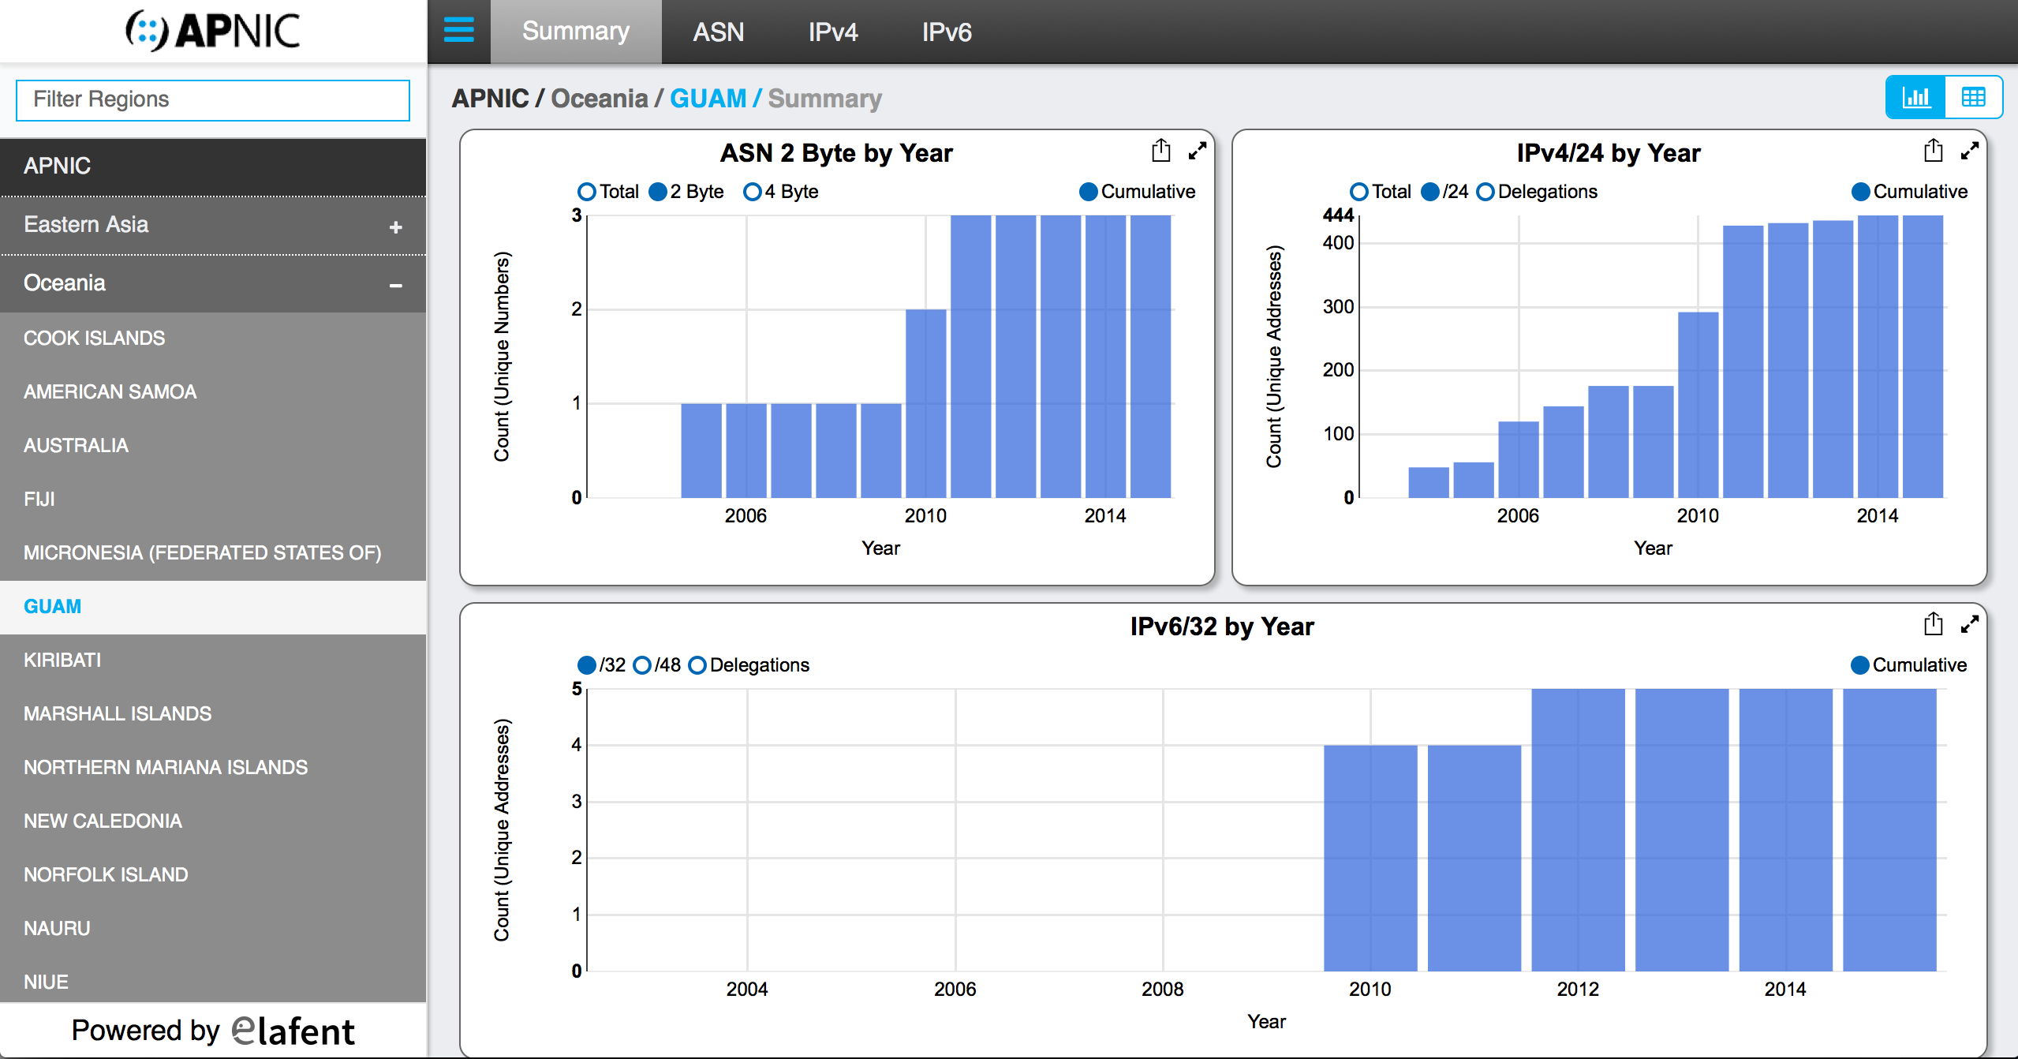
New: Internet Directory

Slide 15
MyAPNIC Development
MyAPNIC Survey 2015
700+ responses from 30 countries
Priority developments
Improve speed
Simplify authentication
Modernise design and navigation
Integrate DNS management
Simplify whois object management and update
New tools: ASN usage

Slide 16
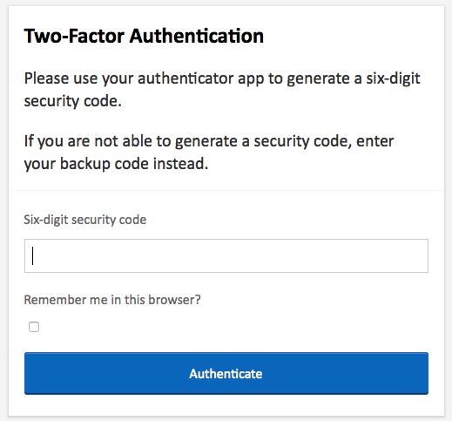
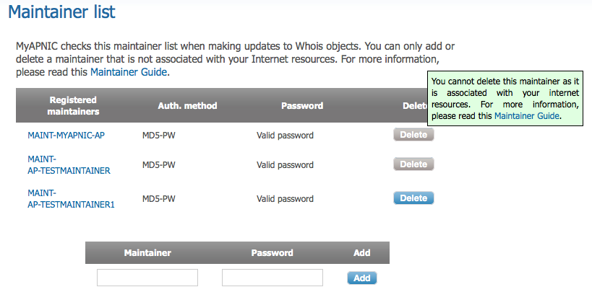
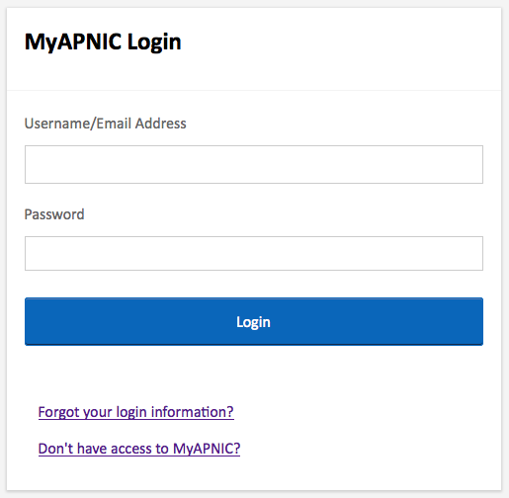
MyAPNIC Development
Two-factor authentication using TOTP
Access all MyAPNIC services (corporate contact, voting, Resource Certification)
Log in to MyAPNIC using your email address
Maintainers managed as independent objects

Slide 17
RDAP
Registry Data Access Protocol
RESTful web services over HTTP
Standardized JSON query format
Standardized JSON response format
Support for redirection, for automatic inter-registry queries
Authorization for access to record attributes
Internationalization
using UTF-8 encoding

Slide 18

RPKI
RPKI presentations to NOGs and conferences
‘Ready to ROA’ Campaign – hands-on sessions to help Members create ROAs
Regional RPKI adoption has doubled in past year - 0.82% to 1.92%
10 face-to-face and eLearning RPKI training courses delivered
Offline simulation of production system
Create and revoke ROAs, observe changes to routing state in lab
apnic.net/roa

Slide 19
Supporting Regional Development
Serving
Supporting
Collaborating

Slide 20

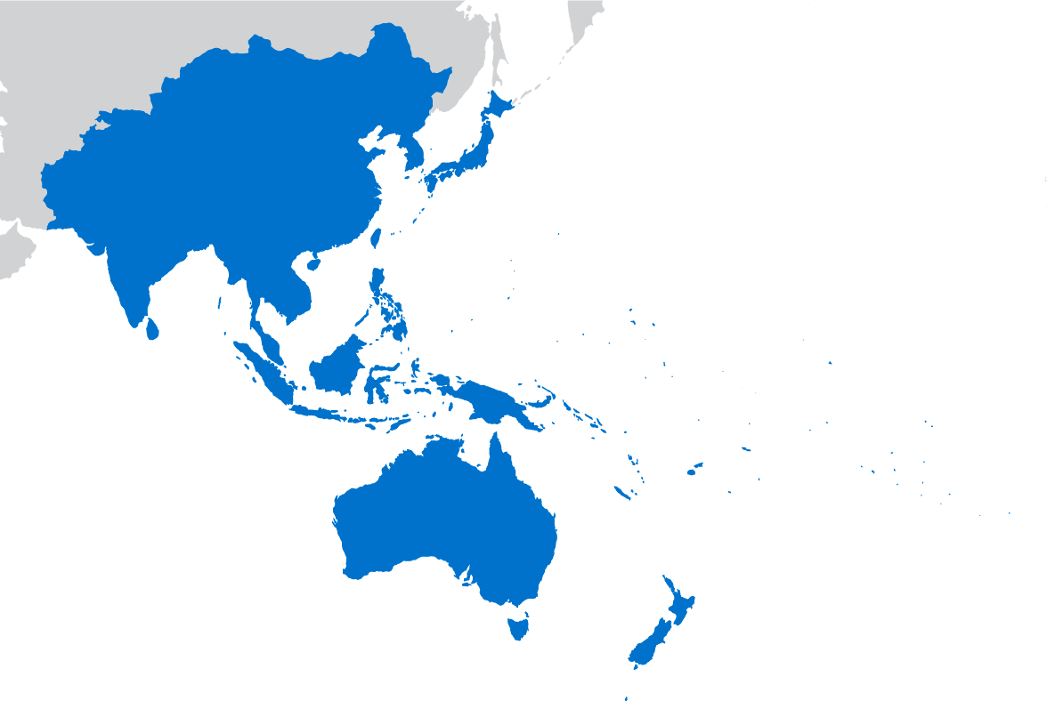
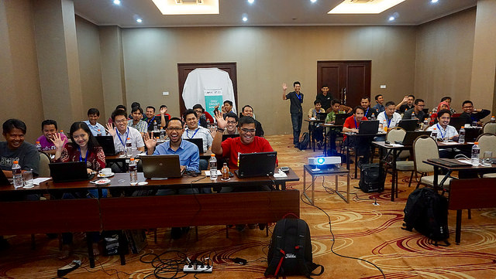
APNIC Training in 2015
1,356 trainees in 50 face-to-face classes,
22 locations
483 trainees in 98 eLearning classes
Received financial contribution from nine donors including:
World Bank
JICA
ITU
NSRC
Video archives
79 videos
89,276 views
Technical Assistance
Sri Lanka, Bangladesh, Thailand (31 Members)

Slide 21
Training Needs Assessment
Topics | Key survey responses | APNIC actions
eLearning | Improve topics; alternative video hosting platform | Reduced from 4 to 3 sessions Changed time slots to 11:00; 13:00 and 15:00 – increased participation Video-on-demand Reviewing content
Self-paced learning | Support for online learning and certification | Looking to partner with RIPE NCC on course development (Internet governance, whois)
Face-to-Face | Strong interests in advanced topics such as network security, IPv6, BGP, DNSSEC and SDN | Reviewing and updating existing courses Introduced Juniper-based materials and Juniper training lab
Capacity | Request for more and frequent training | Third and fourth trainers started in October/November to increase training capacity

Slide 22
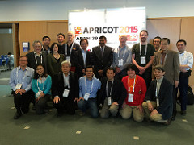
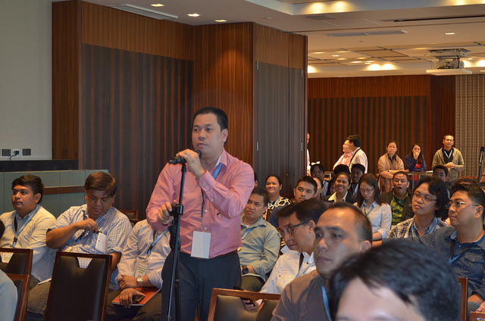
APNIC Events
13 economies in 2015
PK, BD, LK, MM, KH, TH, MY, SG, PH, ID, SB, JP, MN, GU
Attendance
Conferences: 835 + 529
ARMs: 207
Member outreach: 133
APRICOT 2015
APRICOT 2015
APNIC 40
ARM, Philippines

Slide 23
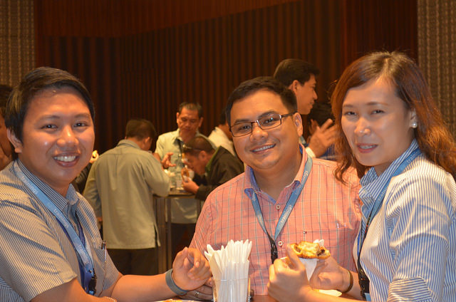
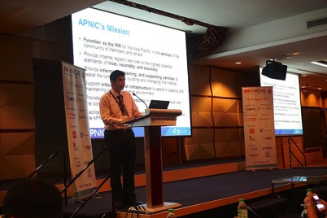
NOGs in 2015
Participated in 14 NOG events JANOG, HKNOG, PHNOG, bdNOG, LKNOG, MyNOG, SGNOC, IDNOG, AusNOG, NZNOG, SANOG, PACNOG
Technical and APNIC updates
Hostmaster consultations
Training sessions
Sponsorship and logistical support
PHNOG 2015
BTNOG 1
SANOG 24
MyNOG 4

Slide 24
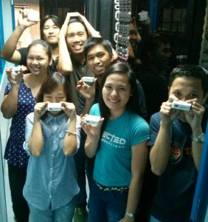
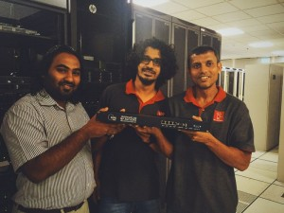
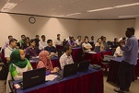

Community Development
Supported 8 RIPE Anchor deployments; distributed 100+ RIPE Atlas probes
15 fellowships for APRICOT 2015; 24 for APNIC 40 including 5 youth fellowships
Established MoUs to support local and regional development – 46 so far
L-root (ICANN) server in Apia, Samoa
K-root (RIPE) server in Quezon City, Philippines
Working with NSRC in New Caledonia and Samoa on IXP support
RIPE Atlas anchor deployment in Maldives – Dhiraagu staff
Probe hosts in the Philippines
MoU signing for
L-root
BdNOG 3
SANOG

Slide 25
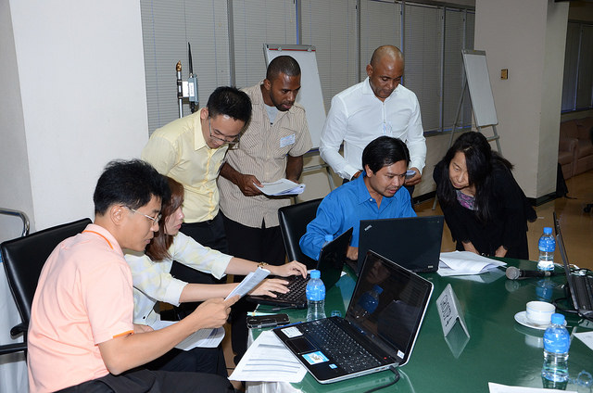
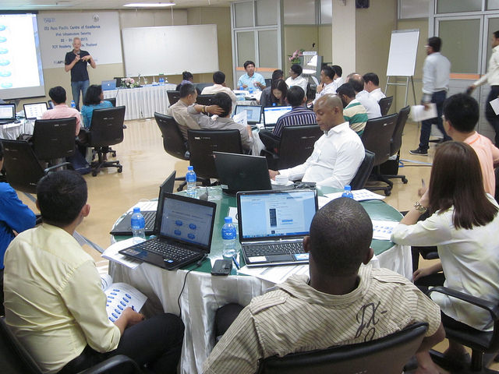
IPv6 in 2015
ITU/APNIC IPv6 workshop
261 trainees
in 7 economies
Presented at 7 IPv6 industry events
IPv6 workshop
with ITU in TH
and TAS in MN
Supporting APIPv6TF Secretariat
ITU/APNIC IPv6 workshop
www.apnic.net/ipv6
APNIC/ITU IPv6 Workshop, Bangkok

Slide 26
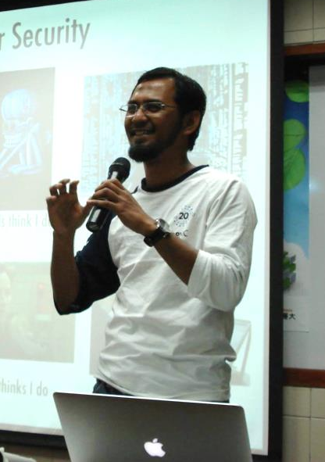
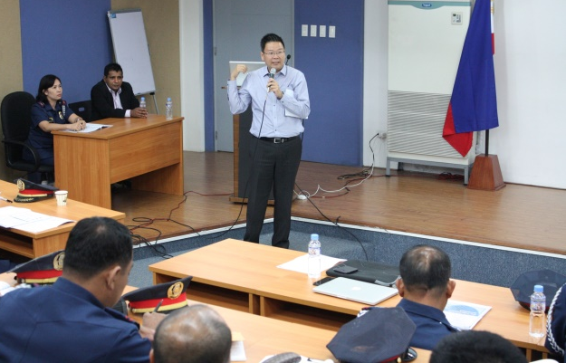
Security Outreach
Promoting security initiatives and best practices in the
APNIC community
NOGs, CSIRTS and LEA events
PK, CN, HK, KR, JP, PH SG, MY, ID, AU
Collaboration with JICA and KISA to deliver regional CERT training
Geoff Huston member of ICANN SSAC
Adli Wahid member of FIRST Board
Adli Wahid
Craig Ng
www.apnic.net/security

Slide 27
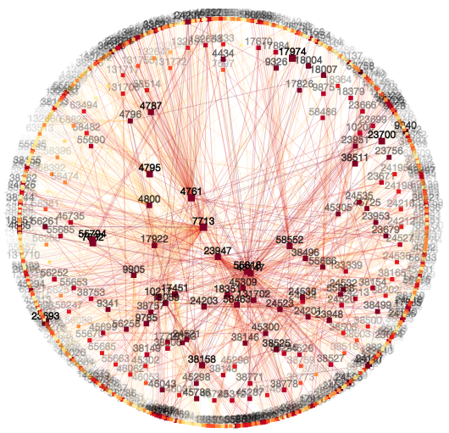
labs.apnic.net
Research to help the APNIC community make informed technical decisions
Measuring IPv6, DNS, DNSSEC,
Single collection platform for measuring end-user capabilities (incl mobiles)
3 million+ measurements per day
Measurement for ICANN’s Universal Acceptance work (IDNs gTLDs)
vizAS AS path visualisation
labs.apnic.net/vizas
50+ research presentations to:
IETF, RIRs, ICANN, DNS OARC,
NOGs, OECD…

Slide 28

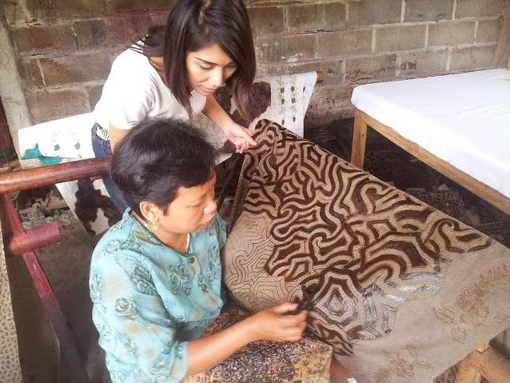


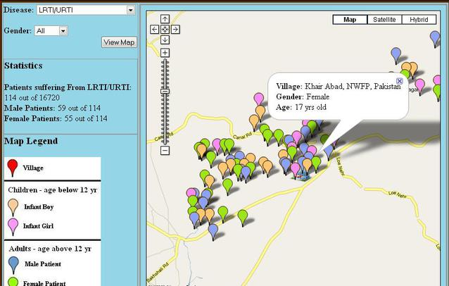
ISIF Awards | 78 nominees from 12 economies India: I Change My City, www.ichangemycity.com Indonesia: Batik Fractal, www.batikfractal.com Pakistan: doctHERs, www.docthers.com Pakistan: Jaroka Tele-Healthcare, www.umtrust.org
ISIF Grants | Projects underway in 2015 Pacific Islands: Peer strategy, NSRC/Telco2 Nepal: TV White spaces deployment, NepalWireless Bangladesh: Mobile and diagnostic devices, UniDhaka India: Carrier access in rural emergencies, InnovadorsLab
APNIC Operational Research Grants | Research aiming to improve availability, reliability, and security of the Internet in the Asia Pacific Network measurement and analysis IPv6 Deployment BGP Routing Network Security

Slide 29
Collaborating Globally
Serving
Supporting
Collaborating

Slide 30
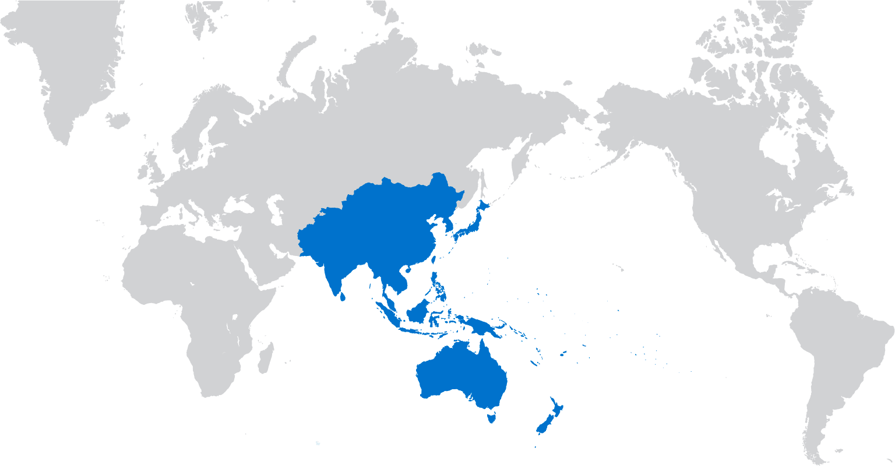
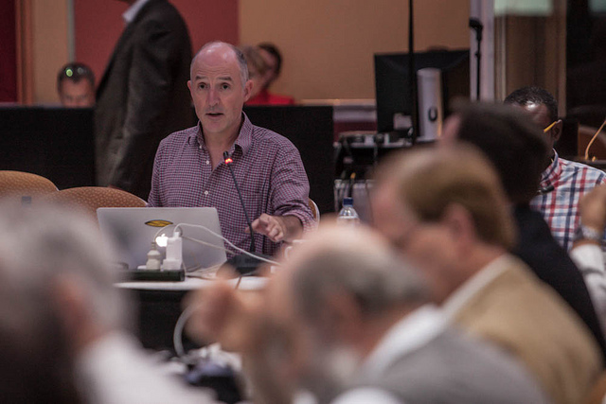

Global Cooperation
Coordination with RIRs and Internet organizations
Engaging with government agencies and IGOs
Engaging with Law Enforcement agencies and networks
Supporting IANA Stewardship Transition
Internet
Governance
Forum

Slide 31
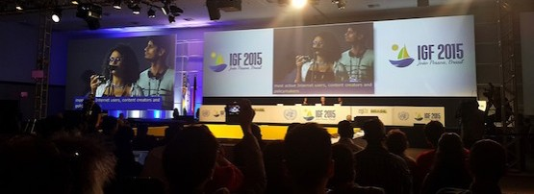
IGF & WSIS
10th Internet Governance Forum held this year
Meeting to determine future of IGF to be held 15-16 Dec
Important meeting for governments deciding their future input into Internet affairs
Multilateral vs Multistakeholder
Pacific has a voice!
IGF 2015

Slide 32
APNIC Activities
Serving
Supporting
Collaborating

Slide 33
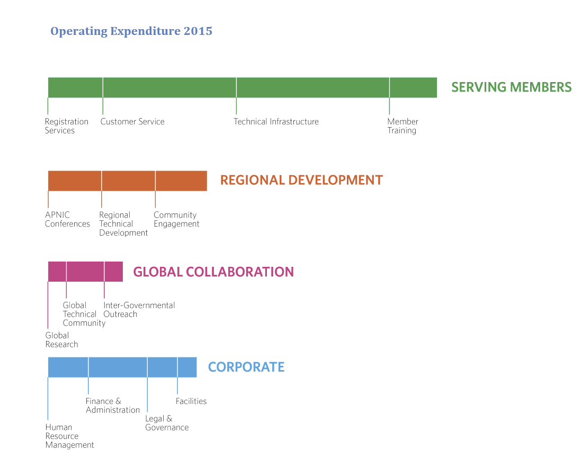
2015 Activity Plan & Budget

Slide 34
Finally…

Slide 35


You’re Invited!
apnic.net/meetings

Slide 36
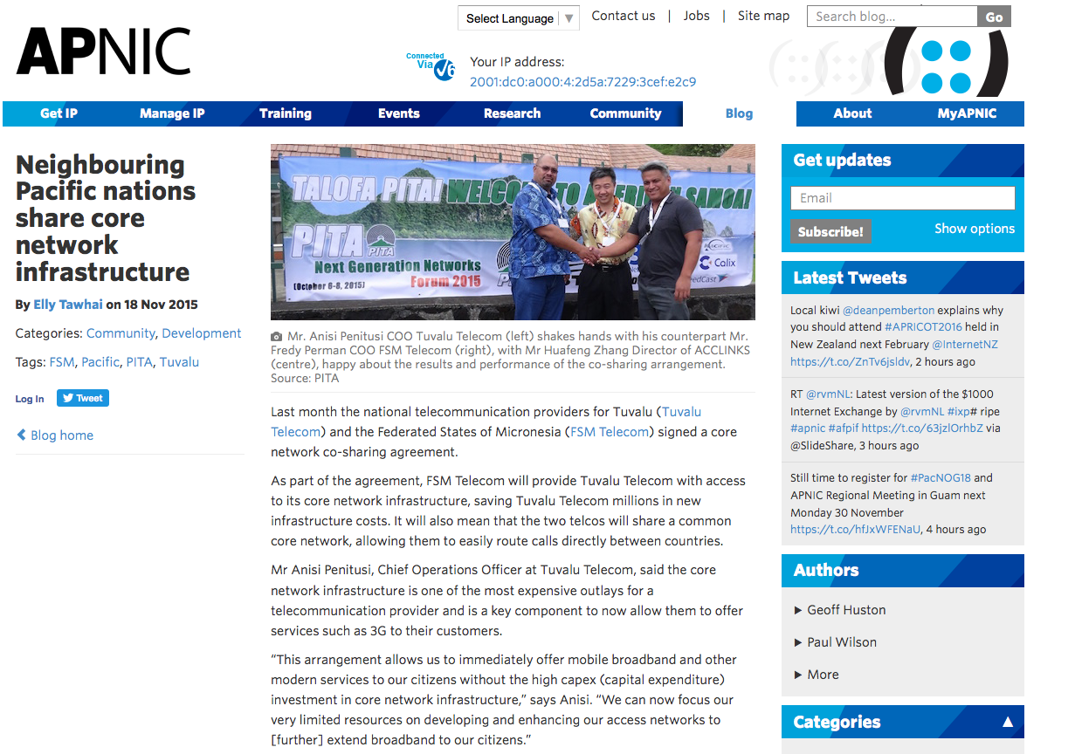

Join the Conversation
blog.apnic.net
apnic.net/social

Slide 37
Thank you

