Slide 1
APNIC IPv6 Deployment
Suva Fiji, July 2017
Arth Paulite

Slide 2
Overview
Deployment motivation
Network deployment
IPv6 Services deployment
IPv6 Anycast service
IPv6 cloud services
Lessons learned

Slide 3
Motivation for deployment
Promoting and supporting IPv6 deployment in the region
Providing critical DNS infrastructure
Providing public whois service for APNIC blocks

Slide 4
Global IPv6 allocation

Slide 5
IPv6 Reverse Delegations
Root
.
net
org
com
arpa
apnic
iana
apple
in-addr
ip6
202
203
0.4.2.ip6.arpa
64
22

Slide 6
Network Deployment

Slide 7
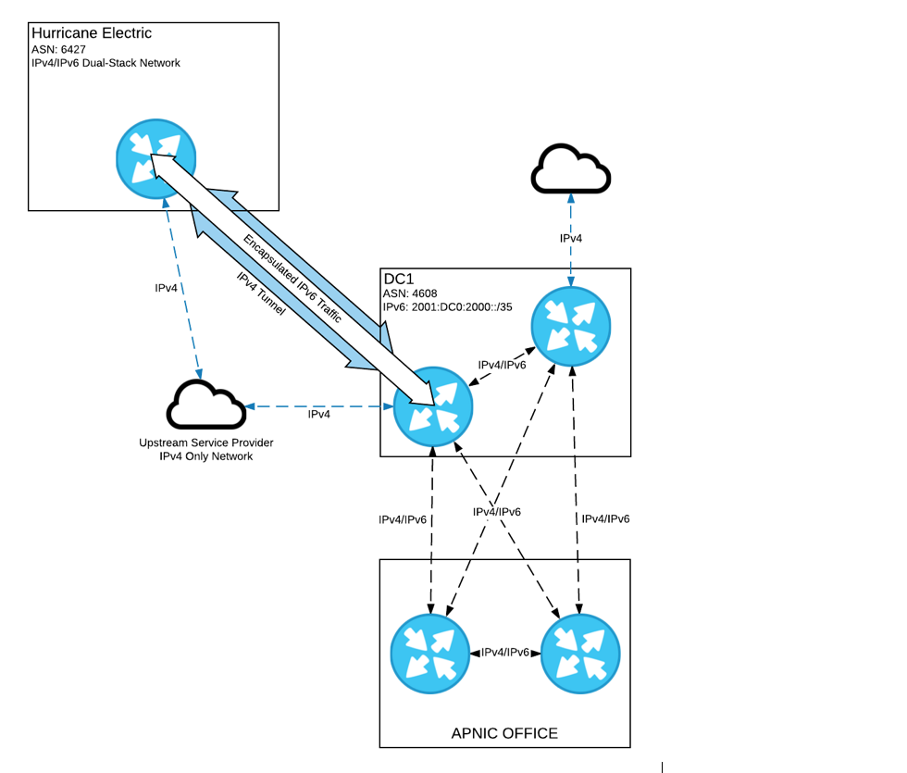
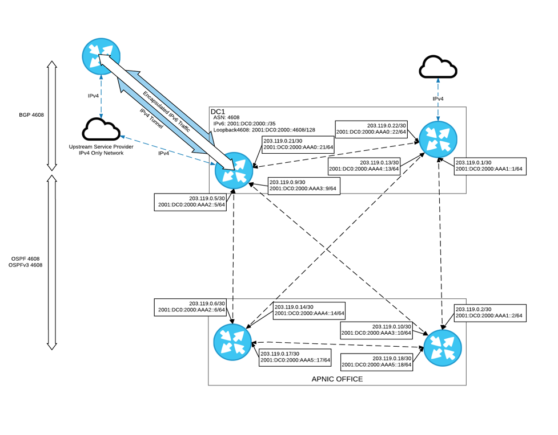
Deployment timeline
1
    Using the initial allocation:
    2001:DC0:2000::/35
    ( before 2003 )
    Use IPv4 tunnel for peering
    while no native IPv6 upstream
    available yet. (2003)
3
2
Deploy IPv6 in parallel with existing IPv4 network (dual stack)
    Best practice
    Use 1 x /48 subnet for staff workstations and mobile device.
    Use 1 x /64 for each network VLAN
    Use 1 x /64 for all loopback and point to point links

Slide 8
Deployment timeline
4
    Split 2001:DC0:2000::/35
    into /48s
Configuration of IPv6 upstream connection
Configured BGP peering with Hurricane Electric
Advertise 2001:DC0:2000::/35
Configure router VLAN 10 interface with /64 subnet.
6
5
Split 2001:DC0:2000:0000::/48 into /64s Used VLAN number as part of subnet:
VLAN 10 => 2001:DC0:2000:10::/64

Slide 9
Deployment timeline
9
Configured Bind caching/recursive DNS server
  Running bind on Redhat Linux
  Assigned static IPv6 on the network interface:
    2001:0DC0:2000:10::53/64
  Enabled Bind to listen on IPv6 address
  dig www.ripe.net @2001:0DC0:2000:10::53 to test
7
Configured cisco router interface
on VLAN 10 as RA
Used 2001:0DC0:2000:10::/64 for stateless auto-configuration
Connected workstations to VLAN 10 for testing
Verify IPv6 auto configuration works by looking at interface IP
Verify reachability: ping6, traceroute6
8

Slide 10
Subnetting (Example)
Original block:
2001:0DC0::/35
Rewrite as a /48 subnet:
2001:0DC0:0000::/48
First /48
Rewrite as /64 subnet
2001:0DC0:0000:0000::/64
First /64
How may /64 blocks are there in /48?
or

Slide 11
Subnetting (Example)
Start by manipulating the LSB of your network prefix – write in BITS
2001:0DC0:0000::/48
In bits
2001:0DC0:
0000 0000 0000 0000
::/48
2001:0DC0:0000::/48
2001:0DC0:
0000 0000 0000 0001
::/48
2001:0DC0:0001::/48
2001:0DC0:
0000 0000 0000 0010
::/48
2001:0DC0:0002::/48
2001:0DC0:
0000 0000 0000 0011
::/48
2001:0DC0:0003::/48
Then write back into hex digits

Slide 12
DNS Production deployment
Use 2001:DC0::/32
  2001:DC0:0000:/35 in Japan
    Secondary DNS servers
  2001:DC0:2000:/35 in Australia
    Secondary DNS servers, APNIC services – Web, Mail, etc.
  2001:DC0:4000:/35 in Hong Kong
    Secondary DNS servers

Slide 13
IPv6 Services deployment

Slide 14
IPv6 Services deployment
DNS Service
  DNS servers for APNIC.NET must be configured first.
    Setup the server static IPv6 address
    Configure to listen on IPv6 UDP and TCP port 53.
    Apply the same DNS ACL of IPv4 for IPv6 traffic.
  Adding AAAA resource records with 5 minutes TTL initially.
    ns1.apnic.net. 1H IN A 202.12.29.25
    ns1.apnic.net. 5M IN AAAA 2001:0DB8:11::25
    tinnie.apnic.net. 1H IN A 202.12.29.59
    tinnie.apnic.net. 5M IN AAAA 2001:0DB8:11::59
    ns3.apnic.net. 1H IN A 202.12.28.131
    ns3.apnic.net. 5M IN AAAA 2001:0DB8:21::131

Slide 15
Services deployment
DNS Service
  Update apnic.net GLUE record from domain registry.
      apnic.net. ns1.apnic.net.
      apnic.net. ns3.apnic.net.
      apnic.net. tinnie.apnic.net.
      ns1.apnic.net. 202.12.29.25
      ns1.apnic.net. 2001:0DB8:11::25
      ns3.apnic.net. 202.12.28.131
      ns3.apnic.net. 2001:0DB8:21::131
      tinnie.apnic.net. 202.12.29.59
      tinnie.apnic.net. 2001:0DB8:11::59

Slide 16
Services deployment
web service
  Update www.apnic.net host with IPv6 static IP address
  Update apache configuration to listen on IPv6 TCP 80, 443.
  Add AAAA record in DNS for www.apnic.net.
      www.apnic.net 1H IN A 203.119.102.244
      www.apnic.net 5M IN AAAA 2001:0DB8:13::244
FTP service
  Update ftp.apnic.net host with IPv6 static IP address
  Update FTP service to listen on IPv6 TCP port 21.
  Add AAAA record in DNS for ftp.apnic.net.
      ftp.apnic.net 1H IN A 202.12.29.205
      ftp.apnic.net 5M IN AAAA 2001:0DB8:11::205

Slide 17
Services deployment
Mail gateway
  Replaced Barracuda spam firewall with Halon
  Supports incoming and outgoing IPv6 SMTP session.
  Uses IPv6 as priority and failover to IPv4 if connection failed.
  Serve as internal IPv6 SMTP open relay.
  Clustering worked only in IPv4 until 2004
  Anti-spam, anti-virus definition updates via IPv4.
Mail store
  Used Courier IMAP to serve IPv6 mail client access.
  Migrated to Microsoft Exchange and works with IPv6.
  Uses IPv6 as priority and failover to IPv4 if connection failed.
Notes:
To verify

Slide 18
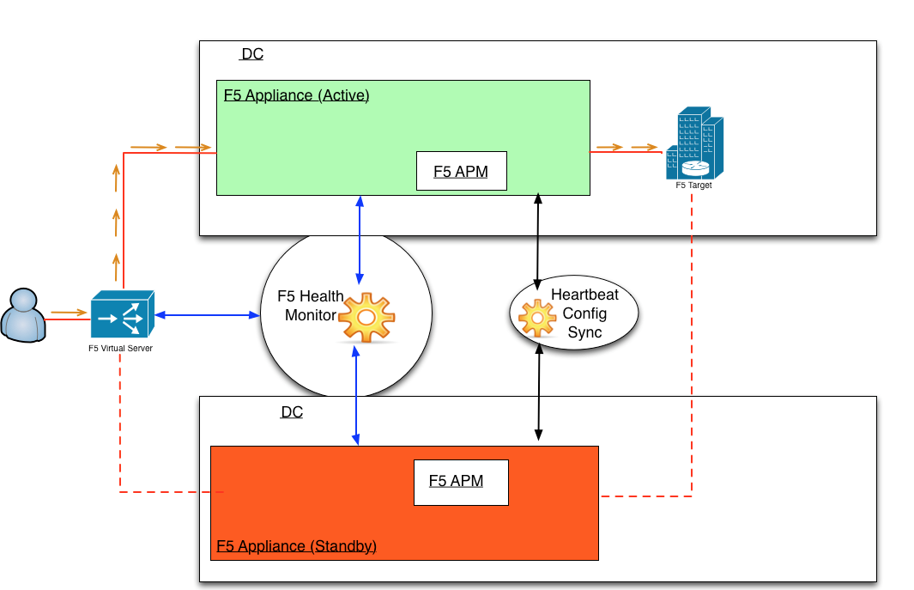
Services deployment
Load balancer
  Replaced Radware with F5 LTM
  Full support of IPv6 service load balancing.
  Allows IPv6 virtual server with IPv4 only backend server pool.
  Use for load balancing whois queries in both IPv4 and IPv6.

Slide 19
Services deployment
LAN and WIFI
  Using router for both LAN and WIFI IPv6 auto configuration
  Using redundant pair of IPv4 DCHP server and DNS resolver
  WIFI authentication uses Radius and LDAP over IPv6.

Slide 20
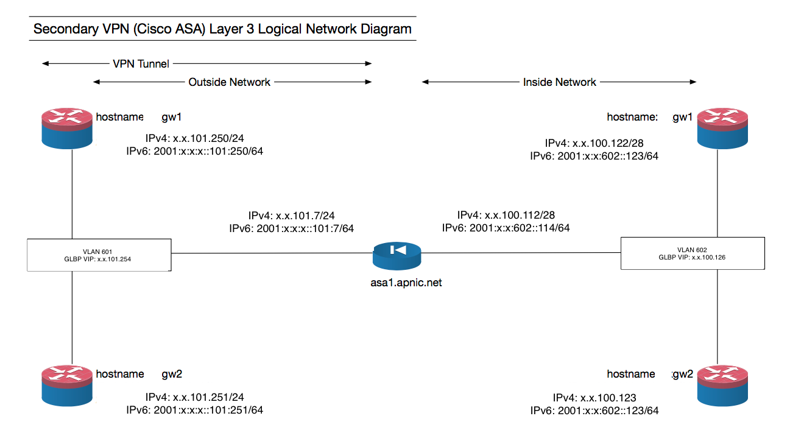
Services deployment
VPN
  Using SSL VPN, assigning IPv4 and IPv6 address
  Authentication uses Active Directory over IPv6.

Slide 21
IPv6 Anycast Services

Slide 22
IPv6 Anycast Service
e.in-addr-servers.arpa – Dual stack anycast DNS server
  Authoritative for in-addr.arpa reverse delegations.
    Example: 202.in-addr.arpa, 1.in-addr.arpa,
  Using the same IP: 203.119.86.101 & 2001:DD8:6::101/48
    Brisbane
    Hong Kong
    Tokyo

Slide 23
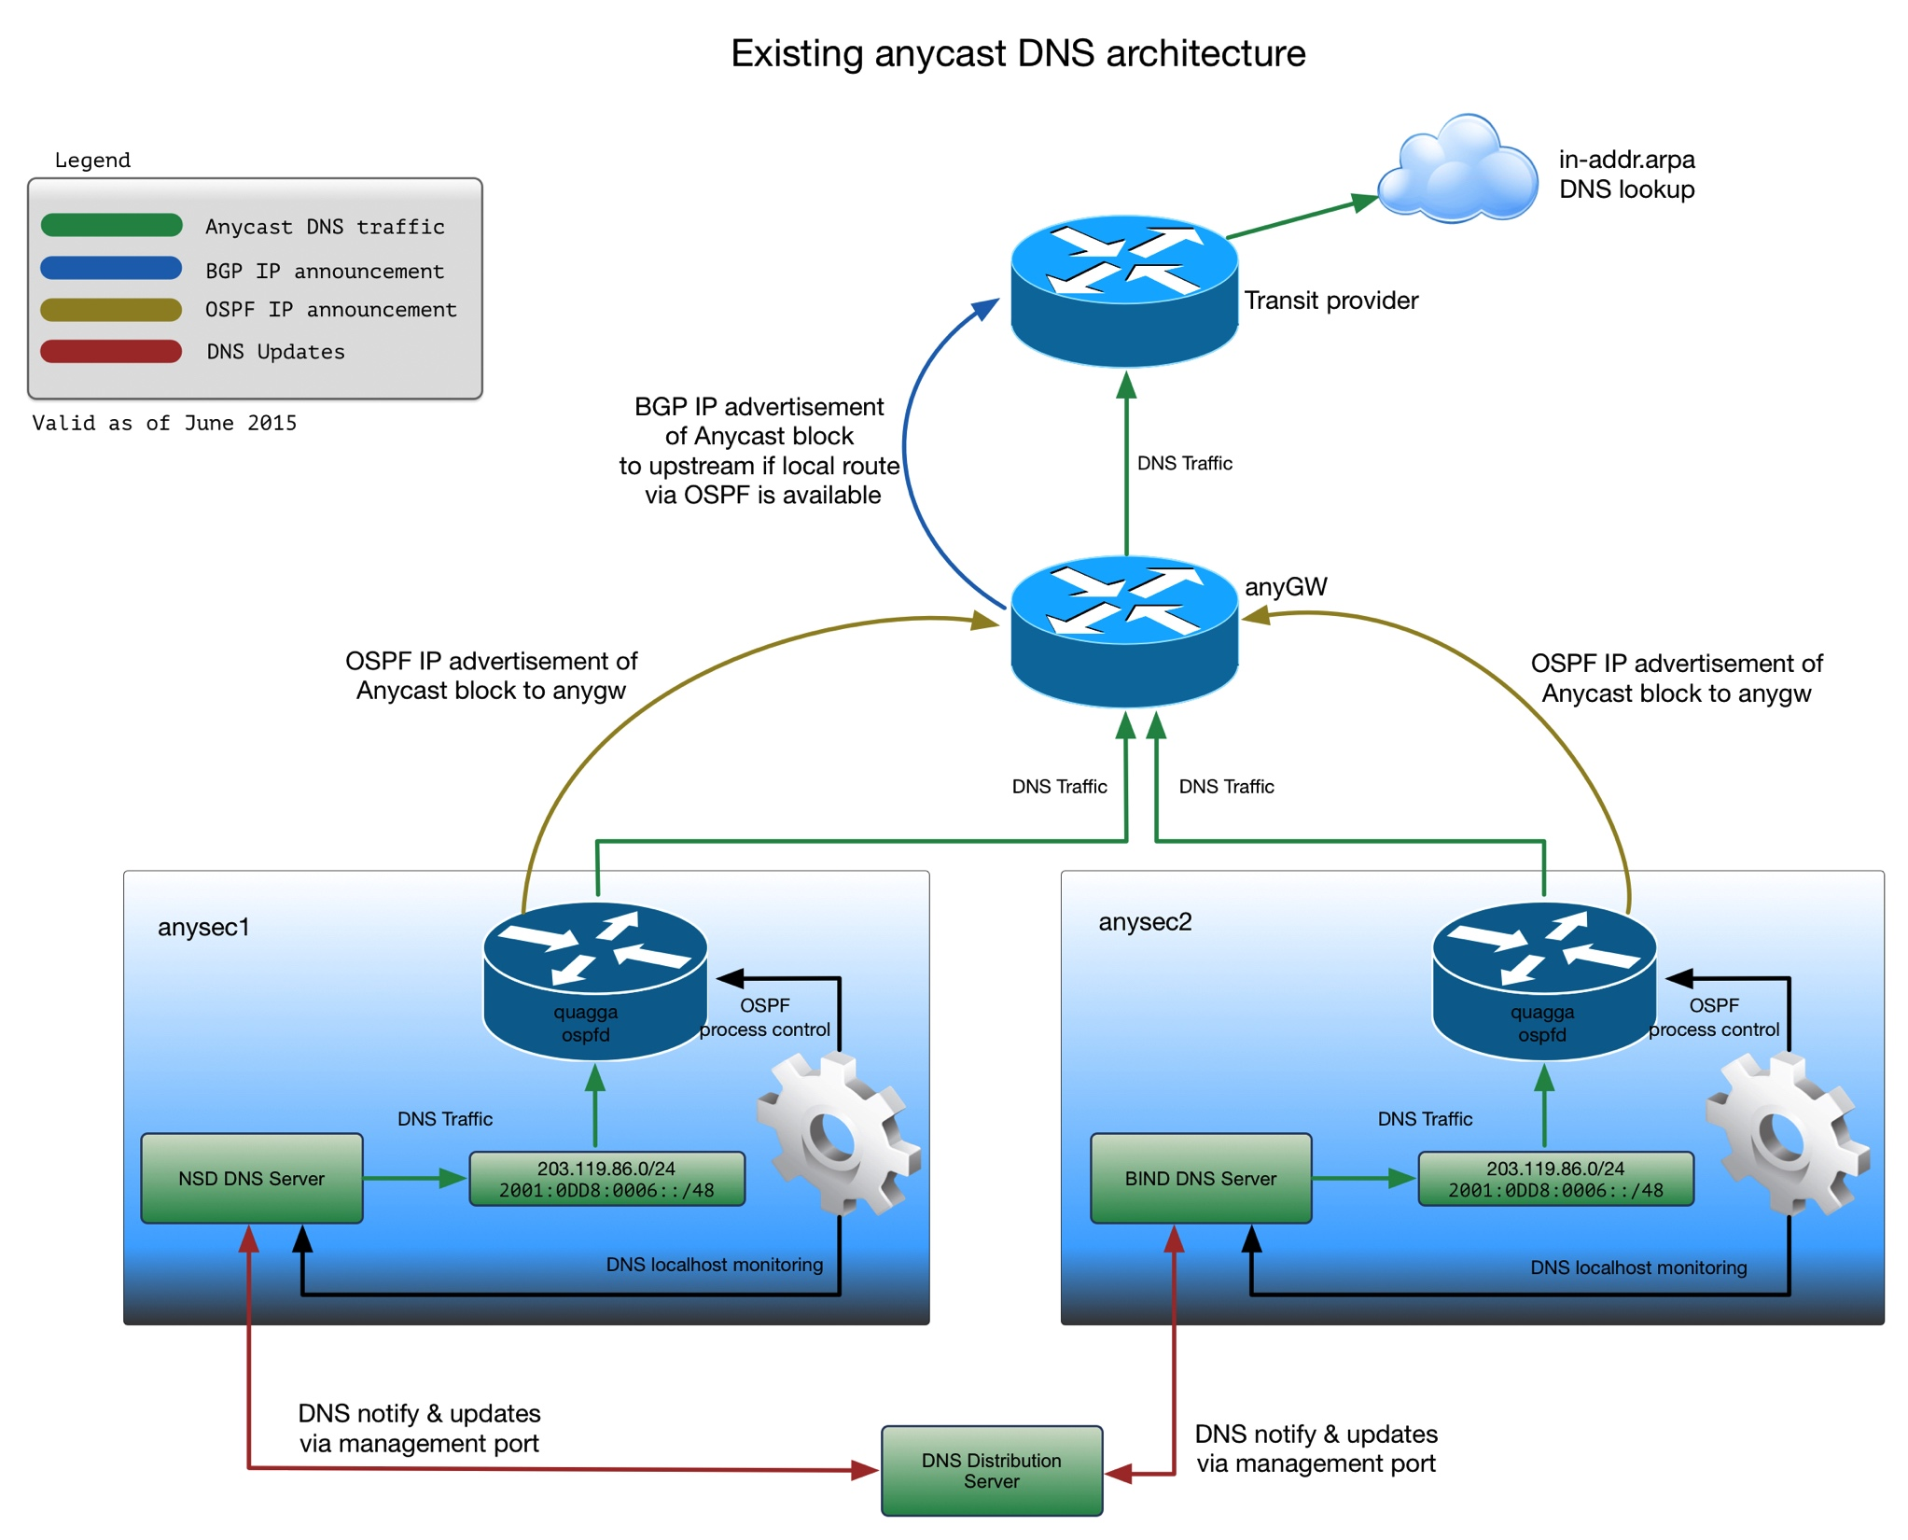
IPv6 Anycast Service

Slide 24
IPv6 Anycast Service
2017 – Additional anycast DNS servers
  Secondary DNS service for CCTLDs in developing countries.
  Anycast instance of APNIC NS servers
    Secondary DNS for APNIC block reverse delegations.
  Anycast instance for e.ip6-servers.arpa
    Secondary DNS for ip6.arpa delegations - IPv6 Registry blocks
  Anycast deployment: Australia, Singapore, Japan

Slide 25
IPv6 cloud
Services

Slide 26
IPv6 service in the Cloud
APNIC Regional whois service: whois.apnic.net
Multiple whois servers behind a load balancer per site
Site locations: Brisbane, Tokyo, London, Fremont US.
Load balancer provides dual stack whois access.
Load balancer and whois server uses IPv4 internally.
Uses the cloud provided IPv4 and IPv6 static IP address.
Uses Linux on provided cloud virtualization platform.

Slide 27
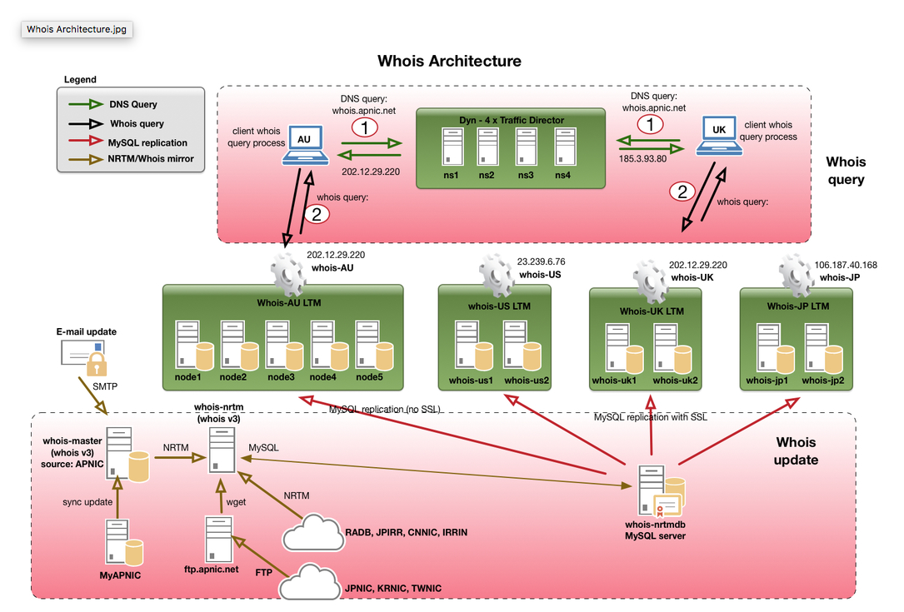
IPv6 service in the Cloud

Slide 28
Lessons Learned

Slide 29
Lessons learned
DNS
  Test the service before adding AAAA in DNS.
    IPv6 hosts will start connecting via IPv6.
  Use low TTL initially e.g. 5 min to easily roll back.
  Must have working reverse DNS for IPv6.
    Google not accepting mail if SMTP server has no reverse DNS.
  Set the outbound IPv6 address
    Configured ACLs normally knows static IP but not autoconfigure IP.

Slide 30
Lessons learned
Mail
  Make sure static IP is being use for outbound.
  IPv6 reverse DNS must be working or mail might bounce.
  Update SPF record if you have existing one for IPv4.
  Update firewall/ACL, the same for IPv4.

Slide 31
Lessons learned
Monitoring
  Review existing monitoring, behavior might have changed.
    Does it check for IPv6 or IPv4?
    Example: SSH check will start using IPv6 not both.
  Duplicating an existing check to work with IPv6
    Making sure critical services have separate check for both IPv4 and IPv6
  Monitoring host must be running on dual stack
  Customized, scripting to suit requirements.
  Monitor services from external network.
    Will give you idea if your IPv6 provider is stable and reliable.
    Allows monitoring of changes in firewall/ACLs rules.

Slide 32
Lessons learned
IPv6 service on cloud
  Cloud providers like Amazon AWS is now supporting IPv6, check location
    Can deploy dual stack virtual machine
    IPv6 load balancer is available
    IPv6 DNS based, geolocation traffic management is available
  Linode supports IPv6 in most locations.
    Can deploy dual stack virtual machine
    IPv6 load balancer is available
    No DNS based, geolocation traffic management
  Dyn DNS based, geolocation traffic management works
    Pricing is not transparent, rely on sales representative for pricing.
    Quite expensive

Slide 34










Stay in touch!
blog.apnic.net
apnic.net/social

