Slide 1
APNIC Update and future planned initiatives
Elly Tawhai
PacNOG 20 03-07-2017

Slide 2
Outline
Current IPv4 delegation practice
Why IPv6
APNIC Whois Database upgrade
Future initiatives

Slide 3
Current IPv4 Delegation Policy and Practice
APNIC: Maximum /22 from final /8 (103/8). Requests for /22 from recovered pool put onto waiting list
RIPE NCC: Maximum /22 from the final /8 pool for each member
ARIN: All requests put onto the waiting list
LACNIC: Maximum /22 for new Members only
AFRINIC: Reached final /8 April 2017. Minimum /24, maximum /13

Slide 4
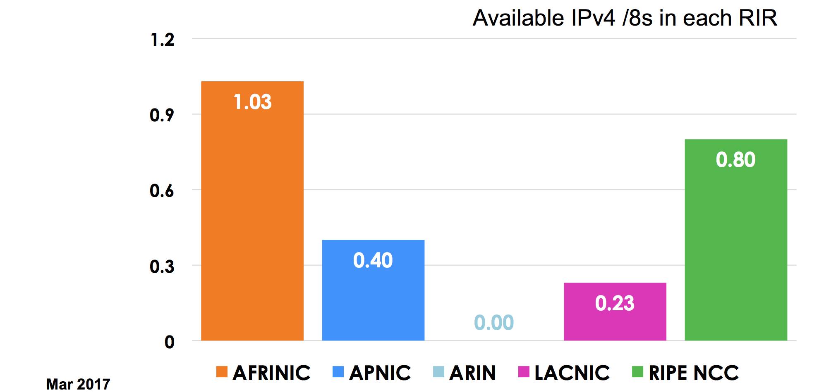
Continued global depletion

Slide 5
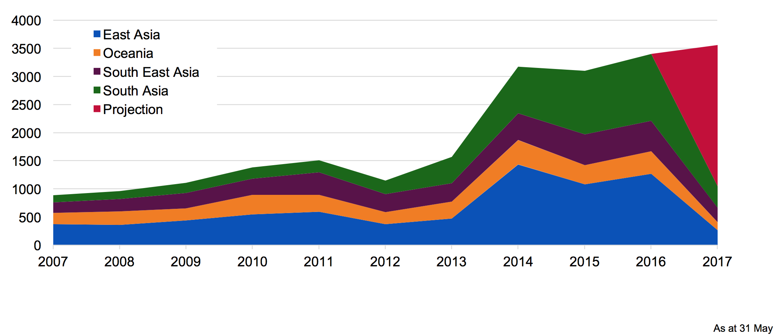
Annual IPv4 Delegations
Notes:
The demand for IPv4 hasn’t gone away, and based on current consumption trends I believe APNIC Labs has predicted the remaining IPv4 space will be depleted in around 3-4 years time
----
Delegations so far for 2017 - 824
Marked increase in IPv4 requests from 2014 as a result of the availability of address space from the recovered pool. After four months of 2016, the level of delegations is at a similar rate to 2015.
Majority of the v4 delegations are /22s, which is the maximum allowed by the policy. So far in 2016, APNIC has made 2,618 IPv4 delegations, the majority to East Asia.
In Q1 (103/8) 594 delegations; Q2 1165; Q3 550
In Q1 (recycled space) 132 delegations; Q2 306; Q3 49
Unsurprisingly, the majority of the v4 delegations are /22s, which is the maximum allowed by the policy. So far in 2016, APNIC has made 2,618 IPv4 delegations, the majority to East Asia.

Slide 6
68% of APNIC Members have received IPv4 from 103/8
Currently only 37% of 103/8 is available

Slide 7
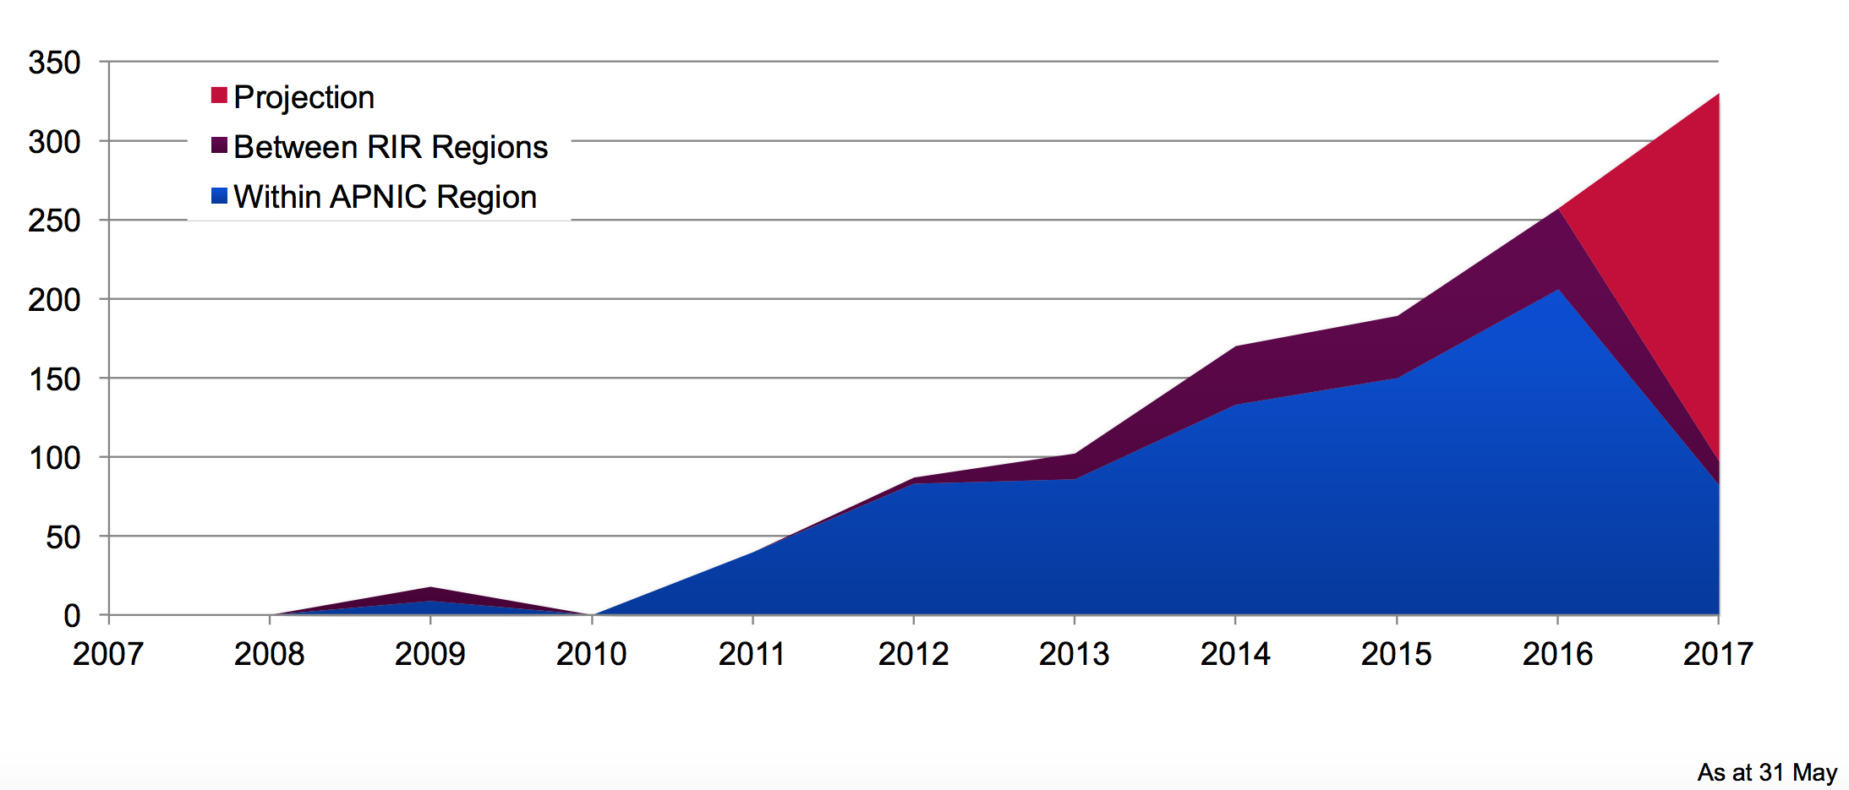
Annual IPv4 Transfers
As at 31 Dcember
Notes:
Given the scarcity of IPv4, it’s no surprise that IPv4 transfers remain frequent
Most transfers are still within the APNIC region but the number of Inter-RIR transfers is growing
Another way to source address space
9 registered brokers listed on the APNIC website.
APNIC, ARIN and RIPE NCC implemented inter RIR IPv4 transfer policy
LACNIC and AFRINIC have no inter-RIR transfer policy
Time required for transfers: minimum two days

Slide 8
Why IPv6?
IPv4 address supply is exhausted
  New networks require addresses
  Stop-gap measures are damaging (NAT)
The Internet is growing fast
  Broadband: mobile and wifi
  “Internet of Things”
IPv6 is the only viable option we have now
  Much larger address space than IPv4
Notes:
IPv6 is the only viable option we have now
Enable sustainable growth of the Internet
Support the emergence of new technologies

Slide 9
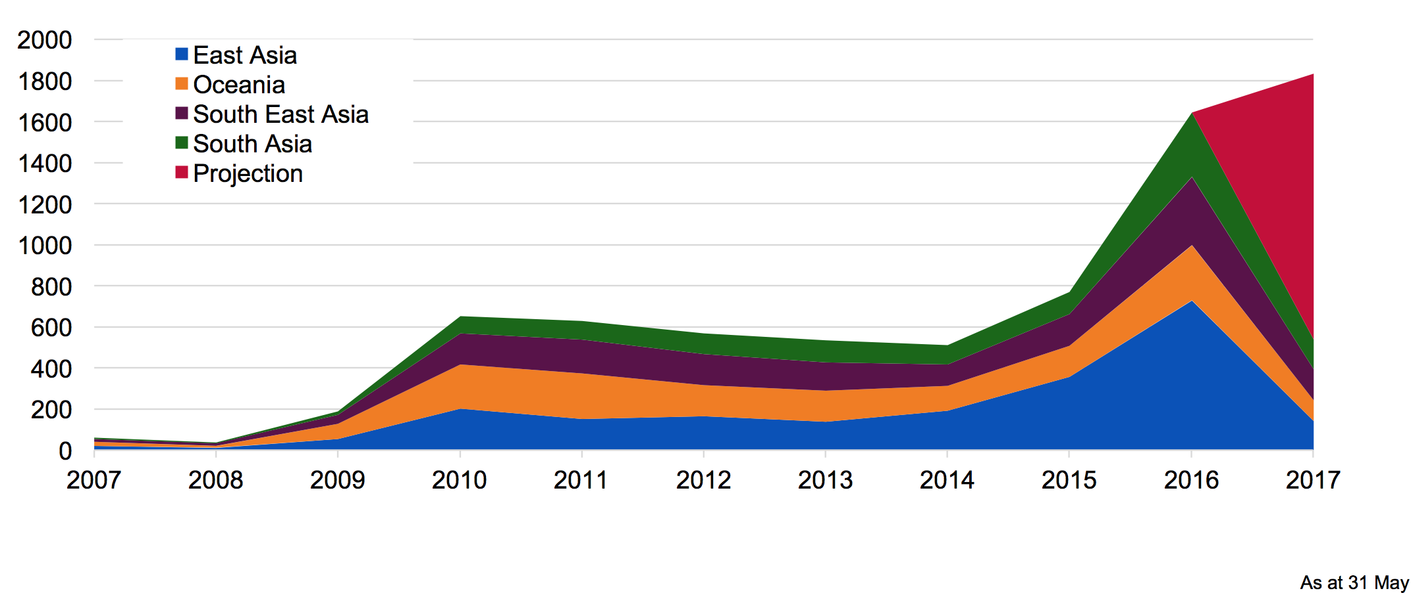
Annual IPv6 Delegations
Notes:
Total delegations so far in 2017 – 430; consistent with delegations in 2016
The majority of delegations have been a /32 (71%) which is the default allocation size for providers, followed by /48s which is the default assignment size for end-sites. Most came from normal allocations, instead of one-click.
In Q1 – 228 delegations; Q2 421 delegations; Q3 201
The majority of delegations have been a /32 (71%) which is the default allocation size for providers, followed by /48s which is the default assignment size for end-sites. Most came from normal allocations, instead of one-click.

Slide 10
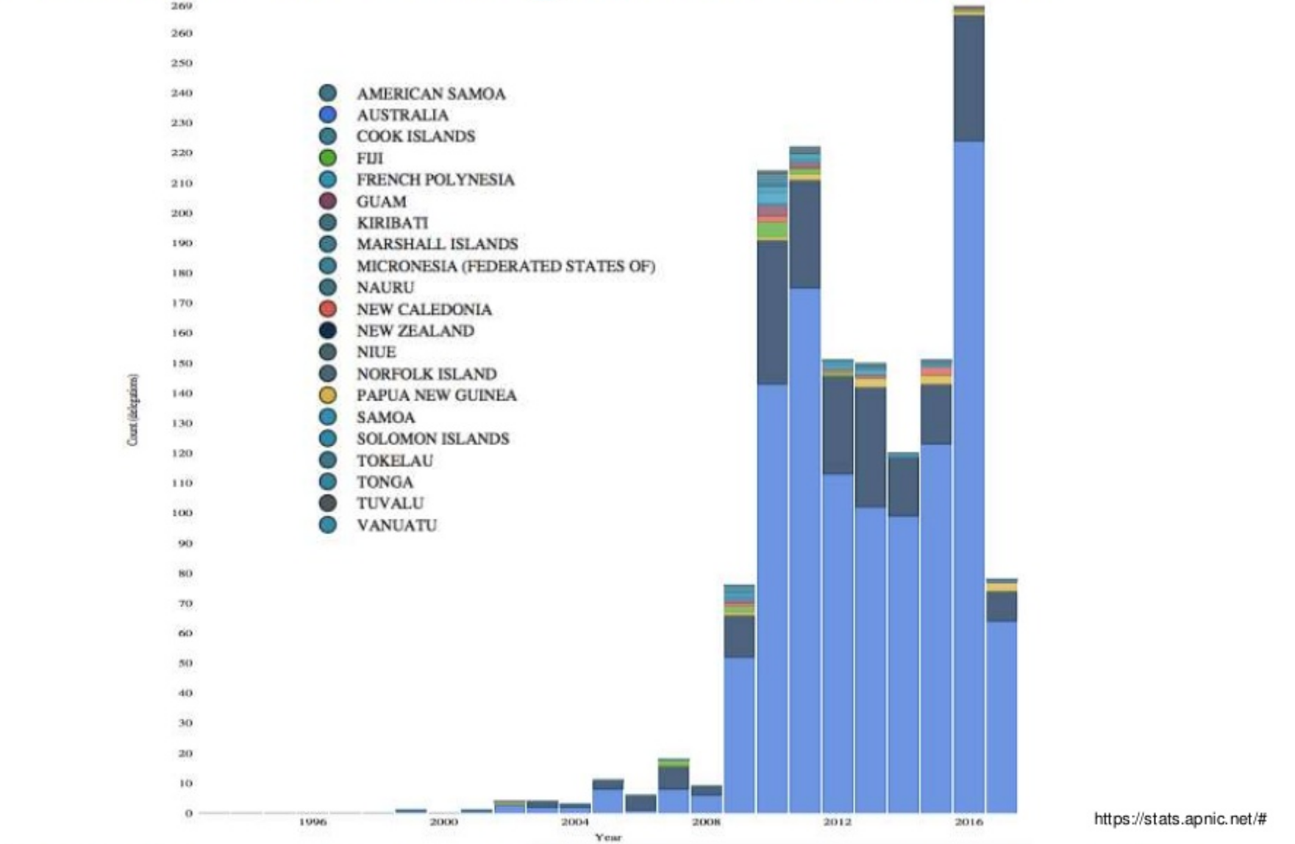
APNIC IPv6 Delegation Oceania
Notes:
269

Slide 11
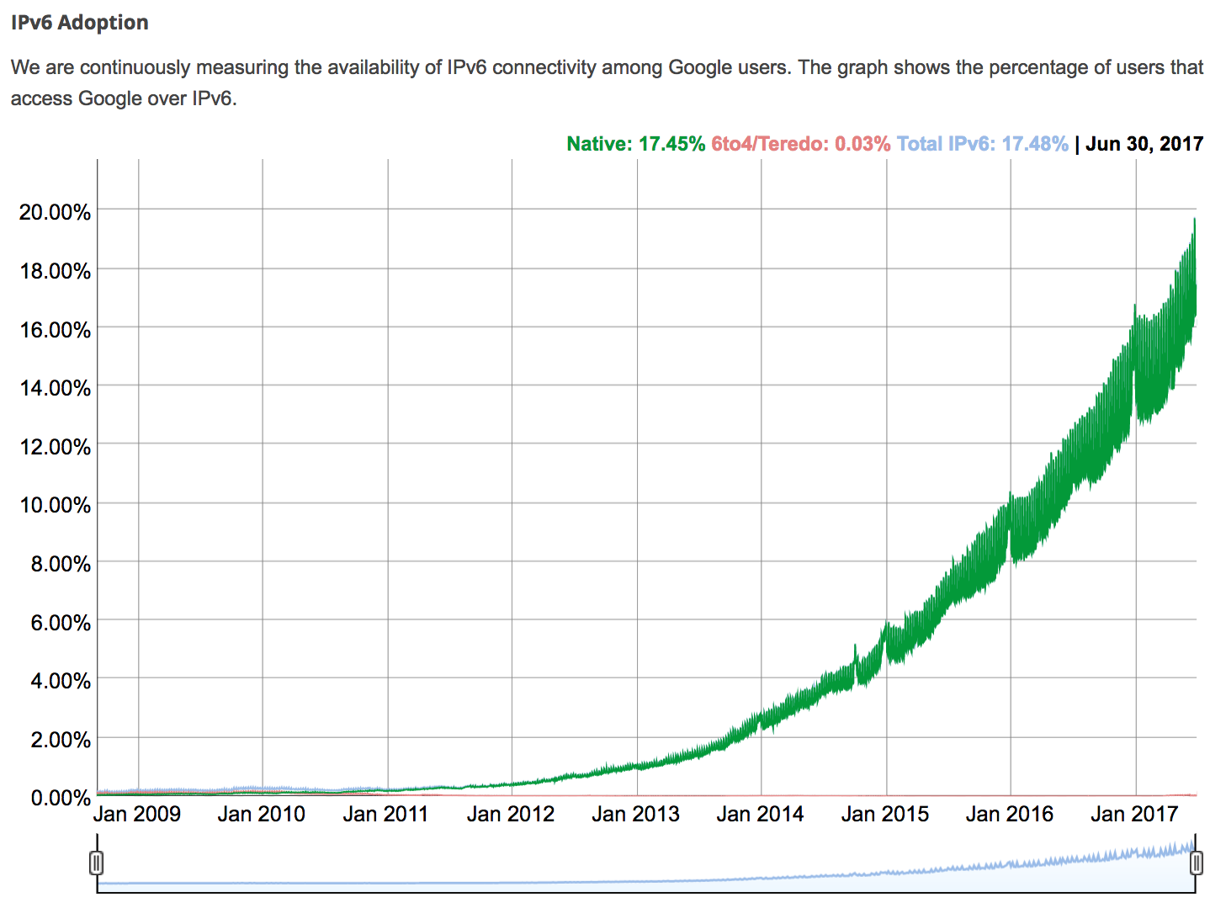
IPv6 adoption statistics by Google
Notes:
Measuring IPv6 connectivity among Google - 17.48% access Google over IPv6

Slide 12
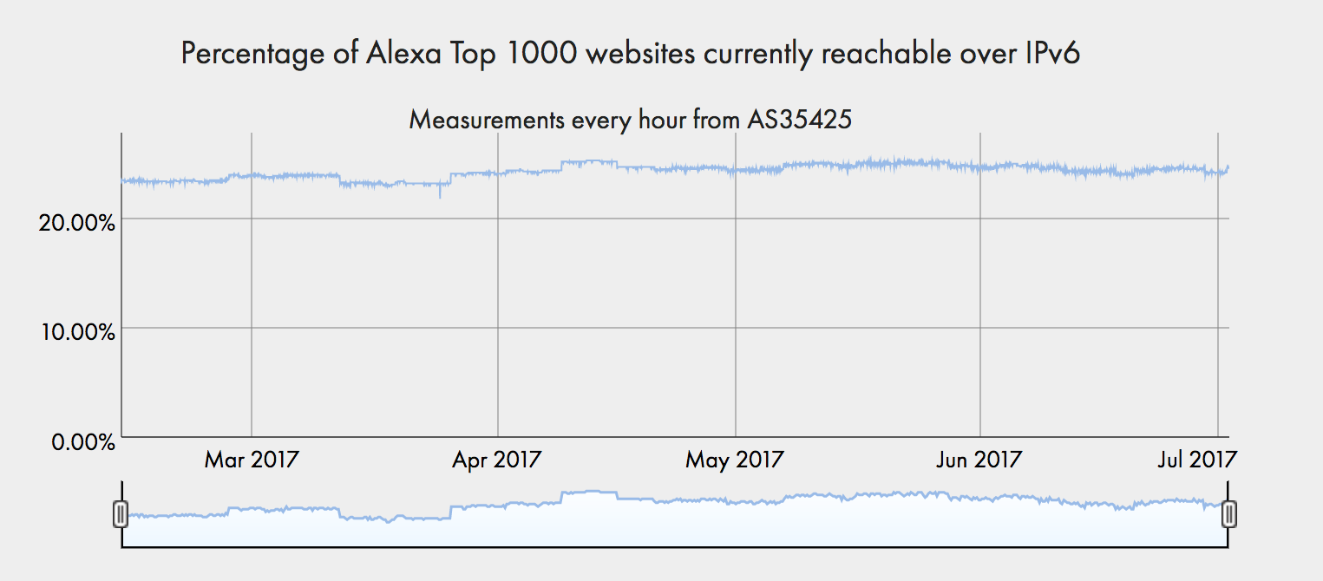
Top 1000 websites IPv6
Notes:
24% of the world top 1000 websites reachable via IPv6

Slide 13
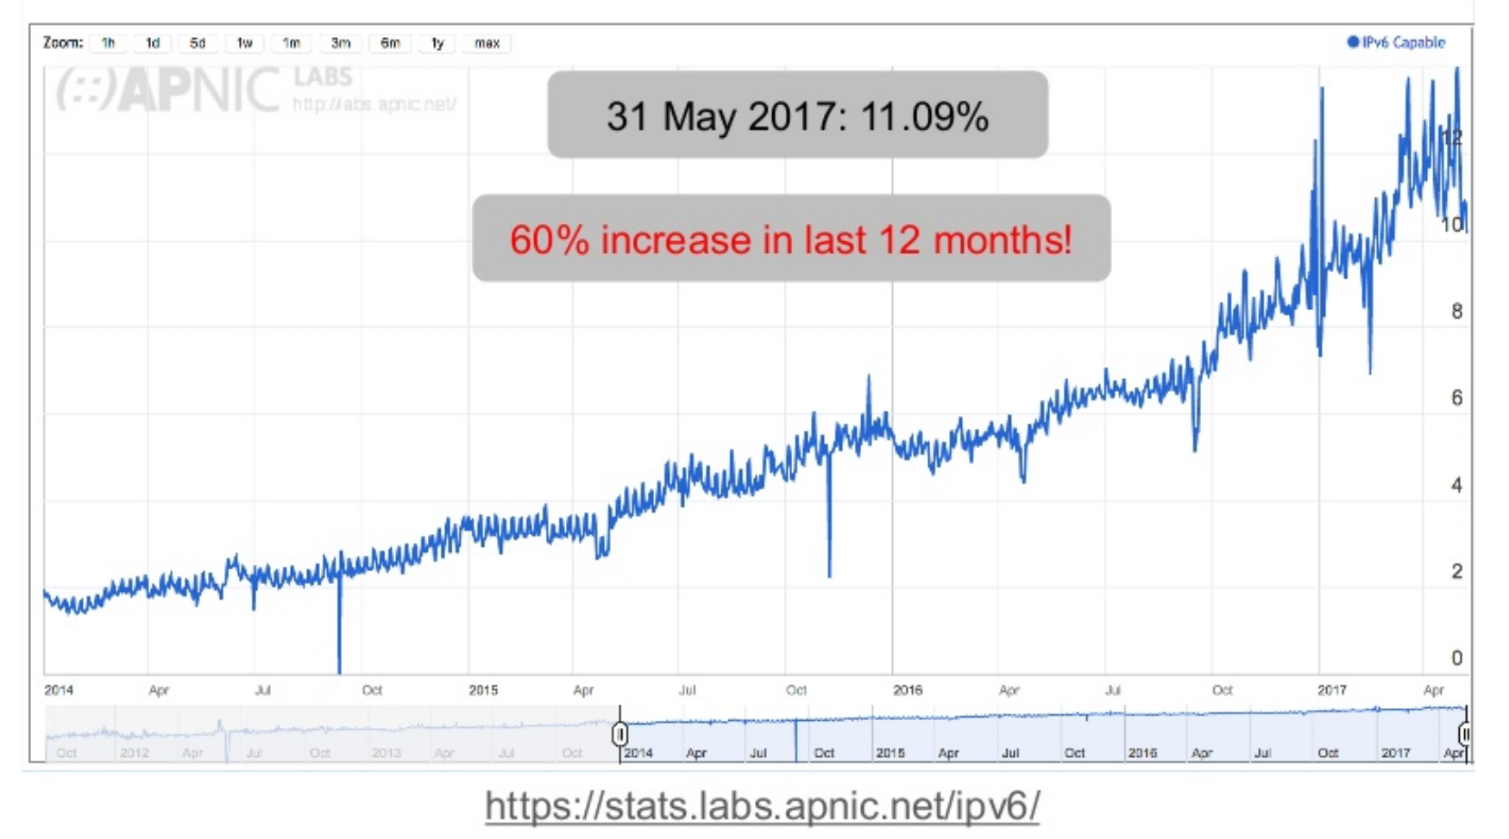
End user readiness: APNIC Labs
Notes:
APNIC Labs IPv6 measurement: 60% increase in end users with
https://stats.labs.apnic.net/ipv6/
IPv6 in last 12 months

Slide 14
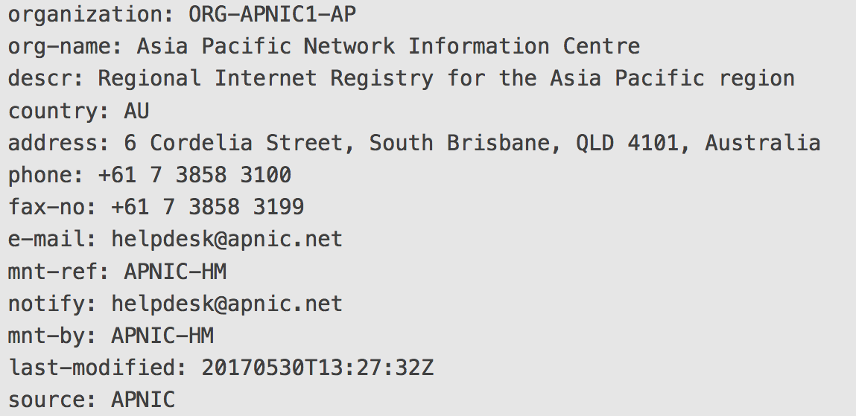
New object - Organization object
Notes:
Provides information about an organization that has been delegated resources within the whois database.

Slide 15
Purpose of Organization object
Links all resources associated with an Organization
  Quicker to filter information
  Contains business information only
Provides clarity
  Resource custodianship VS resource usage
  https://www.apnic.net/get-ip/faqs/organization-object
15
Notes:
This object will hold the business name/contact information and location etc. Its purpose is to map all resources to an organization and vice versa. Every other object can reference this.
Organisation objects to be inserted within inetnum, inet6num, and aut-num objects at the same time

Slide 16
What’s next for you
First phase of Whois upgrade completed 28 June 2017
Organization object email week commencing 10 July
Check your company information
Update info via MyAPNIC if needed
16
Notes:
Four weeks from now, the information below will be used to create your organization object. As an account holder, we need you to review the information.
[Insert generated Organization object template for that member]
If any information is incorrect or missing, please update it using the link below by <date>.
[Insert the link to make change for that member]
Alternatively, you can simply reply to this email with the correct information.
A script will generate the text for the organisation object for a member – Org object implementation in June
The script (or a hostmaster) will then email the member (via RT) asking the member to confirm or update the information in the organisation object.
Upon receipt of a member response confirming their organisation object details, or after a predefined waiting period, a hostmaster will enter the information in ARMS and create the organisation object in whois.
When an organisation object is first created:
All whois objects related to resources held by a member (eg, parent and children blocks) will be set with a reference to the new organisation object.
All supporting objects will also be set with a reference to the new organisation object. This list of objects is:
The members primary maintainer, irt, and role object created for each member.

Slide 17
Capacity Building in the Pacific – Cyber Security
Many economies are building or strengthening their cyber security initiatives
Many areas:
  Governance – Strategy
  Awareness - for end-users & organisations
  Incident Handing & Response
APNIC plans to increase support for capacity development in the region
  Empowering resources to support those local initiatives (i.e. setting up CSIRT)
  Working with partners including APCERT members, FIRST.org
17
Notes:
Talking Points
+ We have been hearing a lot about cyber security in the region. A lot of work around national strategy, increasing awareness & seting up CERTs
+ APNIC is _increasing_ security capacity building acvtivities in the next few years. In addition to the current support for training (v6, security etc)
More of introduction, we know that many economies in the region is looking at improving security. And from different angles – Strategy/Governance, Awareness (both technical and for end-users). And APNIC is planning to increase support for security related activities in the region so that the implementation of those initiatives can be successful

Slide 18
Capacity Building in the Pacific – Cyber Security
Planned Activities
  Multi-stakeholder seminar
  Regional Training activities
  Mentoring / Discussion Forum with experts & specialists
  Participate in regional security events & communities
We need your support
  Participate in training activities
  Help with organizing activities
  Amplify the message
Contact – Elly or Adli for more information
18
Notes:
This program will be a bit unique:
+ it is not a one off event, we would like to engage with those who are passionate over a period of time
This is more of a teaser of how we plan to do this (so not just training). Many activities, multi-stakeholder seminars, technical training, mentoring etc. Then we do a call for help – we are at the planning stage, so we need to identify folks to be part of this as well as plan for the activities (so need hosts etc). The last bit was who to contact to get more information (not sure if this is really required since you are there but in case people want to email later or if they read the slides online)

Slide 19

Your all invited!
Register now!
conference.apnic.net/44
Notes:
7 - 14 September
Fellowship applications close - Friday, 07 July 2017
Early bird ends 4 August
Free attendance to the conference for 4 APNIC Members and 2 TWNIC members
Other discounts apply to students and those from least developing economies

Slide 20
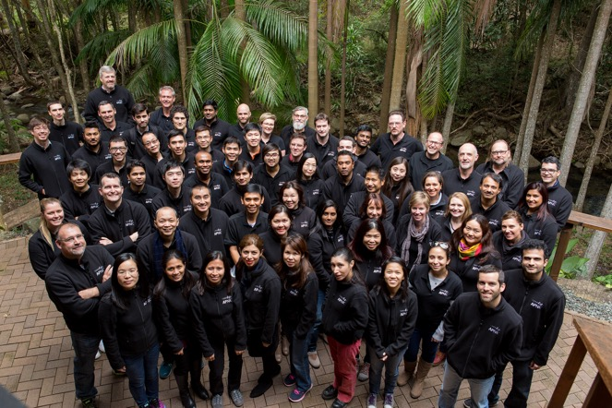
Thanks!
Notes:
Thanks very much for your time and attention!

