Slide 1


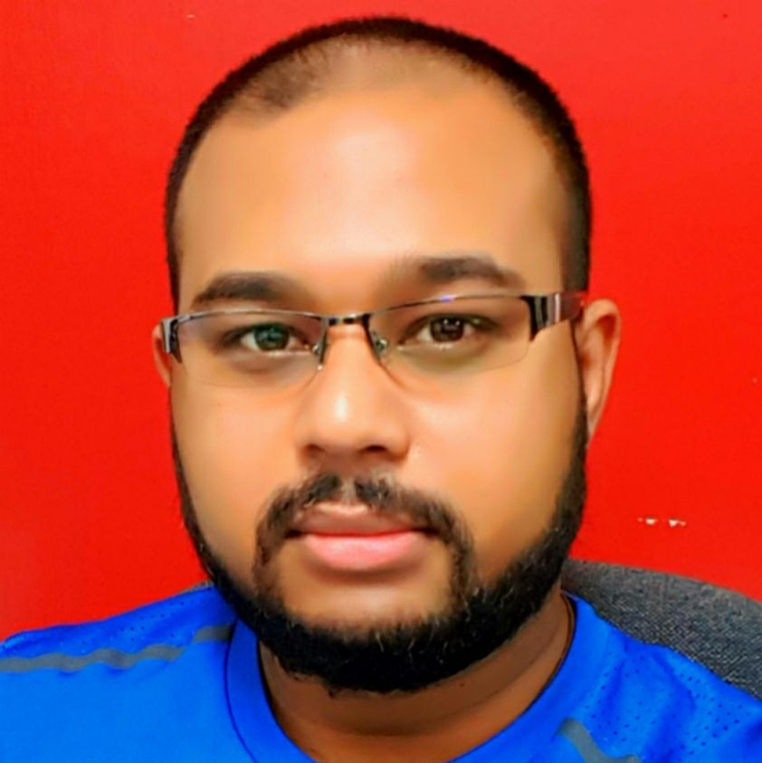

Accessing International Educational Network
Sanjay Singh
Acting Manager ICT Infrastructure
Division of ICT
3 JuLY 2017

Slide 2
Objective
Changing Needs of the Educational Sector
Current WAN Setup
Current Internet Setup
The AARNET Setup
Desired Distribution Case

Slide 3
Changing needs of the educational sector
Traditional – Books – 1 Way flow of knowledge
Age of Information – Encyclopedias, Local Shared Digital Contents – DVD, LAN hosted materials
Modern Learning and Teaching Concept – Access to Quality Research Materials – Journals – Videos, Digital Collaborative Tools
Internet for Education – Not for Profit

Slide 4



Current Scenario WAN
LABASA CAMPUS
5M LEASED LINE
ROSAWA CAMPUS
6M LEASED LINE
SAMABULA
KORONIVIA
FARM- VPN
SMB HOSTEL RTR
SMB HOSTEL ASDL
REWA ST ASDL
NASINU
NATABUA
NASINU CORPORATE
BAYVIEW
HOODLESS
PACIFIKA
NARERE
DR – SITE
NAVITI
KORONIVIA
ISP
MPLS
NURSING
MARITIME NADI
CMNHS - LAUTOKA
TOTAL BANDWIDTH
CURRENT: 293 M
TOTAL CONNECTION
30
FMA MARITIME
NABUA
MARINE DR LTK
EMBA CENTER
NACEVA
TAMAVUA
NAMAKA
BA
NASESE
NAVUA
SIGATOKA

Slide 5



Current iNTERNET
LABASA CAMPUS
NASINU SERVER ROOM
HOODLESS
NASINU CORPORATE
DR – SITE
NATABUA
KORONIVIA
SAMABULA
TFL INTERNET
FMA MARITIME
TOTAL BANDWIDTH
TOTAL: 192 Mbps
16 Total Connections
NURSING
NAMAKA
EMBA CENTER
TAMAVUA

Slide 6
Going AARNET
AARNet (Australian Academic and Research Network) provides Internet services to the Australian education and research communities and their research partners.
AARNet is widely regarded as the founder of the Internet in Australia and renowned as the architect, builder and operator of world-class high speed low latency network infrastructure for research and education.
AARNet Pty Ltd, which owns and operates the AARNet, is a not-for-profit company

Slide 7
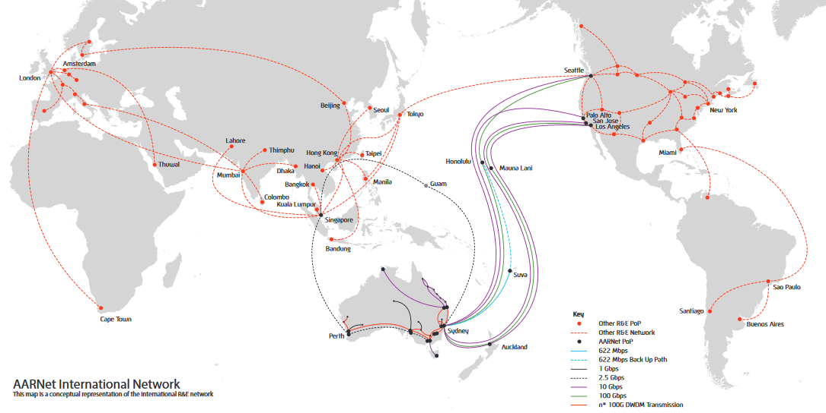

Slide 8

THE AARNET
FINTEL SITE
ISP’s SITE
AARNET
ISP SWITCH
ISP Switch
SOUTHERN CROSS
FIBER
FIBER
FIBER
FNU
Sites
Distribution By ISP
FNU’s Switch
ISP Switch
ISP Switch
FIBER
FNU’s Cloud Hosted Infrastructure
At ISP’s site
FNU
Sites
ISP Switch
FIBER
FIBER
FNU’s Firewalls
FNU
Sites
ISP Switch

Slide 9
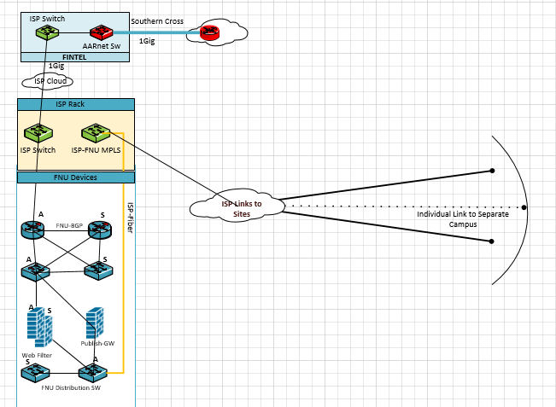
AARNET Distribution

Slide 10



Stakeholder Involvement
Division of ICT of FNU invites any interested party to review the design and provide feedback.
Aim
Flexible Design
Scalable
Cost Effective

Slide 11

Thank You

