Slide 1
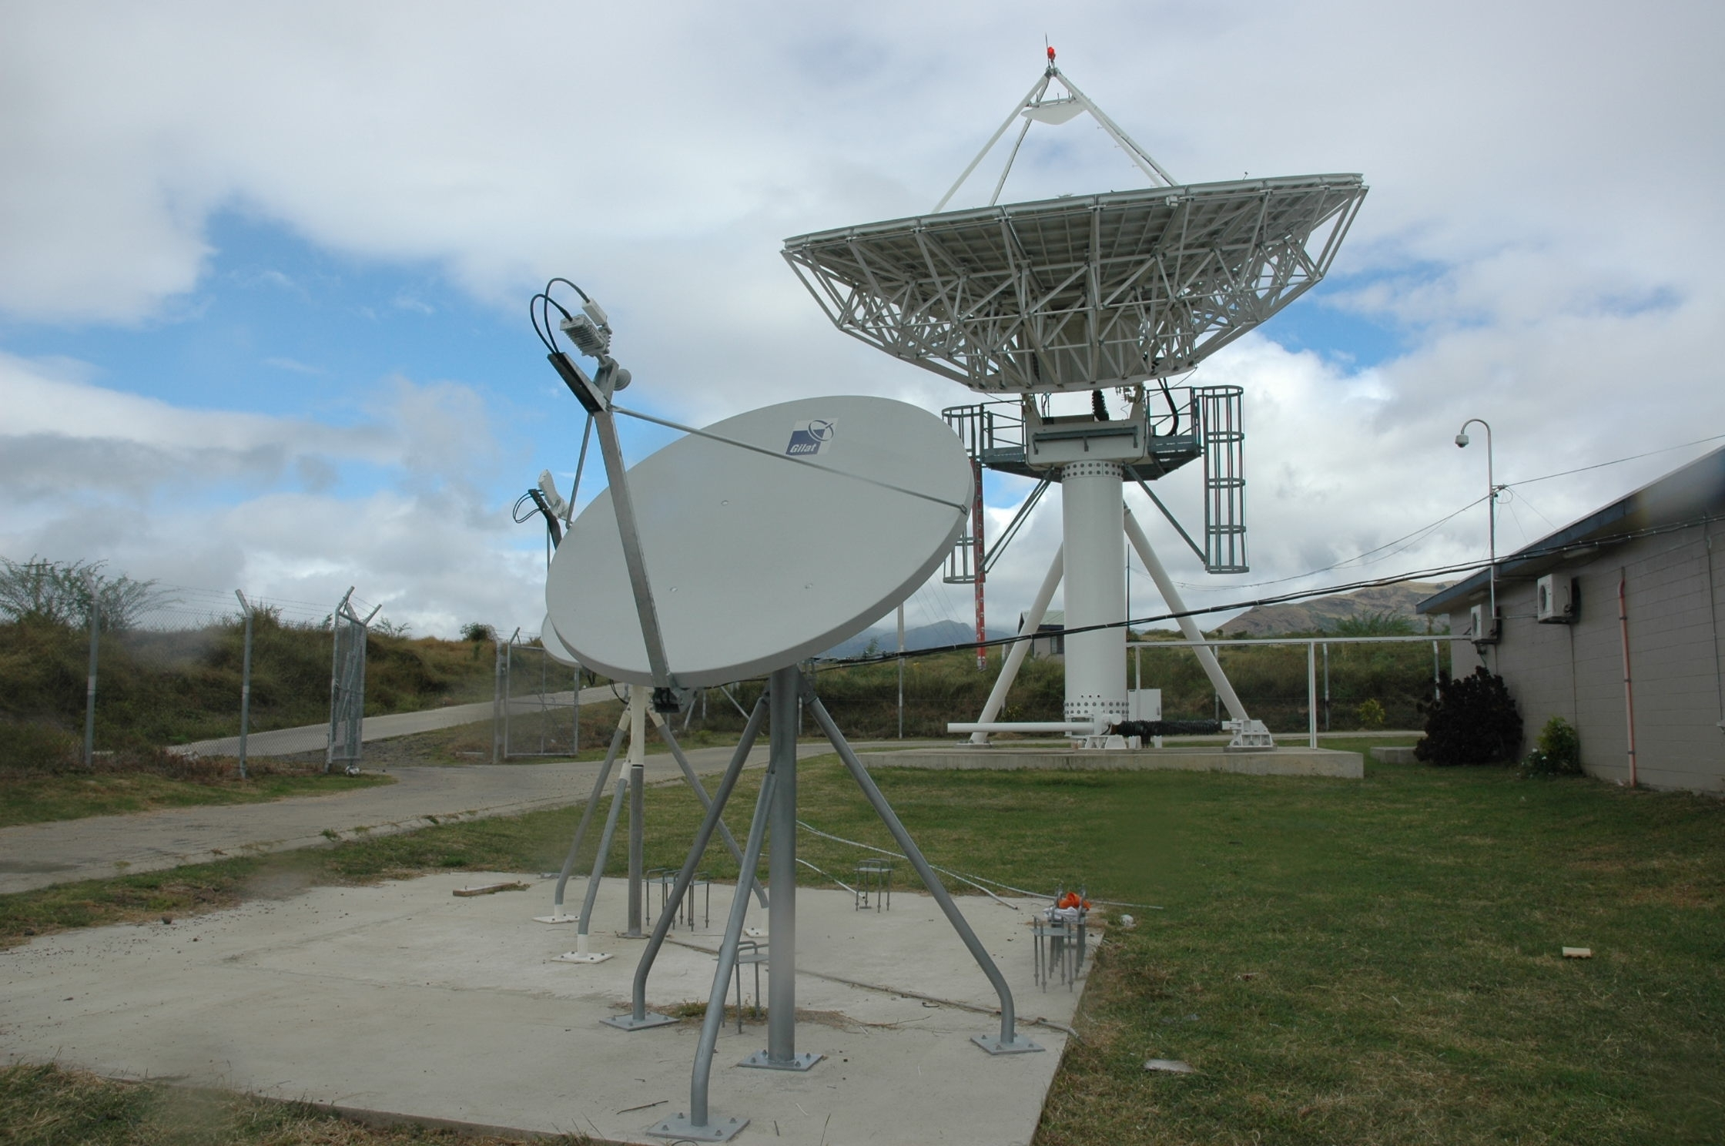

TFL’s Transformation of
VSAT Network
TANOA PLAZA – SUVA
3rd JULY, 2017
BY: PRIT CHAND
Act. MANAGER NETWORK PLANNING
Email: prit.chand@tfl.com.fj

Slide 2
Yaqara Earth Station
Built in 2004 as part of $40M Satellite Project
As Replacement for HF & VHF RT Services and introduce automated voice and internet services
Hub is managed by 2 full-time staff based at the Earth Station and supported by 4 other staff nationally
Complete (manual) provisioning, management and control of the VSAT’s
Primarily offering voice, fax and Data services to remote and maritime areas of Fiji
11.2m Dish with fully automated pointing and Antenna Control Unit

Slide 3
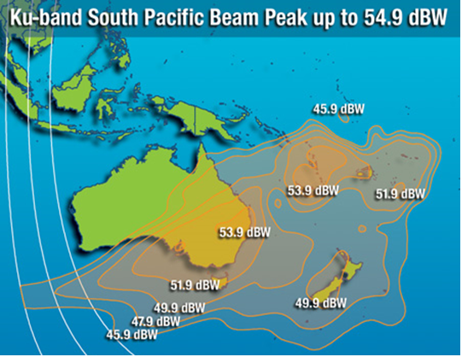
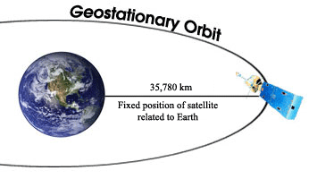
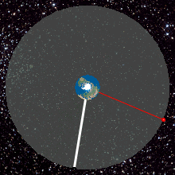
Satellite Network Coverage – Ku Band IS-18
Satellite Bandwidth Provider: Intelsat
Geostationary Satellite 35786m above earth
Leased bandwidth: 15.2MHz on Ku Band
Fully covers Fiji including Rotuma & PI Nations
Covers other Pacific nations such as Vanuatu, Tonga, New Caledonia, NZ, Aust etc.

Slide 4
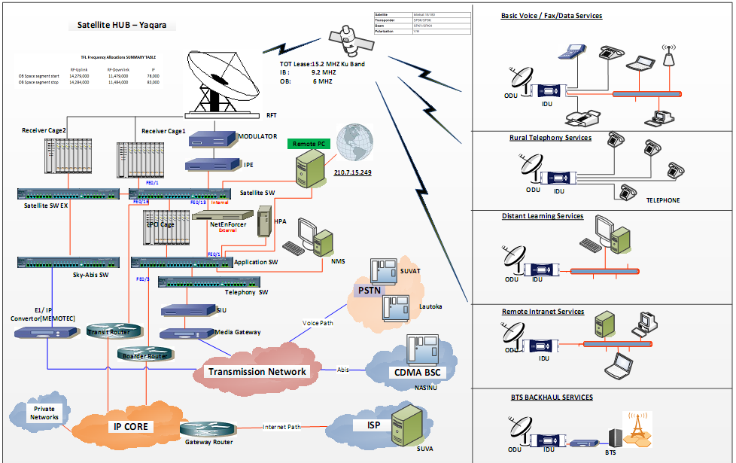
Network Topology (SkyEdge I)

Slide 5
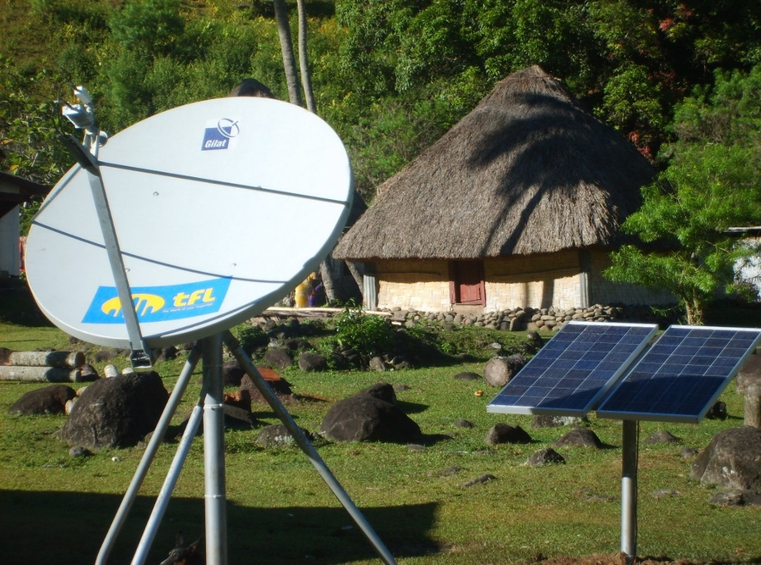
VSAT Remote Setup - SEI
  Remote Setup consists of the following:
  Either AC or DC powered
      Sealed Batteries
      Solar Panels
      Solar Controllers
  Out Door Unit (ODU)
      1.8m Dish
      RF Unit (BUC, LNB, Horn etc.)
      RF Cables
  In Door Unit
      Supports 4 lines/card
      Maximum of 12 voice lines and 1 Data port
  Terminals
      Phones
      Fax Machines
      PC, Laptop, AP’s etc.

Slide 6
The Transformation Journey
TFL started this journey mid 2016 in response to sun setting of legacy VSAT network which was commissioned in 2004 and could support maximum bandwidth of 512kbps.
This technology was sufficient for that era but no longer relevant in this day and age
Support, EOS and maintaining spares was a challenge as well as serving growing needs of customers
We began with RFP from known suppliers and evaluation followed shortly; particular focus on carrier grade solution, coverage, scalability, reliability, end-to-end visibility and fully IP managed service (Bandwidth, Hub, RFT and terminal), security, automated provisioning and cost of RF bandwidth.
TFL chose Gilat Satellite Networks (Israel) for this project

Slide 7
Project Challenges
Design Changes – incorporating design changes as a result of technology/platform changes
  Eg. Mesh Topology is no longer supported
  New terminals only supporting Ethernet port as opposed to both Ethernet and telephony ports
  Requires VoIP boxes to provided telephony services leading to increased power requirement at remote site.
  New IDU works on 24v dc while TFL had 12v dc or 48v dc systems at remote. We had to look for dc/dc converters.

Slide 8
Project Challenges
Supply Chain – getting the complete and correct indent delivered on time!!
Remoteness – vsats are typically deployed in the remotest of locations where no other SP has presence. Typically have irregular shipping schedules. Getting there is the first hurdle!!
Protocol – staff have to be mindful of the customary protocols, sevusevu, rest days, high/low tide

Slide 9
Project Challenges
Utility– remoteness means the community lacks general utility services generally available in the city – reliable power, roads, bridges. How to power the equipment?
Reliability – increased system load (24v IDU, ATA etc) means reduced power autonomy.
  During project planning, we sourced sample DC/DC converters, ATA etc for PoC
  We setup dummy load for power autonomy tests

Slide 10
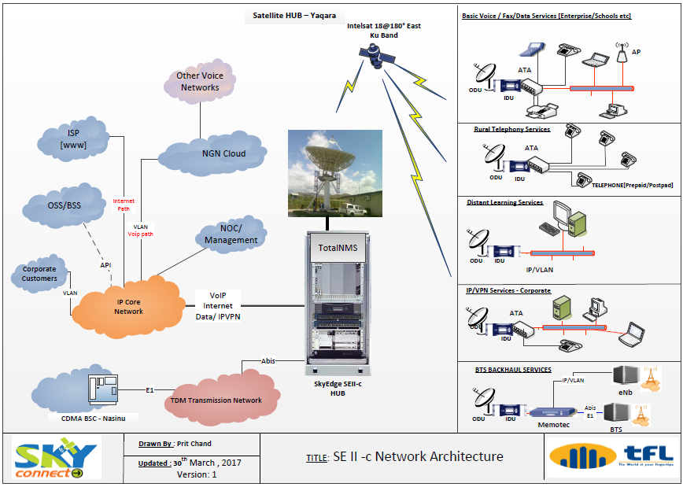
Network Topology - SEIIc

Slide 11
Benefits
OPEX Savings – Under Managed Service model, the vendor takes care of RF Bandwidth, Hub, RFT and Terminals.
Vendor manages and monitors the Network remotely
No separate support agreement required
Able to re-utilise the Dish, LNB, Feed Horn and RF cables. Only need to change BUC and IDU

Slide 12
Benefits - Services
Bridging the rural digital divide
  Remote communities now have access to high speed internet access in line with Fiji Govt National Broadband Policy
  Telephony is now delivered via VoIP instead of TDM including FAX
  VoIP is more bandwidth efficient leading to OPEX savings. TFL is using G.729 codec and backward compatible to G.711
  Single site can support max throughput of 10Mbps which can be license upgraded to 40Mbps if required

Slide 13
Benefits - Services
Corporate customers now able to enjoy high speed internet to better support bandwidth intensive applications eg. Online payment, OTT, YouTube, EFTPOS
MOE – Higher bandwidth means schools are now able to efficiently update FEMIS (Fiji Education Management Information System) on time, download teaching resources, check emails and carry out other administrative functions.

Slide 14
Benefits - Services
Bandwidth Efficiency – upgraded network will support the same amount of customers and services on reduced bandwidth leading to OPEX savings and upsell opportunity
IPVPN – utilising TFL’s full suit of services, customers on TFL’s MPLS Network are able to run their office applications at remote locations. Eg. Post Fiji no longer relying on Fax for TMO’s, AFL extending their corporate LAN across to Rotuma for running VoIP applications.

Slide 15
Benefits - Services
Network also supports backhaul applications
TFL tested and deployed Micro broadband Node (MSAN) backhauled via vsat in only 3 days in Rotuma when a legacy switch gave up.
This was then shipped across for quick deployment.
It uses 2.4m Antenna, 8W BUC and Capricorn IDU
TFL is currently trialling out 4G & WIFI backhaul
  TFL wants to utilise its extensive coverage within the Pacific Island nations to support last mile backhaul requirements of other SP’s in the region.

Slide 16
Learnings
Have a carrier grade IP Network (MPLS) ready to transport last mile IP network traffic to Core Networks
Have Core Network ready to support necessary codecs (G.711/G.729 etc) from day 1
  Otherwise have to spend on IB bandwidth
E2E Network should support QoS for traffic priority
  Eg.VoIP takes higher priority than YouTube
Design the network keeping in mind operational requirements
  Eg. TFL can remotely access any ATA without the need to travel to site
  We setup a FTP server in Hub to assist with quick troubleshooting and escalations

Slide 17
Learnings
Trial and evaluate remote site peripheral devices, Analogue Telephone Adapters, DC Converters, SIP Phones beforehand
  We found a reputable ATA had issues with ringback tone and DTMF
Mobilising – have a robust team in place that can mobilise on short notice.
Operational Continuity – choose a provider that can plan ahead and avoid messy cutovers on production networks.
  TFL avoided service disruption and costly re-pointing exercise by maintaining current footprint

Slide 18
Learnings
Migration– have a plan in place to perform a live incremental migration spanning 3-4 months – Manpower, Tools, Training, Logistics
Growing Plan – have in place bandwidth growing plan so the RF bandwidth can be reserved in advanced
Vendor – choose a vendor who is willing to go the extra mile and values partnership instead of being transactional

Slide 19
Questions
?

